Slide 1
Project Mid Review
An website that lets you customise craft tours.
A Case Study By
Yashaswi Joshi

Slide 2
Project overview
The product:
An website that lets its users customise and purchase Craft Tours in India
Project duration:
January 2023 – April 2023

Slide 3
Project overview
The problem:
In today's travel scene, there's a missing link when it comes to truly experiencing India's diverse crafts. Many travel apps don't focus on the unique beauty of traditional crafts, leaving a gap in personalized cultural experiences.
The goal:
This website steps in to fill this gap by offering a user-friendly platform that connects travelers with customizable craft tours, allowing travelers to fully engage with the authentic culture of the places they visit.

Slide 4
User research
Personas
User journey maps
Understanding
the user

Slide 5
Literary Insights: Summary
Definition and Importance: Craft tourism involves travel experiences centered around the exploration and purchase of local handicrafts, where tourists engage directly with artisans, understand the making process, and appreciate the cultural significance behind the craft.
Cultural Exchange: It acts as a vibrant form of cultural exchange, allowing tourists to take home a piece of the destination’s heritage, thus promoting cross-cultural understanding.
Education and Engagement: Offers educational experiences for tourists, allowing them to understand the complexities, skill, and tradition behind each crafted item, fostering a deeper appreciation and meaningful connections.

Slide 6
Literary Insights: Craft Tourism Benefits
Safeguarding Livelihoods: In India, millions of artisans depend on traditional crafts for their livelihoods. Craft tourism provides these artisans with direct access to markets, helping sustain their practices and communities.
Cultural Preservation: With the growing threat of cultural homogenization, craft tourism stands as a vital means to preserve unique cultural identities and traditions.
Economic Diversification: It promotes economic diversification in tourist destinations, reducing dependency on conventional tourism models that can sometimes be environmentally and culturally disruptive.
Empowering Communities: By bringing tourists directly to artisan communities, it empowers local populations, promotes pride in cultural heritage, and strengthens local economies.
Environmental Sustainability: Craft tourism encourages the use of local materials and traditional, often more sustainable, production techniques, aligning with global movements towards environmental sustainability.

Slide 7
Literary Insights: Craft Tourism Challenges
Quality vs. Quantity: The demand for souvenirs can lead artisans to compromise on the quality of craftsmanship, impacting the authenticity and value of their work.
Exploitation by Middlemen: Artisans often face exploitation by middlemen who demand high commissions, limiting the economic benefits that should accrue to the artisans themselves.
Mechanization Threats: The push towards mechanization, as seen in moves to repeal certain protective acts, threatens the very essence of traditional crafts, risking the loss of unique cultural identities.

Slide 8
Literary Insights: Craft Tourism Challenges
Lack of Adequate Support: Artisans struggle with accessing raw materials, adequate credit facilities, and appropriate marketplaces, hindering the growth and sustainability of craft tourism.
Misrepresentation and Cultural Appropriation: There is a risk of cultural appropriation and misrepresentation in the marketing and sale of handicrafts, which can dilute or misinterpret the cultural significance behind crafts.
Infrastructure and Accessibility Issues: Inadequate infrastructure and limited accessibility to remote artisan communities can pose significant challenges to developing craft tourism.

Slide 9
User research: pain points
1
2
3
4
Complex Itinerary Planning
Difficulty in Customization
LanguageBarrier
Artisan’s Technical Unawareness
Travelers face difficulties in planning and organizing craft-focused itineraries efficiently
Travelers are not able to find many accessible Indian travel agencies that let them customize their craft tour, one might need to rely on educational institutions or own sources to create craft tours.
Travelers face from urban areas who have highest spending capacity often face language barrier and are not able to understand the craft in local language.
In today’s day and age, everyone has a smartphone however artisans are not able to utilize or understand and interact well with the travel apps UI.

Slide 10

Goals
Uncover hidden gems and lesser-explored craft traditions.
Easily customize travel plans to accommodate craft workshops.
Support local artisans by purchasing handmade crafts directly.
Frustrations
Challenges in finding and accessing authentic local craft experiences.
Lack of customization options in traditional travel platforms.
Limited interaction with local artisans due to language barriers.
Rajesh Sharma
Age:
Education:
Hometown:
Family:
Occupation:
28
B.Tech
Delhi, India
Lives with his dog
Software Developer

Slide 11
[Rajesh Sharma]
Software Engineer who is very passionate about arts and crafts
Be able to customize the itineraries for my tours and travels
I can enjoy and immerse in craft experience at my own pace

Slide 12

Goals
To discover and engage in authentic craft experiences during travels.
Customizable itineraries that align with her specific craft interests.
Connect with local artisans to learn about traditional craftsmanship.
Frustrations
Limited options for personalized craft-focused itineraries.
Difficulty in finding reliable information about authentic crafts.
Lack of interactive and engaging cultural experiences during trips.
Maya Patel
Age:
Education:
Hometown:
Family:
Occupation:
36
Bachelors of Arts
Vadodara, India
Lives with Husband
Marketing Manager

Slide 13
[Maya Patel]
Passionate traveler and cultural enthusiast
Experience crafts first hand and hear directly from artisans rather than reading about crafts online
I can truly remember the experience

Slide 14
Current User Journey Map for Traveler Persona
Goal: Book a customised Craft Tour
ACTION | Search About Craft | Search About Location | Book Train/flights | Book Cab/ Bus | Book Stay
TASK LIST | Tasks Note where the craft is taking place Note what the craft is about | Tasks Learn a little bit about the kind of location user will travel to Look for best time to travel | Tasks Create itinerary Check Multiple websites for finding best deal Book tickets for train and (or) flight tickets | Tasks A. Find cab/bus route from major railway junction/airport to rural area B. Book Multiple reservations. | Tasks Find hotels/homestays/guest houses near the craft sight Book stay
FEELING ADJECTIVE | Overwhelmed by a lot of information | Overwhelmed by a lot of information Frustrated about lack of experts insights | Anxious about doing multiple bookings Exhausted | Frustrated about not finding satisfactory options Exhausted about doing even more bookings | Frustrated about doing yet more bookings Anxious if the stay seen in images is anything like it in real life
IMPROVEMENT OPPORTUNITIES | Create an app to Search crafts based on filters such as product type or location | App provides expert insights about best time to travel and things to keep in mind before travelling. | App creates itineraries for the dates user has selected and lets them customise using filters like budget, trip duration, type of transport etc. | App creates bookings with private taxi/bus services depending on no of pax or budget | App offers travel of train/flight, bus/cab, stay, artisans viewing fees and souvenir in a bundle package. Tourist will be able to book everything under one umbrella and customize them to their liking.

Slide 15
Insights from User Journey of Travelers
Features that can be included in the app design
Filter Craft packages on basis of location (near user or state wise), type of craft (textile, pottery, metal work, jewellery)
Provide insights about when is the best season to visit or nearby tourist attractions.
Provide all necessary details in brief about the Craft and the Craft Person so that there is no misunderstanding or misinformation shared about the craft or craft procedure during tours.
Provide instant quotations for bundle packages that can include travel arrangements via bus/cab/train/flight etc, Hotel/homestay/guesthouse etc, craft tour/workshop timeslot and souvenir.
These above fields should be completely customisable.

Slide 16
Competitor Audit of Craft Tourism Websites
https://docs.google.com/spreadsheets/d/1wWvPpW8gTgx-_XD2OeflC2tQEw6GtSnCCOv9rv6L8L4/edit#gid=2113780013

Slide 17
Mood Board
Brand Colors
Brand Logo
Fonts
Branding

Slide 18
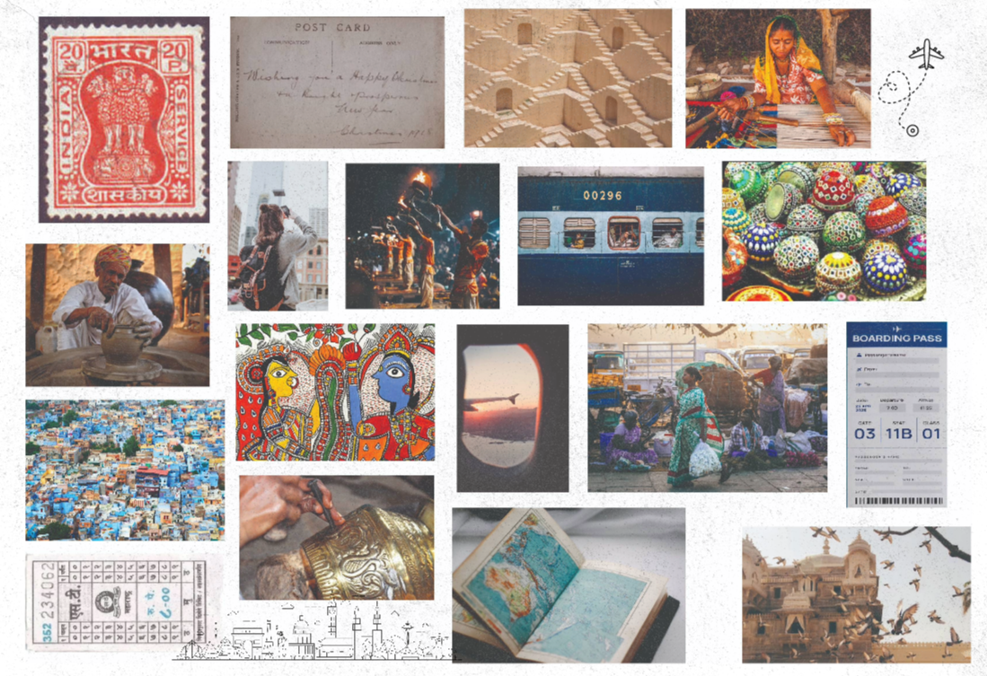

Slide 19
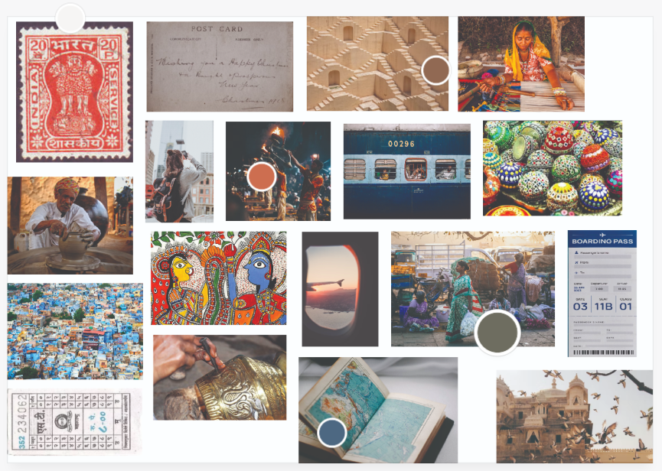

Slide 20




Slide 21




Slide 22
Rangeela Caravan
Font Name: Diplomata
Font Purpose: Logo
Font Style: Serif
Font Weight: Regular
Concept: Serif fonts are generally perceived as classic, traditional, and trustworthy. They’re favored by brands that want to convey a feeling of respectability and tradition and in our case, heritage. The Negative space within the bold stroke of the font symbolizes decorative display, which is a trait we often find in Indian Crafts, hence it seems more fitting.

Slide 23
Rangeela Caravan
Font Name: Playfair Display
Font Purpose: Headings (Largest)
Font Style: Serif
Font Weight: Bold
Concept: Serif fonts are generally perceived as classic, traditional, and trustworthy. They’re favored by brands that want to convey a feeling of respectability and tradition and in our case, heritage. Our app will be dealing with heavy financial transaction between cultural experience and travelers wishing to seek the same. We must create a trustworthy and traditional brand identity.

Slide 24
Rangeela Caravan
Font Name: Karla
Font Purpose: Sub Headings/Buttons
Font Style: Serif
Font Weight: Bold
Concept: Sans-serif fonts are modern, clean, and help create a minimal design. Sans Serif Fonts offer a very easily readable experience to users. Text is easy to read and instructions are easy to follow, which is very essential in case of an app which will be providing a plethora of information.

Slide 25
Rangeela Caravan
Font Name: Karla
Font Purpose: Text Body/Footers
Font Style: Serif
Font Weight: Regular
Concept: Sans-serif fonts are modern, clean, and help create a minimal design. Sans Serif Fonts offer a very easily readable experience to users. Text is easy to read and instructions are easy to follow, which is very essential in case of an app which will be providing a plethora of information.

Slide 26
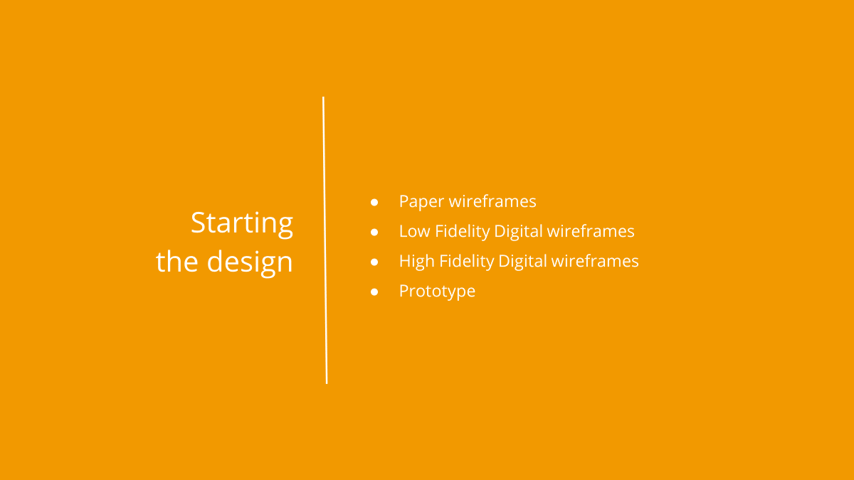

Slide 27
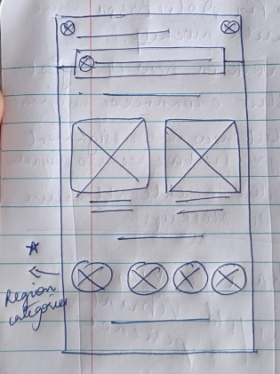
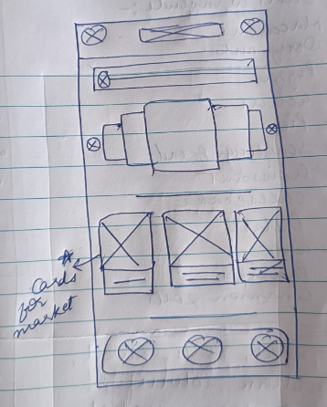
Paper wireframes
I have tried to capture the work flow of Opening the app to customisinging a new Craft and Travel Package with help of these Paper Wireframes. After drawing multiple Iterations of the same screens, I tried to pick out the best features from each and compiled them into digital wireframes

Slide 28
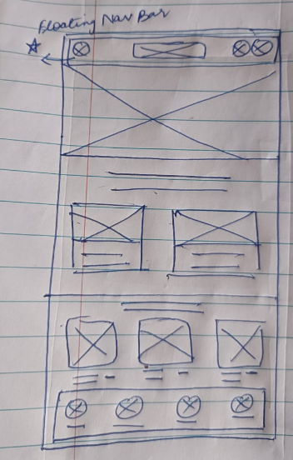
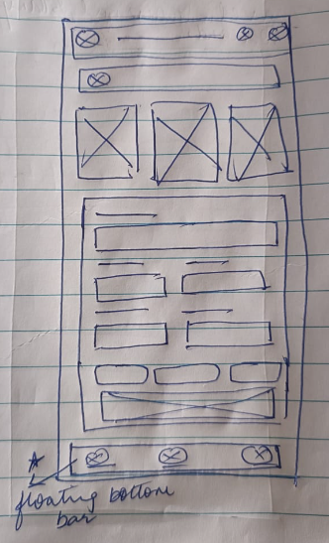

Slide 29
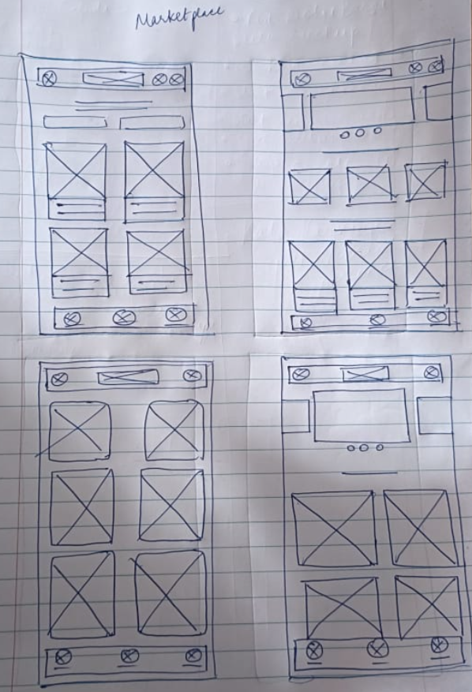
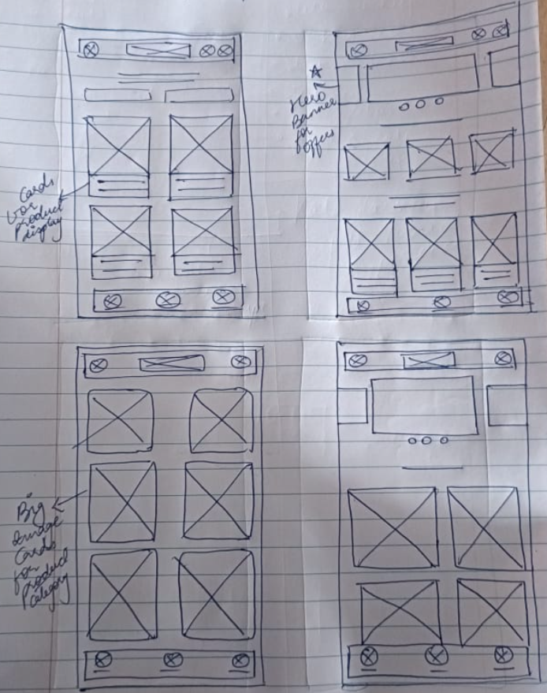

Slide 30
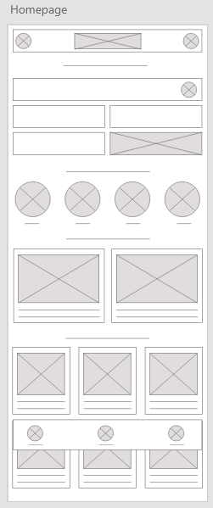
Digital wireframes
Quick Itinerary Details like Place, dates and number of travelers
The Homepage Provides Multiple experience through multiple ways. A user has the Opportunity to start the Itinerary planning from:
Quick Itinerary Planner
Type of Craft
Bestseller/Most Popular Craft tours
Insert first wireframe example that demonstrates design thinking aligned with user research
Search destinations via category of type of Craft
Popular/ Bestseller Curated Craft Tours
Quick Preview of top selling products from Marketplace

Slide 31
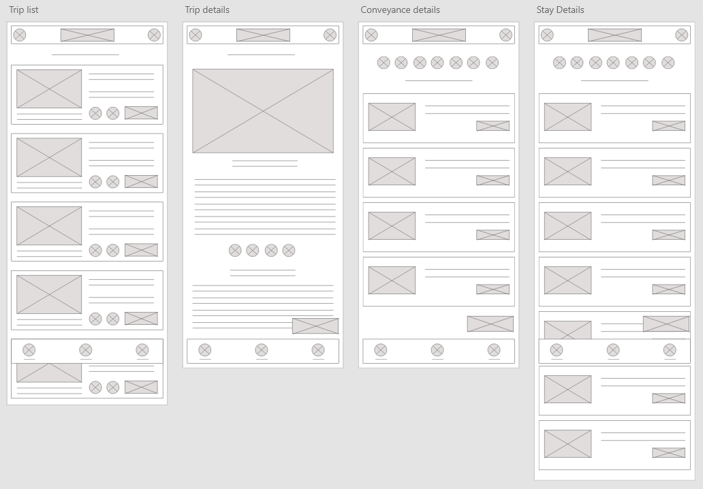

Slide 32
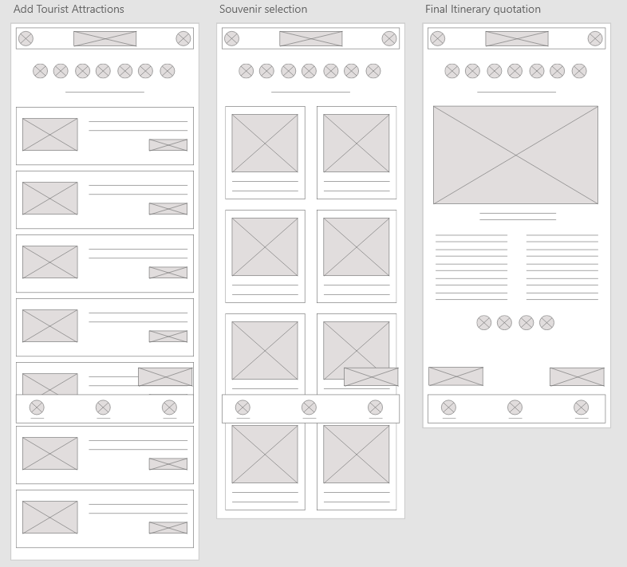

Slide 33
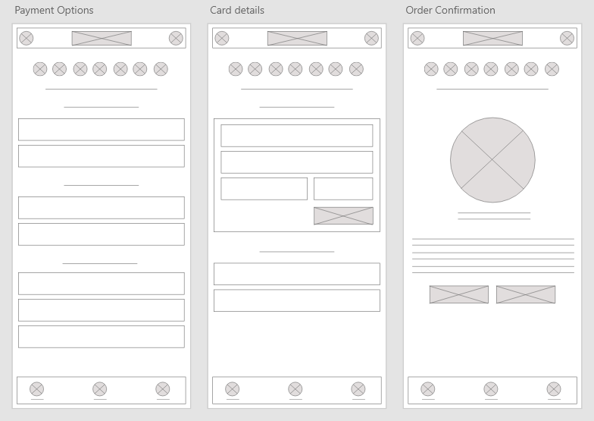

Slide 34
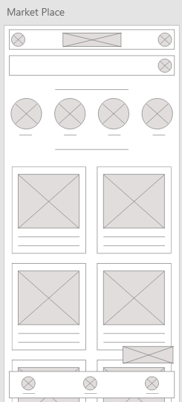
Digital wireframes
Direct Search
Search Via Categories of crafts
Alternatively, User also has an opportunity to start the Task Flow from the Best Selling Products Preview of the Craft Marketplace.
Insert first wireframe example that demonstrates design thinking aligned with user research
Popular/ Bestseller Products

Slide 35
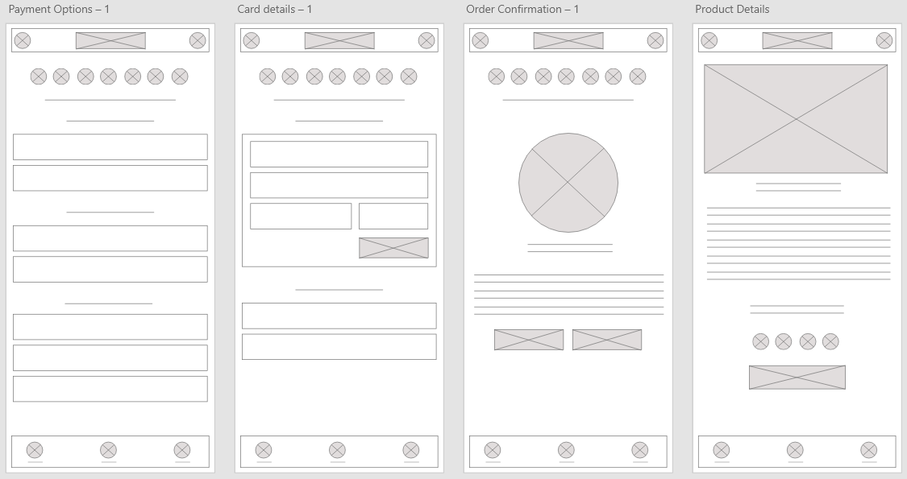

Slide 36
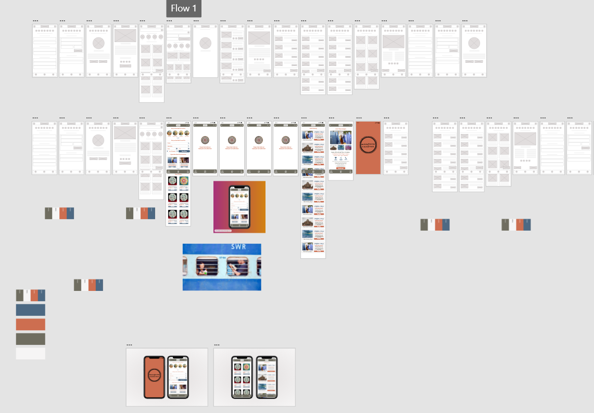

Slide 37
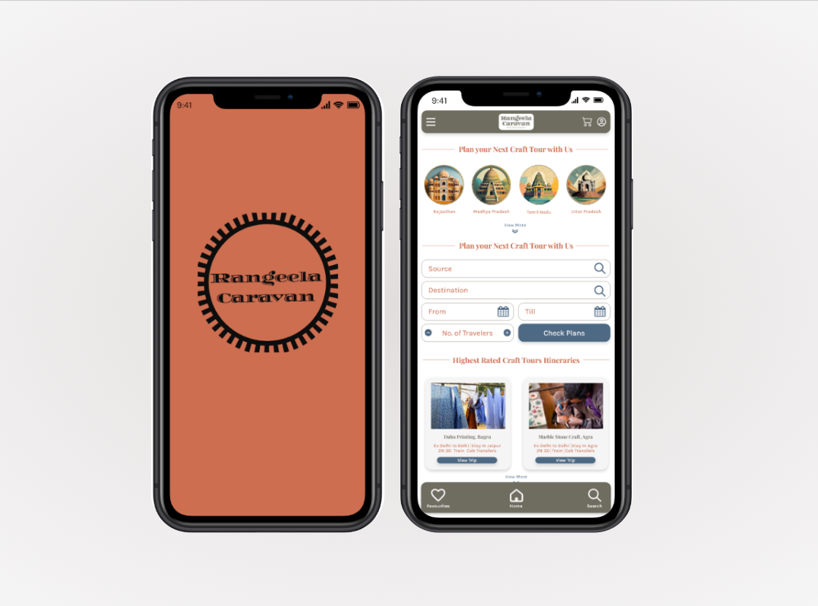

Slide 38
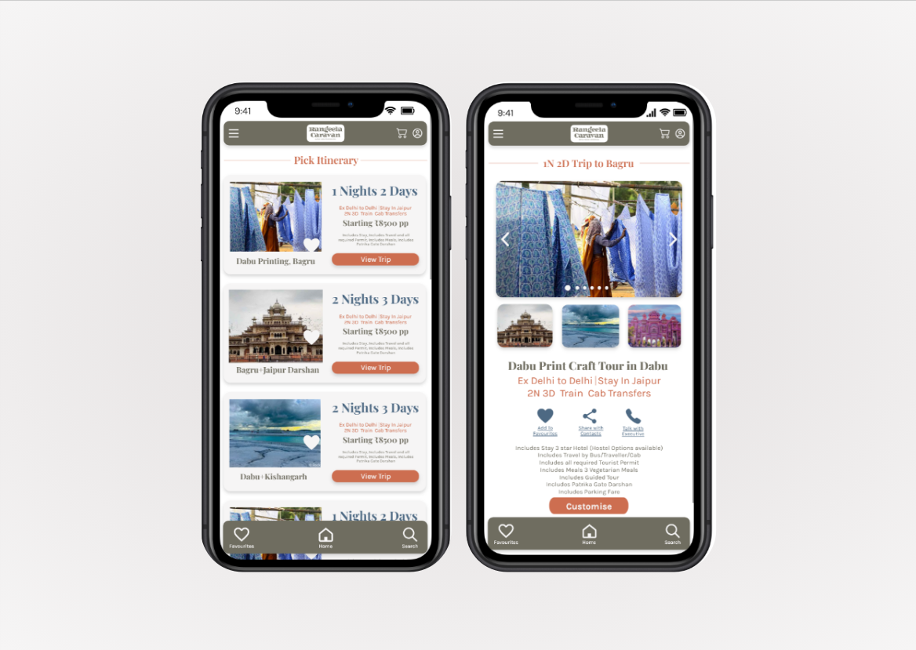

Slide 39
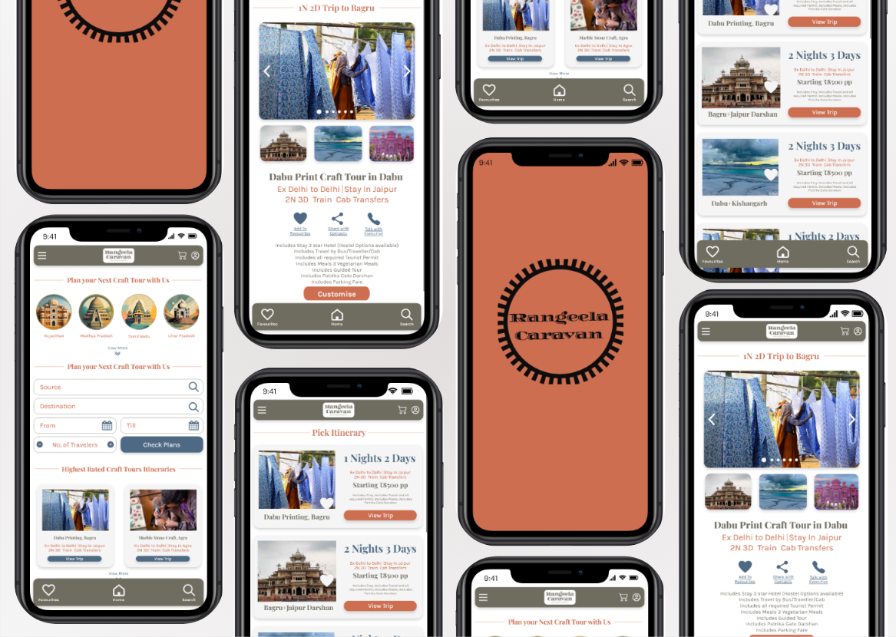

Slide 40
Business Plan
Revenue Streams
Expected Sales Figures
Initial Investment
Costing

Slide 41
Revenew Streams
Craft Tour Bookings: The primary revenue stream involves charging users for booking craft tours. This can be based on the complexity and duration of the tour.
Subscription Plans: Users can opt for subscription plans to unlock additional features or receive special perks, contributing to recurring revenue.
Craft Product Marketplace: Generate revenue by facilitating the sale of handmade crafts, taking a percentage of each transaction.

Slide 42
Revenew Streams
In-App Advertisements: Collaborate with local businesses to display targeted ads, creating an additional revenue stream.
Affiliate Partnerships: Establish partnerships with local businesses and earn commissions for driving referrals through the app.
Data Analytics Insights: Leverage user data (in compliance with privacy regulations) to provide valuable insights to interested businesses.

Slide 43
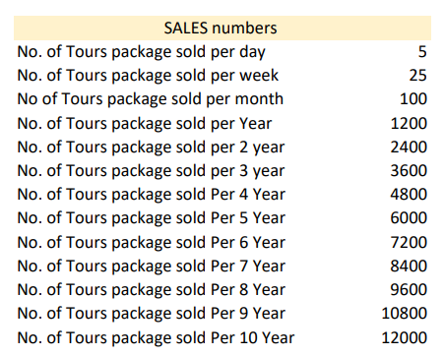

Slide 44
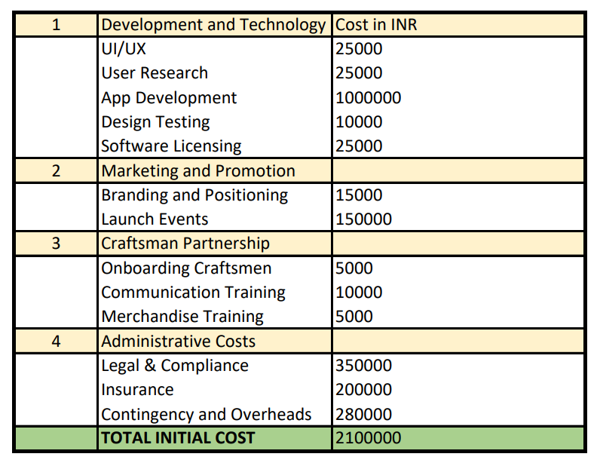
Initial Investments

Slide 45
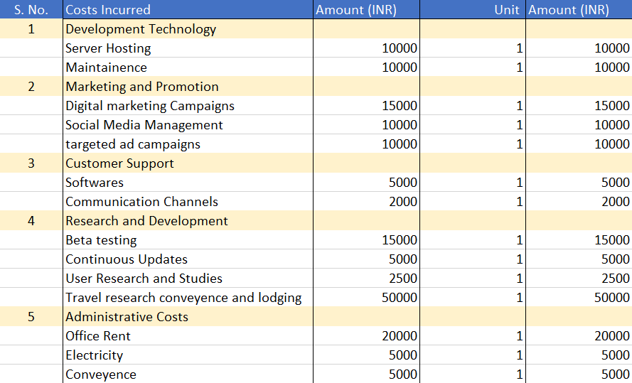
Costing Per Trip

Slide 46
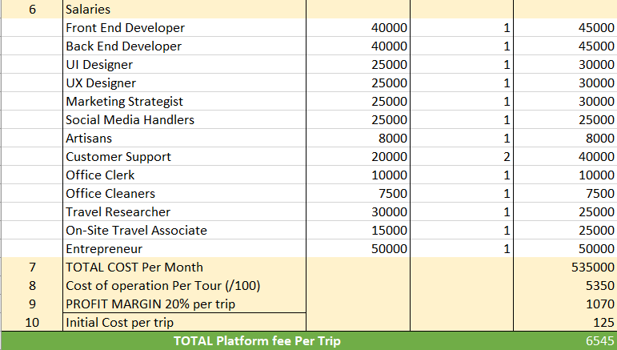

Slide 47
Going forward
Takeaways
Next steps

Slide 48
Takeaways
Impact:
This app can help in bridging the gap between Craft enthusiasts and Artisans. This can help in generating additional income for artisans and providing the travelers a hassle-free travel experience.
What I learned:
Throughout this module, I Strengthened my foundations of Branding and User Experience Research. I also learnt how to create Business Models.

Slide 49
Next steps
1
2
3
Design More Mock-Up and reach prototype stage
Conduct User Testing and gain insights to make iterations
Create an attractive pitch deck for investors to invite funding

Slide 50
Thank you!

