Slide 1
VIGNAN'S INSTITUTE OF MANAGEMENT AND TECHNOLOGY FOR WOMEN DEPARTMENT OF COMPUTER SCIENCE AND ENGINEERING MAJOR PROJECT REVIEW ON ICU PATIENT MONITORING SYSTEM BASED ON IOT
Submitted by: Batch 08
Under the Guidance of: M.SNEHA(20UP1A0584)
Mrs. BHAVANI GEETHA M.TULASI(20UP1A0588)
Assistant professor G.SAI SHIVANI(20UP1A0572)
Dept. of CSE D.VASANTHA(20UP1A0564)

Slide 2
CONTENTS
ABSTRACT
INTRODUCTION
EXISTING SYSTEM
DISADVANTAGES
PROPOSED SYSTEM
ADVANTAGES
SYSTEM REQUIREMENTS
BLOCK DIAGRAM
FLOW CHART
METHODOLOGY

Slide 3
ABSTRACT
In contemporary healthcare, the integration of Internet of Things (IoT) technology has proven instrumental in enhancing patient care and monitoring. This project is about IoT based ICU Patient Monitoring System designed for real-time tracking of critical health parameters such as temperature, body humidity, pulse rate, and blood pressure. The system utilizes Arduino microcontrollers for data acquisition and processing, coupled with the powerful cloud-based platform Thing Speak for seamless data storage and analysis.

Slide 4
INTRODUCTION
Intensive Care Unit or ICU is where the patients who are critically ill are admitted for treatment. For such critical conditions the Doctors need to have an all-time update patient’s health related parameters like their blood pressure, heart pulse and temperature. To do manually, this is too tedious a task and also for multiple patients it becomes close to impossible. For this type of situations this IOT based system can bring about an automation that can keep the Doctors updated all time over internet.

Slide 5
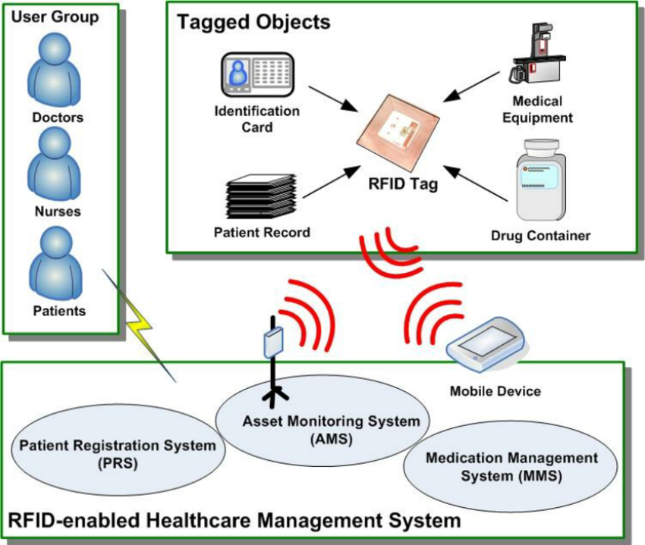
EXISTING SYSTEM
The present ICU patient monitoring system incorporates RFID (Radio Frequency Identification) technology which contains tags that are used for identifying and tracking objects or people. In ICU Patient monitoring system RFID can be used to track equipment, medications, and sometimes patients. RFID tags emits unique identifier when scanned by reader and provide information about the location or status of the tagged item or person.

Slide 6
DISADVANTAGES
Limited Range
Interference
Cost
Limited Data Capture
Scalability

Slide 7
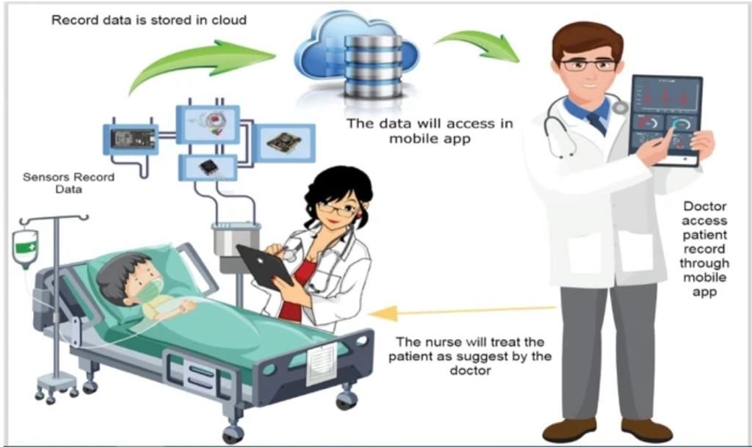
PROPOSED SYSTEM
The proposed system incorporates various sensors to continuously monitor the patient's vital signs, ensuring a comprehensive health assessment. A temperature sensor measures body temperature, a humidity sensor records body humidity levels, a pulse rate sensor captures heart rate, and a blood pressure sensor monitors blood pressure variations. The Arduino microcontroller processes the acquired data and transmits it securely to the Thing Speak cloud platform using Wi-Fi connectivity. The system's user-friendly interface enables remote monitoring, while alerts and notifications ensure timely intervention by medical staff in response to abnormal health parameter deviations.

Slide 8
ADVANTAGES
Real-Time Monitoring
Remote Monitoring
Data Integration
Enhanced patient safety

Slide 9
SYSTEM REQUIREMENTS
HARDWARE REQUIREMENTS:
Arduino UNO
DHT11
Pulse Sensor
BMP 180
LCD
WI-FI Module
RPS
SOFTWARE REQUIREMENTS:
Arduino Compiler
Embedded C Programming
Windows OS

Slide 10
BLOCK DIAGRAM

Slide 11
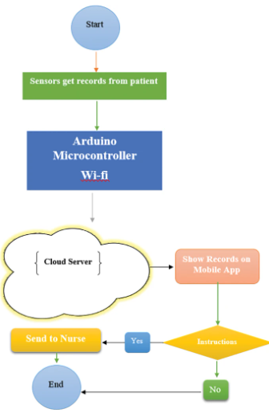
FLOW CHART

Slide 12
METHODOLOGY
The methodology for developing the IoT based ICU Patient Monitoring System involves several key steps.
Firstly, the system architecture is designed, outlining the integration of hardware components such as the Arduino Uno microcontroller, DHT11 sensor, pulse sensor, BMP180 sensor, Wi-Fi module , LCD display, reliable power supply (RPS).
Secondly, the hardware setup is executed, ensuring proper connections and wiring between the components to enable seamless data transmission and processing.
Next, the software implementation phase involves programming the Arduino Uno to interface with each sensor and collect data at regular intervals.
The WiFi module is integrated with the Arduino Uno to establish a connection to the internet, enabling data transmission to the cloud-based platform Thing Speak.

Slide 13
A user-friendly interface is developed for accessing and interacting with the patient monitoring system, accessible through web or mobile applications.
Rigorous testing and validation are conducted to ensure functionality, reliability, and accuracy, with comprehensive documentation prepared covering system architecture, hardware setup, software implementation, and user guidelines.
Finally, the IoT based ICU Patient Monitoring System is deployed in real-world healthcare settings, with proper training and support provided to medical staff.

Slide 14
THANKYOU

