Slide 1
Threat Hunting - Session 5

Slide 2
Preface
In this session our goals are:
- to learn about the phases of the Threat Hunting lifecycle - to correlate our previous learnings (MITRE:ATT&CK) to the Pyramid of Pain and determine which threat hunting steps are best accomplished by manual effort vs automation. - do some analysis using Intezer Analyze (free version) to look at sandboxing, URL reputation analysis and more as could be used during Threat Hunting work

Slide 3
Threat Hunting Cycle

Slide 4
Threat Hunting Cycle
Hypotheses Determine some ideas of where you want to focus - Is there a threat actor you are concerned about? - Did you see some suspicious URLs or IPs being visited by a user and want to see if this relates to any other possible attack vectors - Did you have an incident and are trying to gain further information for your reporting? Example: Your organization is publicly threatened by the organization Anonymous. Using MITRE:ATT&CK can help you to identify the TTPs that they may potentially be using, and you can form your hunt hypothesis around these specific TTPs, and determine which data sources you can use to search against (eg firewall data, proxy logs, antivirus logs, windows logs, etc)

Slide 5
Threat Hunting Cycle
Tools and Techniques Determine the systems you have available to help you analyze your data and use them to perform your hunt. Example: Your organization has its data centralized in a SIEM solution. Use the SIEM first to look for suspicious items, and then transition to MANUAL techniques or more specific systems for further analysis.

Slide 6
Threat Hunting Cycle
Uncover new Patterns and TTPs Determine any new patterns of behavior or TTPs that you did not previously have in the scope of your hunt. This can be used to update your Hypothesis. Example: You identify some Command and Control traffic which has some alignment to the other things you were investigating.

Slide 7
Threat Hunting Cycle
Inform and Enrich Analytics Add additional context from threat intelligence sources:
- Various commercial solutions such as IBM X-Force, Recorded Future, Mandiant, etc - Open source data such as ISAC feeds, Internet Storm Centre and many others - Manual search activities

Slide 8
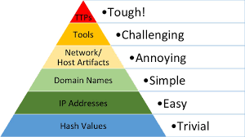
The Pyramid of Pain
Determining effort An important consideration in Threat Hunting is the level of effort required to analyze various areas. The Pyramid of Pain illustrates the level of effort for each of the major areas of investigation. Easier items are the ones that are best suited for automation, machine learning or similar processing. More challenging areas often require manual intervention to identify and address.

Slide 9
Threat Hunting Advanced Analysis
Using tools for difficult analysis tasks
Various systems exist for advanced analysis, such as scanning malicious executables and other file types, performing malicious URL analysis, scanning memory dumps, performing real-time scans, analyzing hashes, etc.
These tools are helpful for threat hunting as they can provide leads which inform or confirm your threat hunting hypotheses.
In this session we will be talking about the system called Intezer. This is not an endorsement for Intezer. While Intezer is a commercial system, they provide a 14 day free trial, and a perpetual free account (with usage limitations) which is useful for our learning purposes.
LIVE DEMO: Intezer Analyze https://intezer.com

Slide 10
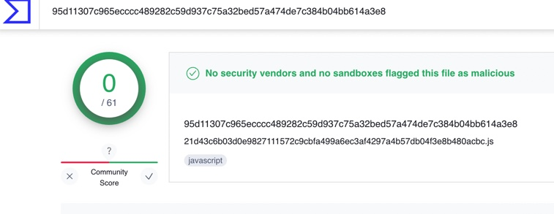
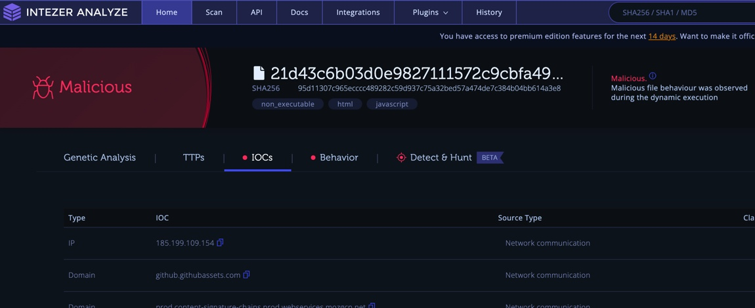
Threat Hunting Advanced Analysis
Why the right tools matter
While a common recommendation in the security world is to use the VirusTotal.com site, the data on VirusTotal lacks contextual information and real-time public threat intelligence data so often can lead to false negatives. Example using malicious JavaScript file and uploading to both VirusTotal and Intezer

Slide 11
Assignment – Session 5 Due Date: Monday Nov 6 (post reading week)
Sign up for a FREE account with Intezer (https://intezer.com)- Click on "Start now for free" and complete the account registration process. Go to the Scans section of Intezer Analyze. 1. On the File tab, upload a malicious file for Sandbox analysis and wait for the analysis to complete. Repeat this process 3 times, using a different sample file each time. Capture a screenshot in Intezer for each sample. For each of these scans, on the "Detect and Hunt" tab, review the suggestions and list the 3 recommendations that you think are the most useful to implement. 2. On the URL tab, enter a link to a known malicious web URL and wait for the analysis to complete. Repeat this process 3 times using a different URL each time. Capture a screenshot in Intezer for each sample. To summarize the assignment delivery requirements: You will be providing 3 different screenshots and 3 written descriptions of Top 3 recommendations based on the Detect and Hunt tab for Part 1. You will just be providing 3 different screenshots for Part 2. Warning: You will be working with potentially malicious files and links. Please be EXTREMELY careful when working with these files. It is highly recommended to use a test computer, such as https://developer.microsoft.com/en-us/microsoft-edge/tools/vms/
Do not directly run any files or open any URLs – you only need to copy them and upload them to Intezer. Delete all of these files and links from the computer when finished. Helpful site for finding sample files and URLs: https://zeltser.com/malware-sample-sources/ https://zeltser.com/malicious-ip-blocklists/

