Slide 1
Portfolio
Guidance / Template

Slide 2
Features of Annotated Portfolios
What Is Included
Relationships
Works are organised, categorised and arranged in their presentation to have or illustrate a point, or several points, in order to reveal or make clear something in the work you have done that you want to highlight and the nature of the contribution you have made (Hint: Feature elements that match the CLOs or the assessment criteria)
Works do not speak for themselves. They are annotated to show how they fit into a portfolio of the related endeavour and in particular to address the assessment criteria
Annotations capture resemblances and relationships. How does this work reflect (or differ) from your coursework or expectations?
Chart the similarities and differences between the work
Annotations need to link back to each of the CLOs and identify the particular issue or element that each example provided demonstrates (for example, linkages to coursework, reflections on the work you have done, link back to your initial understanding of the problem and how to approach it or the overall reflection)

Slide 3
Features of Annotated Portfolios
Communication
Perspective
Annotations communicate the nature of the portfolio and enable comparison
We communicate with our audience in mind. Annotations should identify the relevant audience and explain the details that may not be apparent to the non-technical reader but would be clearly understood by an industry expert
Annotations reflect different purposes and interests
Remember that this is an academic work, so references are important. References add to the credibility of the work and demonstrate your ability to choose between various readings to support your point of view

Slide 4
What does an annotated portfolio of work contain?
Title Page / Introduction
Overview of the role and its objectives. This provides context
Executive Summary
Signpost to your reader where they will find what they are looking for. Be strategic. Keep it to a page
Descriptive Table of Contents
Incorporate the checklist so that the moderator can find everything you have included
Artefact Description(s)
For each artefact / category of artefact describing your use of the tool, the insights you gained about both the project and the design-thinking approach to solving/understanding the problem is contained in this segment
Excerpts of Your Insights
Incorporate annotations to describe the relevance or link to the theory from your activities
Ensure that you have the required examples
Reference List
Include all relevant sources. Use Australian Harvard

Slide 5
Guidance Note
Keep the assignment brief by your side and regularly check the brief for clarity on the criteria and the guiding questions
Signpost by telling your reader where they can find each element addressed

Slide 6
A template – just for you….

Slide 7
Guidance: Title Page / Introduction
Keep it brief. Should be one paragraph (around 100 words)
Think about a title for your portfolio. Ensure that your title tells your reader what you think, what is important, what your reader will learn about you and what you learnt in this course
The purpose of the introduction is to introduce your reader what they can expect to learn from your portfolio
This is one of the last elements you write for your portfolio

Slide 8
Executive Summary (Write this at the end. Keep it to one page / slide)
Objectives:
ULO1: Work constructively and collaboratively with stakeholders, business networks and peers to formulate a design-thinking approach to innovation (GLOs 1 and 7)
ULO2: Formulate and apply an integrated understanding of design-thinking principles and applications to critically evaluate how different approaches impact innovation in contemporary business practices (GLOs 1 and 4)
Accordingly, use your executive summary to highlight and signpost each of the learning criteria:
Formulate a design-thinking approach
Apply design-thinking tools
Critical evaluation
Teamwork

Slide 9
Descriptive Table of Contents (Example Text only)
Included? Yes/No | Artefact | Justification for Inclusion/Exclusion
Preliminary Exercise
Page x | In-class Design Thinking Experience Exercise (Note: This could be done) | Because I attended class were we worked through the ‘XXX’ experience, I’ve included notes about that rather than the food experience in the Video. Initially I was very confused about the design thinking process as these messy notes will show. I have included this so that you can see the progression following a deeper analysis of the tools.
Industry Problem
Page x | Notes/plan for observing the industry problem in the real world using ethnographic techniques | [Enter text here]
Page x | Stakeholder Map | [Enter text here]
N/a | Plan for interview / Notes of interview using empathy techniques | See page x. I have combined information about the interview in one section in order to provide a more meaningful narrative.
Page x | Notes / insights from interview | [Enter text here]
Page x | Empathy Map | [Enter text here]
Page x | Journey Map | [Enter text here]
Page x | User Persona | [Enter text here]
Page x | Initial design brief / Project scope + insights and revisions | [Enter text here]
Page x | 5Y Tool applied to project | [Enter text here]
Page x | RBT tool applied to project | [Enter text here]
Page x | Write a letter to your problem | [Enter text here]
Page x | JTBD analysis - this is a good one to compare with RBT | [Enter text here]
Page x | Establish POV | [Enter text here]
Page x | HMW exercise (5-10 questions) | [Enter text here]
Page x | Final Design Brief | [Enter text here]
Page x | Final Problem Definition | [Enter text here]
Teamwork
page x | Personal SWOB analysis + personal plan for action in teams | Note – this is particularly important for the Teamwork criteria.
Page x | Team Charter etc. | Note – this is particularly important for the Teamwork criteria.
NB: This might take more than one slide/page

Slide 10
What Should Annotations Look Like?
This is up to you. How would you explain the importance of your work to your reader/assessor?
Footnotes
Text blocks
‘Comments’ in documents (Ensure you print your docs to PDF, so Turnitin can pick them up)
Columns (Align your annotations on one side next to the work)

Slide 11
First Workshop
Include a picture / evidence of your work
You must have done this in class or followed along as Matt and Cath explained in the video
You did this very early on in the project. You may find some value by checking for any changes or insights that you may have had as you moved through the process
In what ways did the tools help you in developing an understanding of design-thinking principles?
If relevant, how does this tool or experience have an impact on problem identification/definition in general?
Based on this experience, in what context would design-thinking tools be most appropriate?
Based on this experience, in what context would these tools not be appropriate?
What insights did you gain by using a particular mix of tools?
Source: Nolan, C 2020, Sketches made to prototype and explain ideas in Virtual Workshop, upGrad Platform, viewed 11 December 2020

Slide 12
Notes or Plan for Observing the Industry Problem in the Real World Using Ethnographic Techniques
Why did you choose to interview this person?
What did you observe?
What did you learn? Focus on insights
What was different or difficult? How did the tools help/hinder your understanding?
What would you do differently next time?
Figure # Picture of Cathryn Nolan interviewing Millennials (2018) Anna Carlisle, All Rights Reserved.

Slide 13
Plan for Interviews or Notes of Interviews Using Empathy Techniques
This diagram is from d.school model
We are happy about the list of questions you chose, but let us know why you were asking these questions
Come back afterwards and summarise what you learnt.
Some reflection prompts to help you with the summary:
What surprised you?
How did you feel about the process?
What did you do differently from other conversations?
What was easy or difficult?
What would you do differently next time?
How would you use this type of interviewing style in your future work? In what context would this be useful or not useful?
Figure # Interviewing with Empathy (2010) d-School, Creative Commons

Slide 14
Stakeholder Map
What would you include in your annotation for this tool?
Use the INR4 example to make sense of this task. Provide enough information regarding why you have included each stakeholder where you have included them so that your grader understands your reasoning
How did this tool help you?
What would you do differently next time?
Did you return and change your thoughts after using another tool? (if so, how?)

Slide 15
Empathy Map: Example
Reflection Prompt | What to Cover
Report / Respond | Include a brief description of the tool, how you used it, and what you learnt about the problem by using it State your reaction to the tool. What did you learn about your own learning, and how would you use this tool in the future. What happened? What did you observe/feel/question about the experience?
Relate | Make a connection between the issue/situation and your own personal skills, experience and understanding Relate this to any relevant theoretical understandings Have you experienced this before? What sense can you make of the situation based on what you already understand? How does this situation relate to the theories in your course?
Reason | Find an explanation for the situation/issue. Discover a relationship between theory and practice in order to seek a deep understanding of why something has happened What significant factors impacted the situation/issue? How do these relate to what you have previously experienced? What evidence can you find in relevant theories to support your understanding of the events? What impact do other perspectives have on the issue?
Reconstruct | Draw a conclusion and discuss the improvements that could be made. Identify any changes or improvements for future planning. Apply your learning to other contexts and your future professional practice Why did this situation/issue occur? What theories support your rationale? How would you deal with the situation next time? What strategies would you develop for future practice based on what you now know? (It is a good practice to come back later and adjust your responses after you have used more tools)
[Enter text here]
Explicitly link your annotations to specific outcomes / insights or observations.
[Enter text here]
[Enter text here]
[Enter text here]
[Enter text here]
Explicitly link your annotations to specific outcomes / insights or observations.

Slide 16
Journey Map
Reflection Prompt | What to Cover
Report / Respond | Include a brief description of the tool, how you used it, and what you learnt about the problem by using it State your reaction to the tool. What did you learn about your own learning, and how would you use this tool in the future. What happened? What did you observe/feel/question about the experience?
Relate | Make a connection between the issue/situation and your own personal skills, experience and understanding Relate this to any relevant theoretical understandings Have you experienced this before? What sense can you make of the situation based on what you already understand? How does this situation relate to the theories in your course?
Reason | Find an explanation for the situation/issue. Discover a relationship between theory and practice in order to seek a deep understanding of why something has happened What significant factors impacted the situation/issue? How do these relate to what you have previously experienced? What evidence can you find in relevant theories to support your understanding of the events? What impact do other perspectives have on the issue?
Reconstruct | Draw a conclusion and discuss the improvements that could be made. Identify any changes or improvements for future planning. Apply your learning to other contexts and your future professional practice Why did this situation/issue occur? What theories support your rationale? How would you deal with the situation next time? What strategies would you develop for future practice based on what you now know? (It is a good practice to come back later and adjust your responses after you have used more tools)

Slide 17
User Persona
Reflection Prompt | What to Cover
Report / Respond | Include a brief description of the tool, how you used it, and what you learnt about the problem by using it State your reaction to the tool. What did you learn about your own learning, and how would you use this tool in the future. What happened? What did you observe/feel/question about the experience?
Relate | Make a connection between the issue/situation and your own personal skills, experience and understanding Relate this to any relevant theoretical understandings Have you experienced this before? What sense can you make of the situation based on what you already understand? How does this situation relate to the theories in your course?
Reason | Find an explanation for the situation/issue. Discover a relationship between theory and practice in order to seek a deep understanding of why something has happened What significant factors impacted the situation/issue? How do these relate to what you have previously experienced? What evidence can you find in relevant theories to support your understanding of the events? What impact do other perspectives have on the issue?
Reconstruct | Draw a conclusion and discuss the improvements that could be made. Identify any changes or improvements for future planning. Apply your learning to other contexts and your future professional practice Why did this situation/issue occur? What theories support your rationale? How would you deal with the situation next time? What strategies would you develop for future practice based on what you now know? (It is a good practice to come back later and adjust your responses after you have used more tools)
You can find templates online (Do not forget to reference them if you do)
Or, you can simply draw it up as you like
Hint: Your persona’s picture should be relatable; not everyone is a toothy American
Link persona to other tools
Hint: https://unsplash.com/s/photos/persona (Images of people who you might want to use)
Choose the categories for your persona that are relevant to your problem

Slide 18
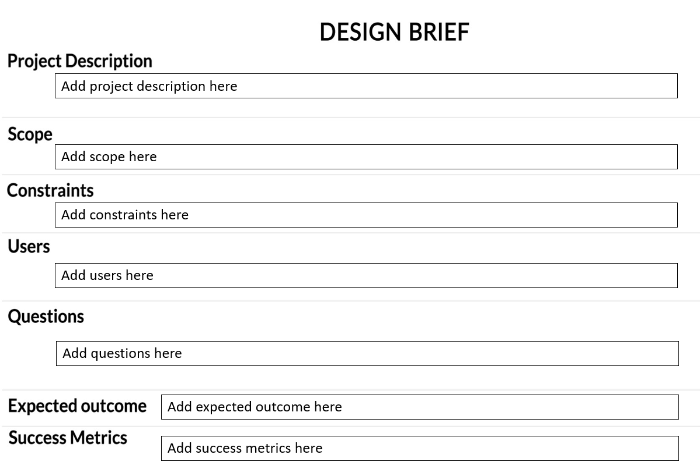
Initial Project Brief or Project Scope (+ Insights and Revisions)

Slide 19
Reflect on your brief and project scope
Reflection Prompt | What to Cover
Report / Respond | Include a brief description of the tool, how you used it, and what you learnt about the problem by using it State your reaction to the tool. What did you learn about your own learning, and how would you use this tool in the future. What happened? What did you observe/feel/question about the experience?
Relate | Make a connection between the issue/situation and your own personal skills, experience and understanding Relate this to any relevant theoretical understandings Have you experienced this before? What sense can you make of the situation based on what you already understand? How does this situation relate to the theories in your course?
Reason | Find an explanation for the situation/issue. Discover a relationship between theory and practice in order to seek a deep understanding of why something has happened What significant factors impacted the situation/issue? How do these relate to what you have previously experienced? What evidence can you find in relevant theories to support your understanding of the events? What impact do other perspectives have on the issue?
Reconstruct | Draw a conclusion and discuss the improvements that could be made. Identify any changes or improvements for future planning. Apply your learning to other contexts and your future professional practice Why did this situation/issue occur? What theories support your rationale? How would you deal with the situation next time? What strategies would you develop for future practice based on what you now know? (It is a good practice to come back later and adjust your responses after you have used more tools)
Include the brief as an appendix or add a photo in here
Summarise what is really important
A brief should be brief!
Performance Criteria specifically requires you to develop and submit a design criteria. Hence, this is critical
Insights are what matters. How did your understanding of the problem change as you used the different tools?

Slide 20
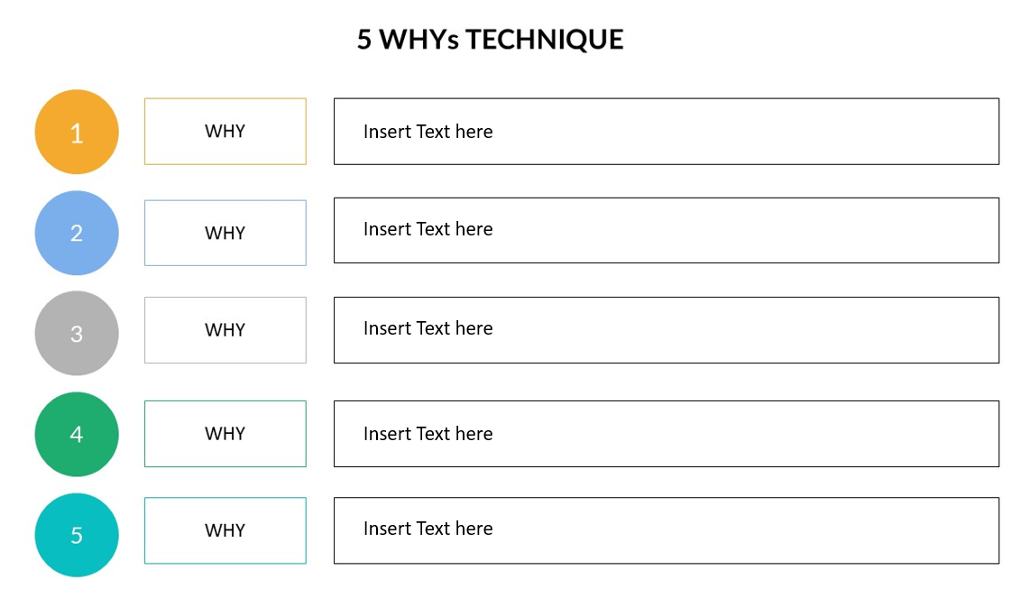
5WHY Tool
As always, include evidence of the work you did
This is a great tool for identifying insights: What did you learn that you might otherwise have missed?
Would you use this again? When? How? Why? What would you do differently next time?
Show relationships
Answer the questions mentioned in the rubric
Focus; going deep is better than going broad (as long as you cover all the material across the whole of your assignment/portfolio)
Use the 4R framework, if it proves to be helpful for you
[Enter text here]

Slide 21
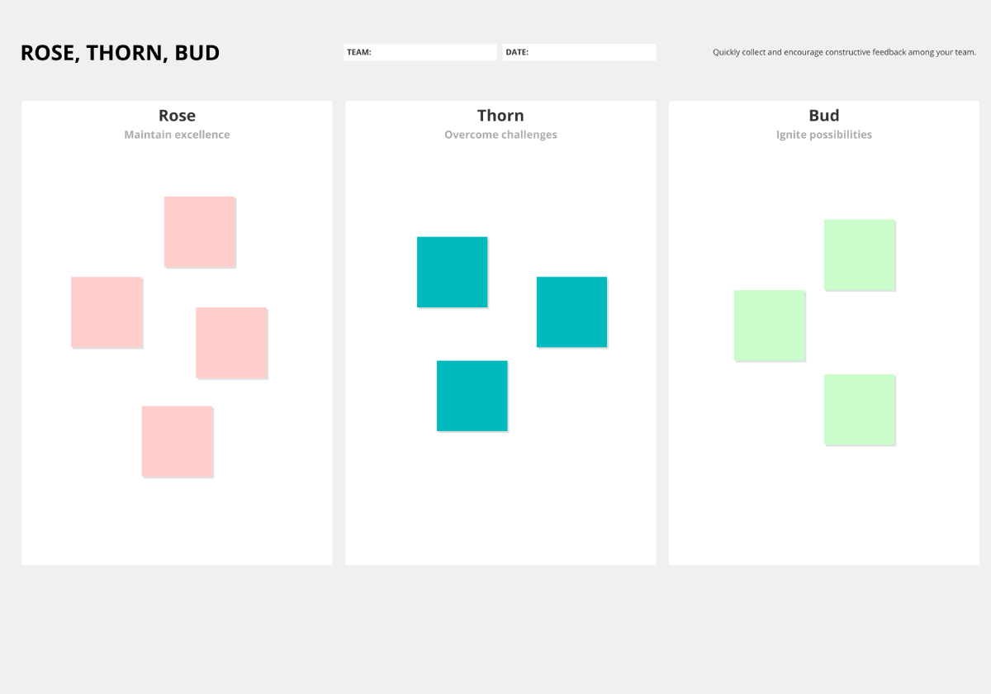
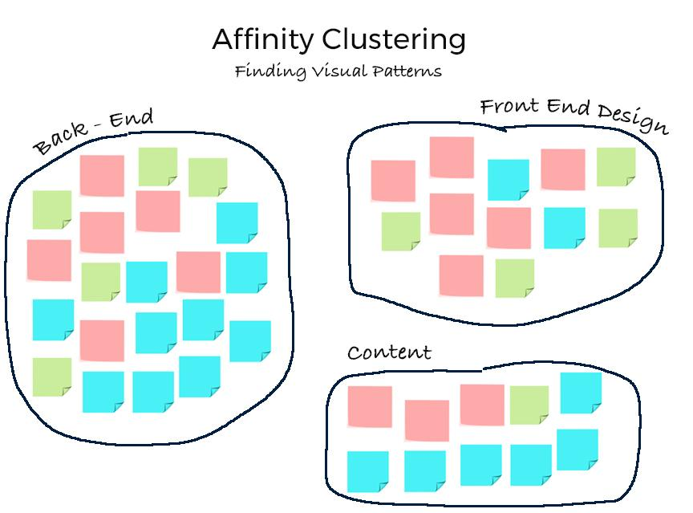
RBT Tools
[Enter text here]
As always, show your work
This is a good tool to show both what you collected and what you did with the information you collected. What did you realise?
Again, look at the questions mentioned in the rubric or assignment brief and go deep on at least one of them
Annotate, make connections, and focus on insights
Use the 4R framework, if it proves to be helpful for you
Hint: Students who take time to do the affinity clustering gain more insights from this tool
[Enter text here]

Slide 22
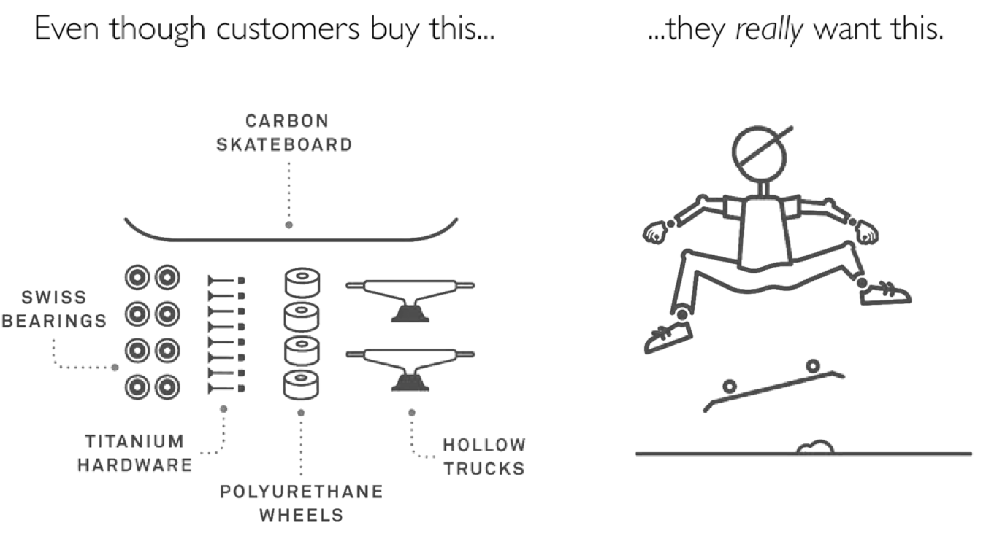
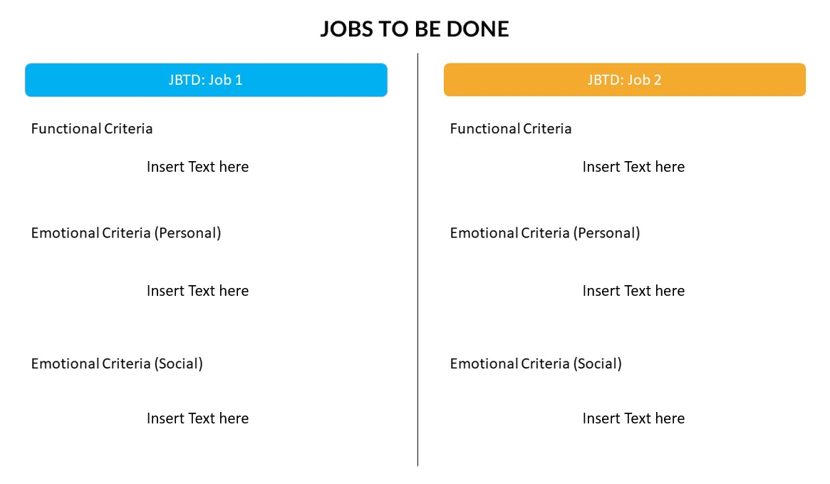
JTBD Analysis
What does your persona hire the product to do?
What are social and emotional jobs?
As always, include evidence of the work you did
This is a great one for identifying insights: What did you learn that you might otherwise have missed?
Would you use this again? When? How? Why? What would you do differently next time?
Show relationships
Answer the questions mentioned in the rubric
Focus; going deep is better than going broad (as long as you cover all the material across the whole of your assignment/portfolio)

Slide 23
Love Letter / Break-up Letter
Dear problem,
What I love about you is…
Blah, blah, blah, insights about what’ awesome
List the features that you love
Focus on the benefits
Affectionately,
You...
What are the features that matter?
Dear problem,
We need to break up. It’s not you, it’s me. No, actually, it’s you!
Blah, blah, blah, insights about what you really don’t like about the problem
List the features that you detest
Focus on the stuff that you do not like
I’m unfriending you on Facebook
You...
What are the insights?
Draw connections
What are the benefits you need?

Slide 24
Establish a POV
Perhaps you can present a couple of options
Be clear about which option you think is the best one (and why)
Link your point of view back to the work you have already done
Try for actionable and generative
What is exciting?
What is interesting?
[PERSONA]
needs to
[USER’S NEEDS]
because
[SURPRISING INSIGHT]

Slide 25
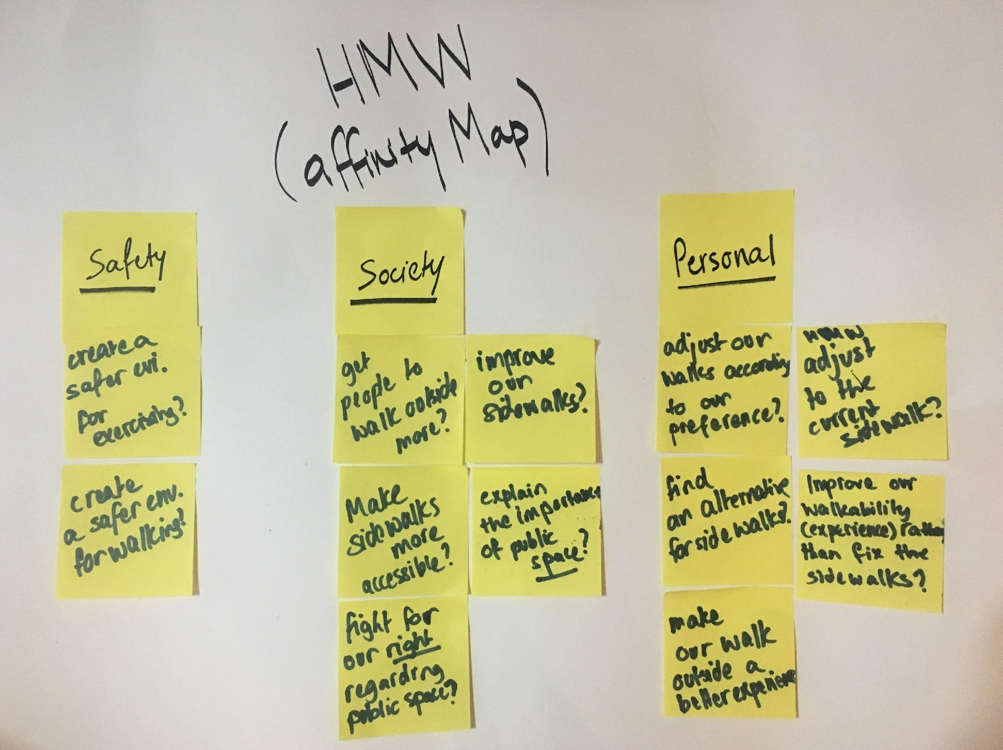
HMW Exercise (5-10 questions)
List your questions: Dig deep and use your insights, track the desired outcomes, write positively and keep them broad enough to ensure many ideas
Revisit the literature and readings about problem framing: How would you use/eliminate the frame to land on the right question?
Notice where you embed a solution in your question (it’s alright, until we have a lot of practice most of us do that): Show us how you move from a poor question to a good one, and from a good question to a great one
Think about each question in terms of User + Need + Insight
Include annotations: Use the 4Rs approach, if you wish
Reflect on this tool: How does it connect with others? Would you use it again? How? When? Why? What would you do differently?
Check the rubric again: Is there something on which you can go deep?

Slide 26
Final Design Brief
Include the brief as an appendix or add a photo here. The point is to link it to your first draft so that you do need not have two sections (This is up to you)
Summarise what is really important. Here, we are interested in how your understanding evolved over time
A brief should be brief!
Performance Criteria specifically requires you to develop and submit a design criteria. This is critical
Insights are what matters. How did your understanding of the problem change as you used the different tools?

Slide 27
Final Problem Definition
Clearly define the problem. This will ‘fall’ out of the work you have already done
Performance Criteria specifically requires you to develop and submit a problem statement. This is critical
Check the rubric carefully

Slide 28
Conclusions About The Industry Problem
This is where you bring it all together
Keep it brief
Highlight the key points that you want us to see. These points will help your teammates in the next course
Be strategic
Check against the rubric
Use signposts
Do not forget to add references

Slide 29
JUST CHECKING | HAVE YOU WRITTEN AN EXECUTIVE SUMMARY? Have you addressed each of these key elements in your portfolio in ways that your grader (and your teammates) can easily find them?
Does it is clearly articulate your problem statement?
Is your problem statement human-centred?
Does it make it clear who your key stakeholder is and why you are solving the problem for them?
Does it include a clear summary of the design criteria you have landed on. Does it answer the this question: What features and benefits would a solution incorporate?
Does it highlight to your reader what insights you derived during the process?
The problem
Your own learning
How you might use these tools in the future
Have you articulated the connections and links between the tools and how they work together to provide insights?
Have you demonstrated critical evaluation by identifying the potential use of the tools in other contexts? strengths and weaknesses of each tool?

Slide 30
Personal SWOB: TEAMWORK
You must incorporate your SWOB analysis activity and include with it a statement in which you articulate the benefits of collaboration in the context of design-thinking and the development of innovations. Your statement should address the requirements for establishing a functional and productive team in the circumstances where creativity and problem-solving is required. It should outline your commitment to team success by articulating the personal commitment and the contributions you will make to that success
When annotating your individual SWOB analysis, ensure that your work is presented in a way that is clear and can be shared with your future team members (this means, for example, that any barriers identified are actually barriers) and is relevant, concise and appropriate for the task. Lastly, it is important to ensure that references to the theories of team formation and planning for team success are woven throughout the statement/plan
strengths
worries
Opportunities
threats

Slide 31
Your Team Charter: TEAMWORK
Reflection Prompt | What to Cover
Report / Respond | Include a brief description of the tool, how you used it, and what you learnt about the problem by using it State your reaction to the tool. What did you learn about your own learning, and how would you use this tool in the future. What happened? What did you observe/feel/question about the experience?
Relate | Make a connection between the issue/situation and your own personal skills, experience and understanding Relate this to any relevant theoretical understandings Have you experienced this before? What sense can you make of the situation based on what you already understand? How does this situation relate to the theories in your course?
Reason | Find an explanation for the situation/issue. Discover a relationship between theory and practice in order to seek a deep understanding of why something has happened What significant factors impacted the situation/issue? How do these relate to what you have previously experienced? What evidence can you find in relevant theories to support your understanding of the events? What impact do other perspectives have on the issue?
Reconstruct | Draw a conclusion and discuss the improvements that could be made. Identify any changes or improvements for future planning. Apply your learning to other contexts and your future professional practice Why did this situation/issue occur? What theories support your rationale? How would you deal with the situation next time? What strategies would you develop for future practice based on what you now know? (It is a good practice to come back later and adjust your responses after you have used more tools)
Include a picture of your Charter
Include your name or logo details
Reflect on the process of creating the charter or making a plan with your teammates
Do you need to adjust any of the strategies you developed for your SWOB?

Slide 32
Reference List
Use the Australian Harvard style

