Slide 1
Innovation by Design
EEdiditt MaMasterster tetextxt ststyleyless
27-06-2020
2

Slide 2
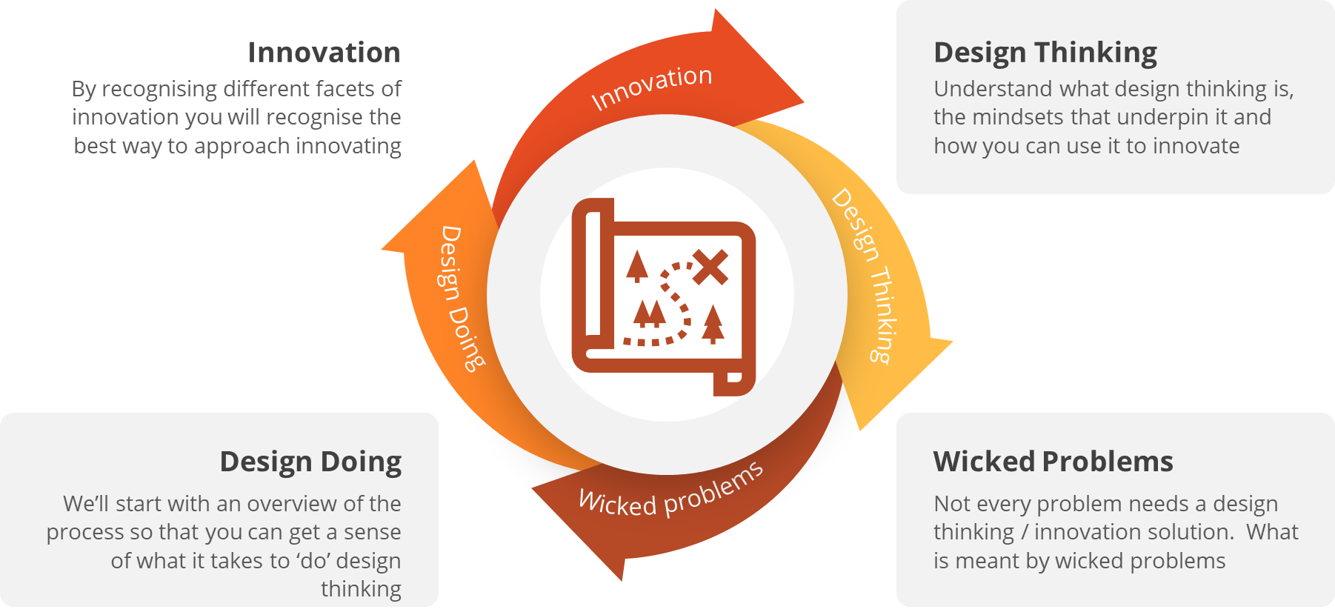
UNIT OBJECTIVES

Slide 3
d.school model provided our framework
The first course in this unit is all about understanding the problem and using the tools

Slide 4
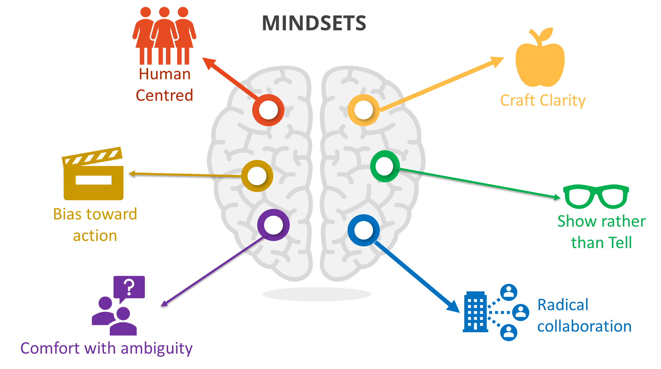

Slide 5
Workshop
This Photo by Unknown Author is licensed under CC BY-SA

Slide 6
THE TOOLBOX
5xWhy
Brain storming
Brain writing
Capturing feedback
Curiosity
Customer journeys
Defining success
Dot voting
Ethnographic techniques
Extreme / lead users
Growth mindset
HMW
Importance v Difficulty matrix
Interviewing with empathy
Jobs to be Done
Journey mapping
Love letter / break up letter
Persona profiles
Problem statement
Prototype to test
Ranking critical assumptions
Reflection / reflective practice
Rose bud thorn
SCAMPER
Stakeholder analysis/mapping
Story telling
Storytelling
Testing sheet / learning cards
Visualisation
What would ‘x’ do?
“Yes and….”

Slide 7
REFLECTIVE PRACTICE IN DESIGN THINKING
Reflection on action
Reflection in action

Slide 8
Assessment 1 – Portfolio Assessment 2 – Report and Presentation

Slide 9
Learn about the theory – readings and explainers from Matt Mount & Cathryn Nolan
See one: Watch the Demos from Chitresh Sinha (BEL)
Do one: Exercises on the platform + applying your ideas to the specific industry problem
Reflect – Look at the guiding questions in the assignment task

