Slide 1
SRM VALLIAMMAI ENGINEERING COLLEGE
(An Autonomous Institution)
SRM Nagar, Kattankulathur, Chengalpattu Dt – 603203,Tamil Nadu
Department of Computer Science and Engineering
1904715 – PROJECT WORK PHASE-2
INTELLIGENT VEHICLE BLACK BOX USING IOT
GUIDED BY
Dr.L.Karthikeyan.,M.Tech.,Ph.D.,
ASSISTANT PROFESSOR(Sel.G)
TEAM MEMBERS
142219104081 - S.J.Nithish
142219104082 - K.Pooja
142219104083 - S.Porselvi

Slide 2
INTELLIGENT VEHICLE BLACK BOX USING IOT

Slide 3
AIM:
To develop a Black Box, technically known as Flight Data Recorder, is an instrument that records all the activities of an aeroplane /aircraft during its flight.

Slide 4
ABSTRACT:
Essentially, a black box flight recorder is heavily protected recording device, similar to a hard disk or a memory card. The black box records all relevant flight data, in addition to conversations in the cockpit.
Previously, this data had to be recorded on two different devices. In science, computing, and engineering, a black box is a device, system, or object which produces useful information without revealing any information about its internal workings. The explanations for its conclusions remain opaque or black.
This Black Box's primary function is to supply data that are sensed by sensors and display online data that has been stored. Accidents can be decreased by properly using the data displayed on the cloud.

Slide 5
INTRODUCTION:
The analysis of a car accident requires physical evidence, including clear evidence from the accident site, a witness, and a trace of the vehicles. In many cases, however, insufficient evidence is collected, and it is difficult to accurately identify the accident cause and the victims or offenders. Vehicle black box records information such as distance of objects in front of the car, unpleasant vibration of the car, temperature of the engine, speed of the vehicle before and during the time of collision. These information are helpful during car accident investigations and could be used in court cases to determine precisely what happened during an accident so that prior decisions can be made with the above mentioned data in the Black Box.

Slide 6
LITERATURE SURVEY:
S.NO | TITLE | AUTHOR | METHODOLOGY | YEAR
1. 2. | License plate detection and recognition algorithm for vehicle black box Data forgery detection for vehicle black box | Jung-Hwan Kim; Sun- Kyu Kim; Sang- Hyuk Lee; Tae-Min Lee; Joonhong Lim Mooseop Kim; Ki-Young Kim | Almost every vehicle has currently installed black box since the stored images by black box can be used to investigate the exact cause of the accident. One of the most important aspects in an accident investigation is the license plate detection and recognition as the license plate has information about the driver and car. This paper presents a security scheme to detect the data forgery in the vehicle black box system. The proposed scheme uses chained hash and symmetric-key encryption to check whether the data is forged or modified. Experimental results show that the proposed scheme can find and notify the point of the falsification. | 2017 2019

Slide 7
EXISTING SYSTEM:
The automotive vehicles doesn’t have a black box system.
The accident data is not stored in any place.
The data generated by the sensors alert the driver through the instrumental console if the set limit exceeds.
PROPOSED SYSTEM:
In the advanced technology each vehicle are monitored and the data are stored in memory.
The data are continuously uploaded to cloud.
Proposed system use Arduino board that provides an easy access to input/output and analog pins and easy burning/uploading of a program.
To monitor the various sensors such as alcohol sensor, temperature sensor, light sensor, accelerometer, ultrasonic sensor, GPS are connected to Arduino board.

Slide 8
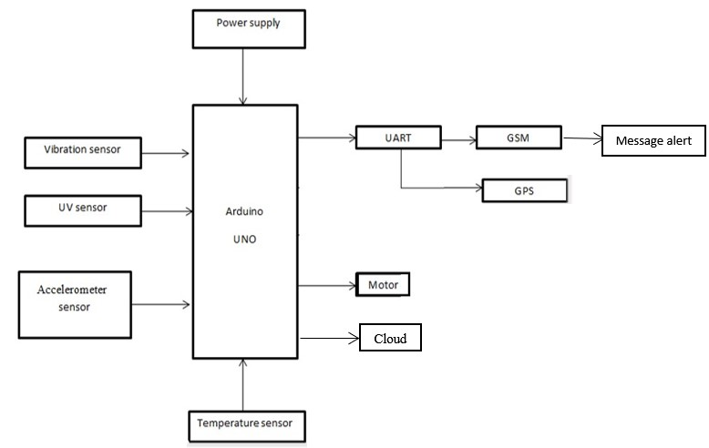
System Architecture:

Slide 9
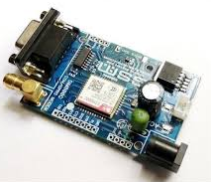
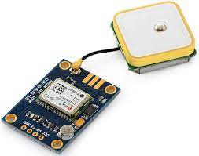
HARDWARE COMPONENTS:
GSM module is a device that uses GSM mobile telephone technology to provide a wireless data link to a network. GSM modems are used in mobile telephones and other equipment that communicates with mobile telephone networks. They use SIMs to identify their device to the network.
The Global Positioning System (GPS) Module is a satellite based navigation system that provides location and time information. The system is freely accessible to anyone with a GPS receiver and unobstructed line of sight to at least four of GPS satellites. A GPS receiver calculates its position by precisely timing the signals sent by GPS satellites.

Slide 10
Hardware requirement Software requirement
Arduino IDE
Embedded C
IOT
Arduino UNO
Power supply
UART
Motor driver
DC motor
ESP8266

Slide 11
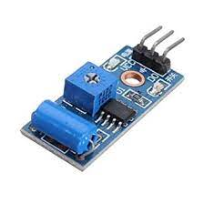
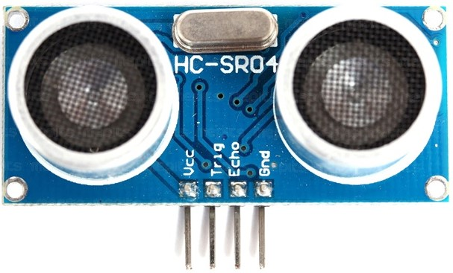
PHASE 1:IMPLEMENTATION
Vibration Sensor:
Vibration sensor measures the amount and frequency of vibration in a given system, machine, or a piece of equipment. It measures vibration levels in machinery for screening and analysis.
UV Sensor:
The Ultrasonic transmitter transmits an ultrasonic wave, this wave travels in air and when it gets objected by any material it gets reflected back toward the sensor this reflected wave is observed by the Ultrasonic receiver module

Slide 12
PHASE 1:IMPLEMENTATION IMAGE

Slide 13
IMPLEMENTATION DEMO:

Slide 14
IMPLEMENTATION DEMO:

Slide 15
PARTIAL OUTPUT:

Slide 16
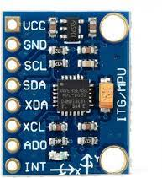
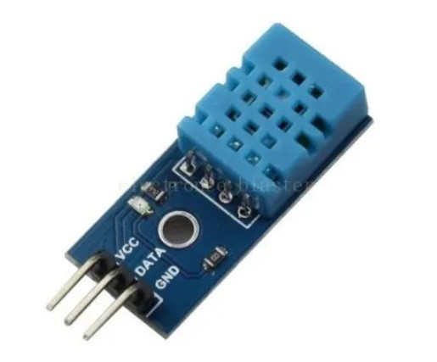
PHASE 2:IMPLEMENTATION
Gyroscope Sensor:
Gyroscope sensors, also known as angular rate sensors or angular velocity sensors, are devices that sense angular velocity. Angular velocity. In simple terms, angular velocity is the change in rotational angle per unit of time. Angular velocity is generally expressed in deg/s (degrees per second)
Temperature Sensor:
Temperature sensor measures the amount of heat energy in a source, allowing them to detect temperature changes and convert these changes to data.

Slide 17
PHASE2:IMPLEMENTATION IMAGE

Slide 18
IMPLEMENTATION OUTPUT:

Slide 19
MESSAGE ALERT:

Slide 20
DATA STORED IN CLOUD:

Slide 21
Reference:
Chanjin Kang and Seo Weon Heo, Member, IEEE Hongik University, Seoul, Republic of korea978-1-5090-5544-9/17, 2017 IEEE
Gilman, Don. "Automotive Black Box Data Recovery Systems." Digital Negative. TARO (The Traffic Accident Reconstruction Origin) 15 (2006).
L. Dae Geun, J. Se Myoung, L. Myoung Seob, “System on Chip design of Embedded Controller for Car Black Box”, Intelligent Vehicles Symposium IEEE 2007, pp. 1174-1177, 13 June 2007
G. Hayes, F. Blosser, “Motor Vehicle Crashes Claim More than a Million Lives Worldwide”, CDC Injury Center Media Relations, Press Release, April, 2004.

Slide 22
CONCLUSION:
With this increasing graph of using smart phones and wireless communication, it is become easy to use this technologies for real time solutions. Despite of the limited resources, these technologies are being used along with machine learning approaches to solve big problems in automotive industry. Our first contribution to this ppt is data generation and feature selection. Sensor data of many car manufactures has been used. We have selected those sensors which can cause a system to break down. And the second contribution is to built a user friendly vehicle fault prediction, vehicle remote health monitoring system.

