Slide 1
Risk and Organisational Resilience
Coursework Support Session

Slide 2
Question
Examine the Global Risk Report 2022 and project what the three most significant risks for 2023. You should justify your top three risk selections.
Consider how these three risks relate to the United Nations Sustainable Development Goals 2030.
As a risk professional, develop a sustainable organisational resilience strategy to minimise the three top risk identified in your chosen organisation.

Slide 3
General Advice on Report Writing
What is a typical report structure? | Glasgow Caledonian University | Scotland, UK (gcu.ac.uk)
LDC – excellent resource and available for one on one sessions to review your work - https://www.gcu.ac.uk/aboutgcu/academicschools/gsbs/study/ldc/contactus

Slide 4
Executive summary
From the Learning and Development Centre Website –
This is a summary of the main ideas contained in the report. It is intended to provide an overview of the aim, scope, main findings, conclusions and recommendations. It is not an introduction – it does not tell readers what they can expect to read, but it is an alternative to reading the whole report. It is always written after the report has been completed. This document highlights the differences between introductions and executive summaries, and provides an example executive summary

Slide 5
Introduction ideas
Define the Global Risk Report,
Define the SDGs,
Chose an organisation,
Describe their main operations,
Aim to find a link between all three sections so your introduction is not disjointed. Always aim for logical flow,
State your intention to provide a resilience strategy for the organisation,
State these three key items provide the main informants of your report,
State your intention e.g. the intention of this report is to highlight…

Slide 6
Part 1 – The Top 3 risks for 2023
What are the key risks in your view according to the Global Risk Report?
Have you read from other sources i.e. recent journal articles which contradict or justify the top three risks?
Have there been any trends in the top three risks over the last decade of the Global Risk Report (see report 2021 for comparison)
Ensure you justify your choice.
How do these three risks impact your chosen company?

Slide 7
Part 2 – Link to three UN sustainable development goals
The UN’s sustainable development goals refer to a 15 year plan for 2030 that addresses 17 global and interconnected issues facing society,
You are required to think how these three risks relate to the UN SDG’s, i.e. how will they impact their implementation/development. Negatively or positively?
You may wish to select the three SDG’s which are most impacted by your top three justified risks,
Is your chosen organisation currently working on the SDG’s in their strategy/operations? Has this proved beneficial for them and could the three top risks (part 1) potentially impact this benefit?

Slide 8
Part 3 – Develop a sustainable organisational resilience Strategy
Chose an organisation,
Provide a brief summary of how their operations may be impacted by the three risks you have chosen,
Consider resilience frameworks,
You may wish to develop new insight into the framework, e.g. state limitations and identify means of how these could be improved. For instance, through using aspects of two frameworks,
How is this going to fit in your chosen organisation? Consider culture, Enterprise Risk Management, Risk Intelligent Organisation

Slide 9
Conclusion
The conclusion should not give new information,
Provide a summary of findings
Good conclusions should demonstrate a new insight or implication of main findings i.e. not just repetition of main body,

Slide 10
Recommendations
No new information here,
Be specific and practical in your recommendations,
Less than 5% of word count,

Slide 11
Marking Criteria
Report 3000 words
Review the Learning Outcomes and Marking Criteria within the module handbook for a guide for marker indications (exam and coursework's).

Slide 12
Submission Instructions
Deadline – January 6th
No hard copy needed
Submit through Turnitin – can test as often as you wish

Slide 13
Purpose of Introduction
Introduction (generally 10% of word count)
Presents relevant background information that provides a rationale for this piece of writing.
This can be research findings and/or real-world information that shows why the issue is important.
Outlines the aim and scope of the essay.
Often indicates the writer’s position or line of argument

Slide 14
Critical Analysis
More than what happened and causes – more application and analysis than description! So what for every point?
Description is not ideal. This report should consist as an individual case insight, based on critical analysis you have formed from further research into the concepts you learn within the class. The key to forming this is in the reading,
Level 3 and beyond, you are expected to demonstrate a more sophisticated approach to critical analysis. This involves:
identifying a range of relevant concepts, theories and models which help you understand an issue
identifying relevant issues and sub-issues and associated problems, benefits, challenges, drawbacks, limitations
showing that you understand presented in the literature around these issues, concepts, theories and models the different perspectives
showing that you recognize the weight of these perspectives in the literature – what is the consensus of opinion on an issue or perspective? Is there broad agreement on an issue, is opinion roughly equally divided, or is a perspective held by only one or two writers?
At its heart, critical analysis involves asking questions: "What...", "How...", "Why...", "So what..."

Slide 15
Structure
With this report, the way you structure it is also part of critical analysis. For instance, how are you going to interweave the Key risks, sustainable development goals and aspects of your chosen organization,
Just because you are able to have headings and subheadings does not mean you should neglect logical flow,

Slide 16
Pointers…
Read, Read, READ!
More analysis than description.
Proof read your work.
Use sections, however ensure logical flow maintains.
Harvard Referencing.
Be concise!

Slide 17
Purpose of Conclusion
Conclusion (generally around 5-10% of word count)
Restates the main argument made in the essay.
Refers back to the issue raised in the introduction
Do not provide a summary of the structure of the essay – focus on issues, not structure.
Considers future implications or possibly recommendations
Why the issue is important
What the main arguments are; what the writer’s position is

Slide 18
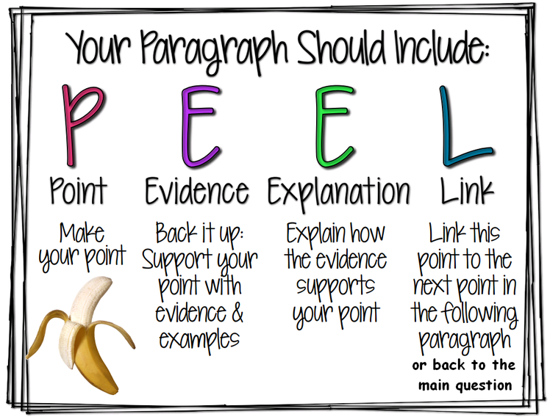
Paragraphing (1) - PEEL

Slide 19
Paragraphing (2) - PEAK
PEAK Paragraphs
Learning this organizational method is crucial to becoming a successful college-level writer.
Point
The paragraph’s main point is the primary purpose of the topic sentence, and it states the main concept in the student’s own words. Consequently, quotations, facts, and questions are unsuitable topic sentences. Like a street sign, the topic sentence points to the paragraph’s key without revealing the full impact of the key (signposts reveal the direction of the venue not its significance). Many students mistakenly insert the writing assignment for the topic sentence. Often students benefit by writing the topic sentence last after they have written the key.
Evidence
Evidence consists of substantial facts, which form the foundation of the paragraph. Only consider interesting, profound facts with aspects worthy of consideration. Think of a simply cut diamond that restricts the entry of light and makes it appear dull. Simple facts lead to superficial conclusions. A diamond with many facets has numerous angles for light to enter, and this gives a diamond its brilliance. Evidence that offers the reader food for thought will be far more convincing to the reader. Just as contractors won’t build on a small foundation, so the writer should not build a paragraph on just one fact. Although two facts are better, citing three significant facts advances a pattern worthy of deliberation. Just as a mountain’s shape is mostly in the base, so the paragraph’s foundation rests on the evidence. Actually, most students find fact finding the easiest part of the writing process.
Analysis
Analysis interprets information for the reader and connects the dots between facts. Bringing together evidence from several sources or from different parts of a novel can be awkward when stated succinctly. Analysis is the way a writer uses transition phrases to fit incongruous facts together to showcase their connectedness. It addresses the issue of how these unrelated facts coalesce to highlight a previously unobserved association. Acting as the glue to hold these facts together, analysis builds patterns, which the writer has seen, for the reader to appreciate. Good writing makes it easy for the reader to understand why facts have been brought together.
Key
The key is the insight that unlocks the real meaning of the analyzed information. Each paragraph builds towards a key insight, the pinnacle of the paragraph. Just as the arrowhead shape of a mountain points upward from the base to the peak, all the evidence and analysis points the reader to the writer’s key, the paragraph’s grand vista. Although often referred to as a summary or conclusion, we find these terms can mislead students. Analyzed evidence does not require a summary or restatement. Instead, writers should conclude with the key insight. Students learn to think in insightful ways when they discuss ideas with interested and wise adults. All students find the key to be the most challenging part of writing, so parents can encourage teens to discuss ideas to discover a more profound significance. Once the writer has a key insight, he should inventory the evidence to see if the current facts are the best foundation or whether they need tweaking, reordering, additions, or deletions. The key helps clear away fluff, so writers concentrate on what is important. The ability to bring facts into focus—to explain their significance—is critical to developing the next generation of persuasive writers.

Slide 20
Linking Words
A variety of linking words are used to demonstrate 3 main types of relationships:
additional information eg moreover; in addition; furthermore
contrasting information eg however; in contrast; conversely
cause and effect eg as a result; consequently; therefore
Note that:
These words have very specific meanings – the linking words indicating contrast are not all interchangeable.
b) These words have specific rules of usage:
ideas may link across 1 or 2 sentences
linking words may be followed by a sentence or a phrase

