Slide 1
PG Diploma
Healthcare Management and Leadership
Dr. Jazla Fadda, MPH, D.P.H, D.D.S
Notes:
Total students on 21-feb-17:
PGD-HCML - 4 Students
MBA - 9 Students

Slide 2

DEAR STUDENTS,
PLEASE, SWITCH YOUR MOBILE PHONES TO “SILENT MODE” DURING LECTURES
Notes:
Total students on 21-feb-17:
PGD-HCML - 4 Students
MBA - 9 Students

Slide 3
Plan of Lecture
6.1. Understand the basic financial terms and definitions
6.2. What are assets and liabilities
6.3. How to make and read a financial statement
6.4. Ingredients of healthcare financial management
6.5. Investment appraisal techniques
6.6. Costs, budgets and reports.

Slide 4
Accounting –
The Language of Business
Accounting is the information system that...
measures business activities,
processes data into reports, and
communicates results to decision makers.

Slide 5
Definitions of Accounting
“The process of identifying, measuring, and communicating economic information to permit informed judgements and decisions by users of the information.”
    —American Accounting Association (AAA)
“A service activity whose function is to provide quantitative information, primarily financial in nature, about economic entities that is intended to be useful in making economic decisions.”
    —American Institute of Certified Public Accountants (AICPA)

Slide 6
Accounting as an Aid to
Decision Making
Accounting helps in decision making by showing where and when money has been spent, by evaluating performance, and by showing the implications of choosing one plan instead of another.
Fundamental relationships in the decision-making process:
Event
Accountant’s
analysis and
recording
Financial
statements
Users

Slide 7
Accounting
An Information Process
Identification
of Users
User
Information
Needs
Economic Data
and Activities
Accounting
System
Reports
User Decisions

Slide 8
Users of Accounting Information
Nonprofit
organizations
Taxing
authorities
Businesses
Individuals
Government
regulatory agencies
Investors and
creditors

Slide 9
Users of Accounting Information
External users
make decisions
about the entity.
Internal users
make decisions
for the entity.

Slide 10
Management Accounting
It measures and reports financial and nonfinancial information that helps managers make decisions to fulfill the goals of an organization.

Slide 11
Assets
What is an asset?
Probable future economic benefits obtained or controlled by a particular entity as a result of past transactions events.
It is something a company owns which has future economic value.
  Land;
  Building;
  Equipment;
  Goodwill.

Slide 12
Liability
What is a liability?
Probable future sacrifices of economic benefits arising from present obligations of a particular entity to transfer assets or provide services to other entities in the future as a result of past transactions or events.
It is something a company owes.
  Money;
  Service;
  Product.

Slide 13
Classifying Assets and Liabilities
Current assets
Long-term assets
Current liabilities
Long-term liabilities

Slide 14

Revenues
What are revenues?
They are amounts received or to be received from customers for sales of products or services.
  Sales;
  Performance of services;
  Rent;
  Interest.

Slide 15
Revenues
Revenues are inflows or other enhancements of assets to an entity.
They result from delivering or producing goods, rendering services, or other activities that constitute the entity’s major or central operations.

Slide 16
Expenses
What are Expenses?
They are amounts that have been paid or will be paid later for costs that have been incurred to earn revenue.
  Salaries and wages;
  Utilities;
  Supplies used;
  Advertising.

Slide 17
Expenses
Expenses are outflows or other using up of assets.
They result from delivering or producing goods, rendering services, or other activities that constitute the entity’s major or central operations.

Slide 18
Owner’s Equity
What is owner’s equity?
It is what’s left of the assets after liabilities have been deducted.
  the same as net assets;
  the owner’s claim on the entity’s assets.

Slide 19
Owner’s Equity
The residual interest in the assets of an entity that remains after deducting its liabilities. It could be:
Investment by owners;
Earned equity.

Slide 20
Transactions that Affect
Owner’s Equity
OWNER’S EQUITY
INCREASES
OWNER’S EQUITY
DECREASES
Owner Investments
in the Business
Owner Withdrawals
from the Business
Owner’s Equity
Revenues
Expenses

Slide 21
Effects of Transactions on Owner’s Equity
Owner’s Equity
decreased by
increased by
Owner’s withdrawals
Expenses
Owner’s investments
Revenues

Slide 22
The Accounting Equation
Assets
=
Liabilities + Owner’s Equity
Economic
Resources
Claims to
Economic
Resources

Slide 23
The Accounting Equation
Resources = Sources
Liabilities
Assets
Owner’s
Equity
Resources used
in the business
Resources supplied by creditors and owners

Slide 24
The Basic Accounting Equation
Accounting data is represented by the following relationship among the assets, liabilities and owners’ equity of a business:
    Assets = Liabilities + Owners’ Equity
The equation must be in balance after every recorded transaction in the system.

Slide 25
Accounting as an Aid to
Decision Making
Accounting information is useful to anyone who makes decisions that have economic results.
  Owners want to know which employees are productive.
  investors want to know if a company is a good investment.
  Legislators want to know how a proposed law will affect budgets.
  Managers want to know if a new product will be profitable.
  Creditors want to know if they should extend credit, how much to extend, and for how long.

Slide 26
Abusive Accounting Practices
Creative accounting practices
  Enron
  Debts Not Reported
  Recognition Of Losses Was Postponed
  Report Income Before Being Earned

Slide 27
The Recording Process
The sequence of steps in recording transactions:
Transactions
Documentation
Journal
Financial
Statements
Trial
Balance
Ledger

Slide 28
The Financial Statements
The financial statements are a picture
of the company in financial terms.
Each financial statement relates to a specific
date or covers a particular period.

Slide 30
Information Reported on the Financial Statements
Question
Answer
Financial
Statement
1. How well did the
company perform
(or operate) during
the period?
Revenues
– Direct Expenses
Gross income (Gross loss)
Trading
Account
2. How well did the
company perform
(or operate) during
the period?
Gross Profit
– Indirect Expenses
Net income (Net loss)
Profit and
Loss
Account

Slide 31
Information Reported on the Financial Statements
Question
Answer
Financial
Statement
3. What is the company’s
financial position at the
end of the period?
Assets
= Liabilities
+ Owners’ equity
Balance
sheet
4. How much cash did
the company generate
and spend during
the period?
Operating cash flows
± Investing cash flows
± Financing cash flows
Increase or decrease in cash
Statement
of
cash
flows

Slide 32
Income Statement (1)
The income statement,
reports the company’s revenues,
expenses, and net income
or net loss for the period.

Slide 33
Income Statement (2)
The income statement is a financial
tool that provides information about
a company’s past performance.

Slide 34
Income Statement (3)
Revenues
Expenses
Net income
(or Net loss)
–
=

Slide 35
Income Statement Format
Sales revenues
– Cost of goods sold
Gross profit
Selling and
administrative
expenses
Operating
income
-
=
Add: Other revenues and gains
Less: Other expenses and losses

Slide 36
Income Statement
Revenue | the proceeds that come from sales to customers
Cost of Goods Sold | an expense that reflects the cost of the product or good that generates revenue
Gross Margin | also called gross profit, this is revenue minus COGS
Operating Expenses | any expense that doesn't fit under COGS such as administration and marketing expenses
Net Income before Interest and Tax | net income before taking interest and income tax expenses into account
Interest Expense | the payments made on the company's outstanding debt
Income Tax Expense | the amount payable to government
Net Income | the final profit after deducting all expenses from revenue

Slide 37

This is Paul
He loves guitars…
…and he has a little Guitar shop
His company is called
Paul’s Guitar Shop, Inc.

Slide 38
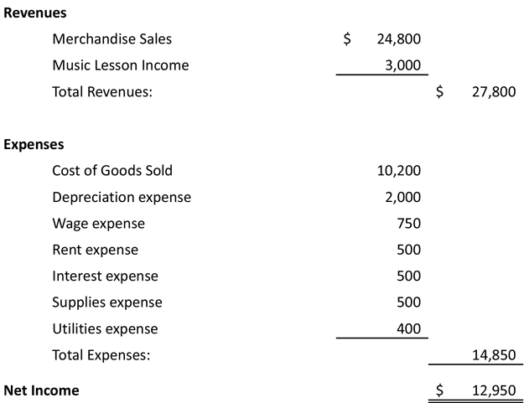

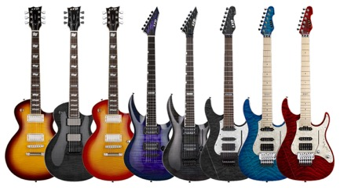
Paul’s Guitar Shop, Inc.
Income Statement
For the year ended December 2016

Slide 39

Money doesn’t make you happy.
I now have $ 50 million but I was just as happy when I had $ 48 million

Slide 40
The Balance Sheet
The balance sheet is the financial
tool that focuses on the present
condition of a business.

Slide 41
The Balance Sheet
The Balance sheet shows the financial position of a company at a particular point in time. It is also referred to as the statement of financial position or the statement of financial condition.
The left side lists
assets
The right side lists
liabilities and owners’ equity

Slide 42
Formats of Balance Sheets
Balance sheet formats:
  Report format - a classified balance sheet with assets at the top and liabilities and equity below;
  Account format - a classified balance sheet with assets at the left and liabilities and equity at the right.
Regardless of format, balance sheets always contain the same basic information.

Slide 43
Balance Sheet Transactions
The balance sheet is affected by every transaction that an entity encounters.
Each transaction has counterbalancing entries that keep total assets equal to total liabilities and owners’ equity.

Slide 44
The Balance Sheet
Elements of the balance sheet:
  Assets - resources of the firm that are expected to increase or cause future cash flows (everything the firm owns)
  Liabilities - obligations of the firm to outsiders or claims against its assets by outsiders (debts of the firm)
  Owners’ Equity - the residual interest in, or remaining claims against, the firm’s assets after deducting liabilities (rights of the owners)

Slide 45
The Balance Sheet
Resources Available For Use By The Firm (Entity)
Assets - Probable Future Economic Benefits
How Resources Are Financed
Liabilities - Debt Owed To Others
Owners’ Equity - Investment By Owners
  Direct
  Indirect

Slide 46

Paul’s Guitar Shop, Inc.
Balance Sheet
31 December 2016

Slide 47
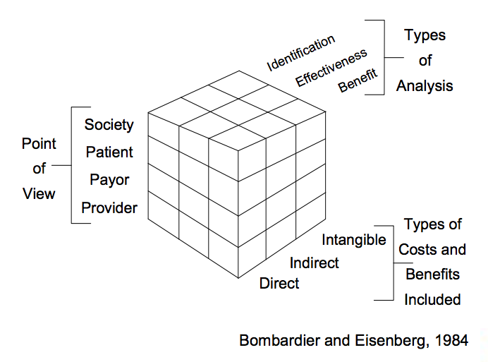
Health Economic Analysis

Slide 48
Investment appraisal techniques
Cost Identification
Cost-Benefit Analysis
Feasibility study
Cost-Consequences Analysis
Option Appraisal
Cost-Effectiveness Analysis
Cost-Utility Analysis
Health Impact Assessment
Health Technology Assessment
Notes:
Read more: http://www.esifforhealth.eu/pdf/WP3(6)_Appraisal%20techniques_FINAL_20150216.pdf

Slide 49
Cost Identification
• Also referred to as cost minimization and cost-cost analysis;
• Estimates costs of an intervention, but not benefits;
• Appropriate only when two options of equal efficacy are compared.

Slide 50
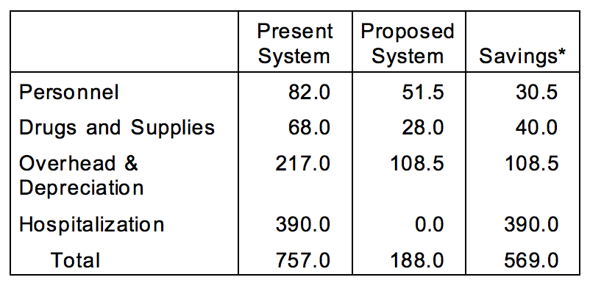
Example: Cost Identification of Herniorrhaphy
Notes:
* All costs in Columbian pesos (1975 value). Source: Velez-Gil et al., 1975

Slide 51
Cost-Effectiveness Analysis
• Estimates costs and outcomes of intervention
• Costs and outcomes are measured in different units
• Results meaningful in comparison with other interventions or a predetermined standard – (e.g., $50,000 per quality-adjusted year of life saved)
• Incremental cost-effectiveness ratio:
Costs₁ – Costs₂
Effects₁ – Effects₂

Slide 52
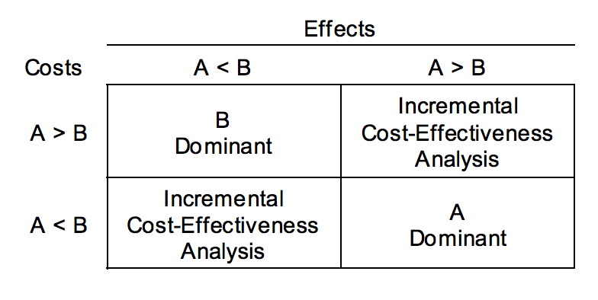
Choosing Among Alternative Interventions

Slide 53
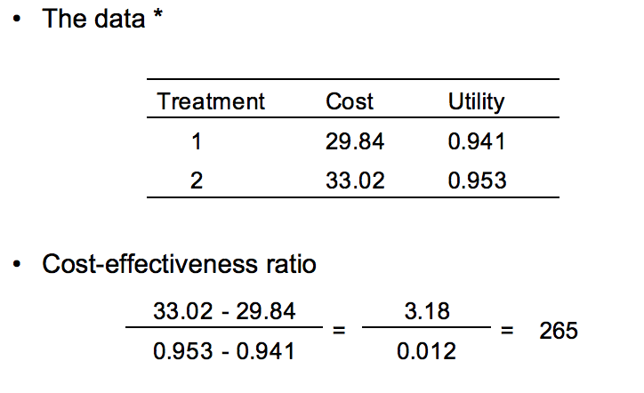
Example: Treatment for Chlamydia
Notes:
* Source: Nettleman et al., 1986

Slide 54
Alternatives to cost-benefit analysis
• Years of life gained
• Lives saved
• Successful treatments
• Cases of illness avoided
• Intermediate outcomes gained

Slide 55
Direct Costs in Healthcare
OPD visits cost
Diagnostic testing
Durable and nondurable medical equipments
Hospital, nursing home and home health care services
Medications, immunizations
Physicians and other professionals
Treatment of general medical conditions attributed to condition

Slide 56
Indirect Costs in Healthcare
Absenteeism of employees who care for Patients
Care provided by spportive caregivers
Cessation of work
Patients health education
Financial assistance to persons with chronic disease
Household preventive control measures
Housekeeping assistance needed because of disease
Loss of productivity at work
Pain and suffering, quality of life
Research and construction of healthcare facilities
Restricted activity days
Transportation to and from healthcare visits
Unpaid household labor resulting from diseases /premature death
Value of lost future earnings from paid market

Slide 57
Books on Healthcare Financial Management
Understanding Healthcare Financial Management
https://books.google.bg/books?id=QhgIDAAAQBAJ&pg=PT58&lpg=PT58&dq=Ingredients+of+healthcare+financial+management&source=bl&ots=GkrCbjMJ6E&sig=frFVow0RLIJlEW3BRjirvooG0mE&hl=en&sa=X&ved=0ahUKEwiSipX_oIDTAhXEuhQKHTPvALQQ6AEIPjAD#v=onepage&q=Ingredients%20of%20healthcare%20financial%20management&f=false
Understanding Healthcare Financial Management
http://www.ache.org/pubs/chap1-3gapenski5th.pdf
More info at: Healthcare Financial Management Association
https://www.hfma.org/

