Slide 1
BINC
Group Presentation
On
E-CUISINE
The Bridge Where Four Nations Come Together
Module : Digital Marketing
Module Code : M065LON
Academic Level : 7
Module Credit : 15
Course Instructor : Dr. Joshie Juggessur

Slide 2
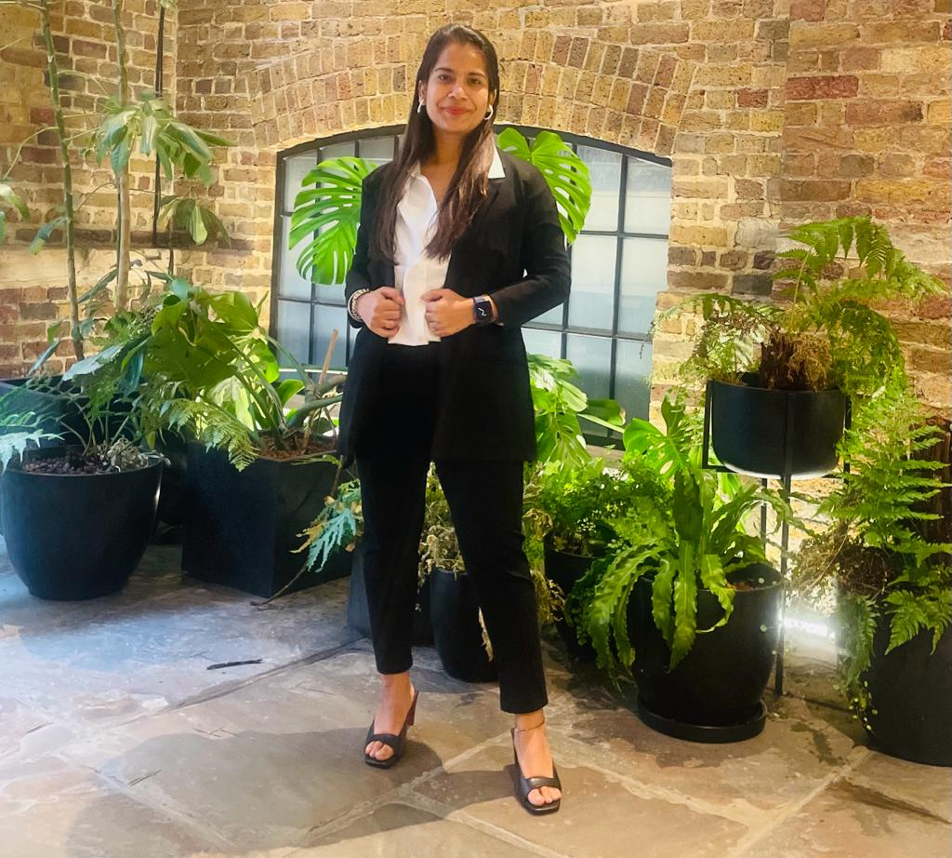
YINAN ZHANG-12690457
PRIYA BANSAL-12562936
MUSHFIK MONJUR-12565306
VEENA KAMATHAM-12274958
CHIDI OLUOHA-12762134
FAVOUR OGUCHI12764725

Slide 3
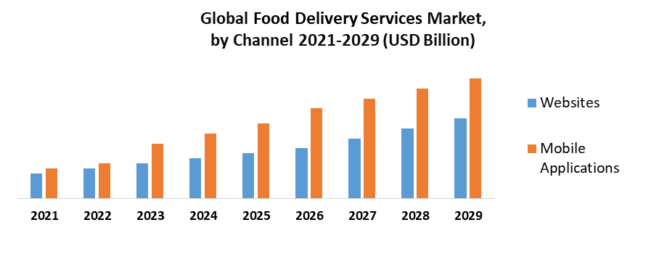
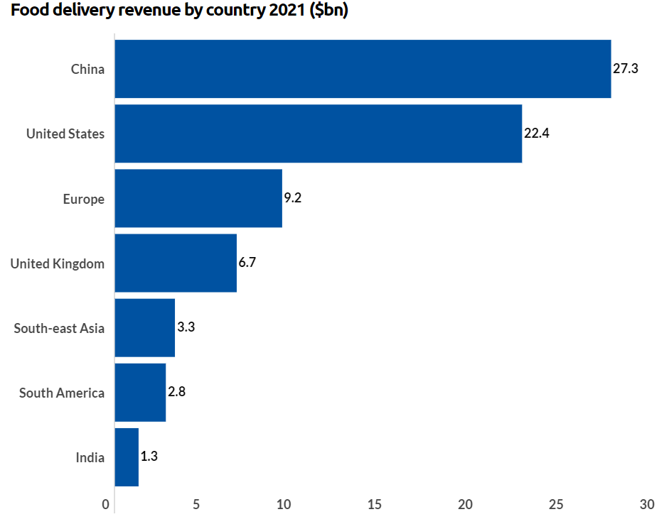
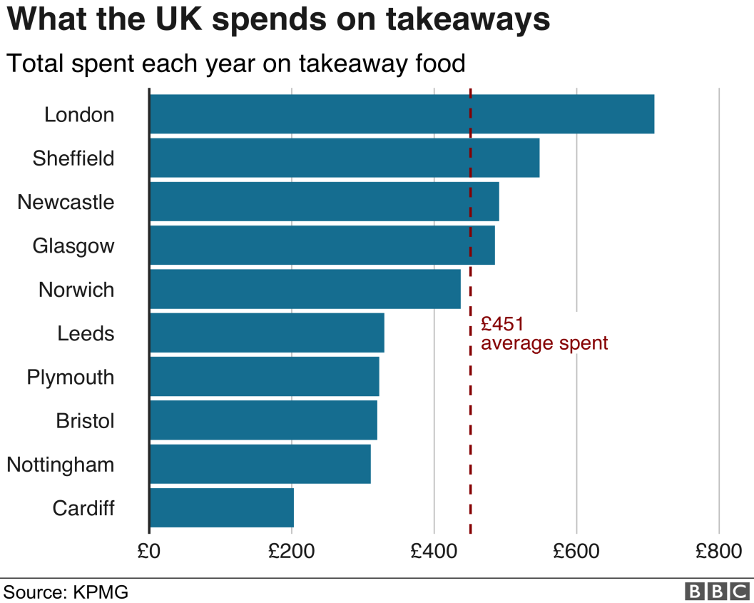
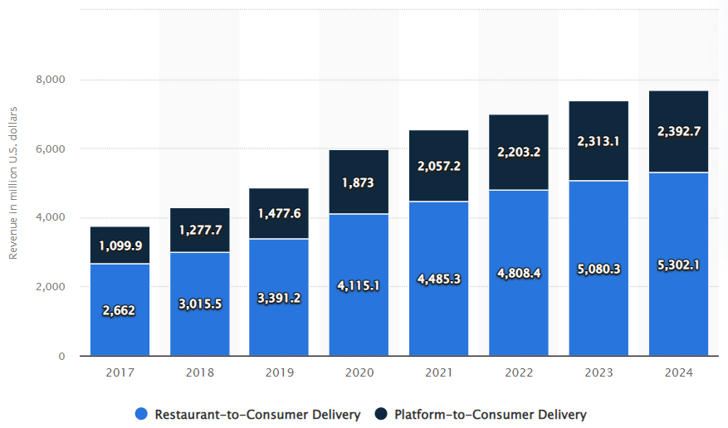
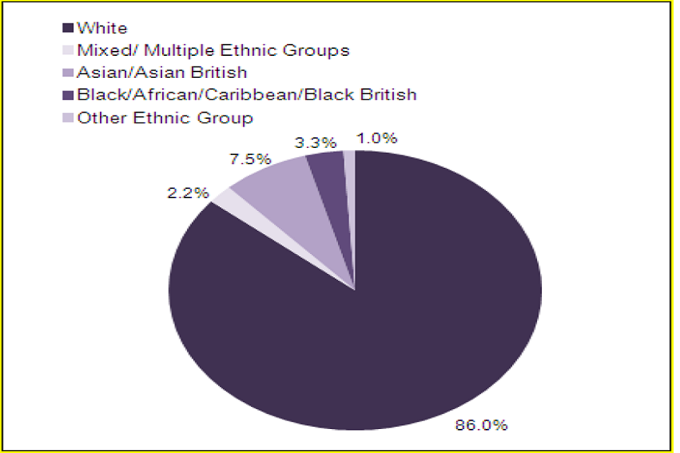
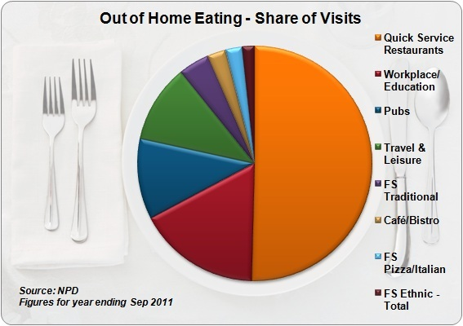
Market Research
Sources: CB Insights, Research & Markets (Food Delivery Services Market: Global Industry Analysis and Forecast (2022-2029), n.d.)
How Many Takeaways Do You Have A Week? (n.d.). Charlton Life. October 28, 2022
Sources: Company Data, Bloomberg, Daxue Consulting, The Information (Food
Delivery App Revenue and Usage Statistics (2022), )
(Briggs, n.d.)

Slide 4
Customer Persona
Name : Emma Gabriel
Age : 31
Profession : Teacher
Interest : Travelling, Shopping
Country : Kenya
Name : Aquib Javed
Age : 44
Profession : Medical Doctor
Interest : Watching Movies
Country : Bangladesh
Name : Puneet Agarwal
Age : 50
Profession : Businessman
Interest : Investment banking
Country : India
Name : Henry Olonga
Age : 24
Profession : University Student
Interest : Sports
Country : Nigeria
Name : Michael Chang
Age : 42
Profession : Engineer
Interest : Reading novels
Country : China
Name : Bushra Khan
Age : 18
Profession : Young professional
Interest : Modeling
Country : Pakistan

Slide 5
Target Market
Target Market
Age between 18 to 50
Enjoys living busy lives
Young professionals
Young professionals with families
Middle class – Disposable income for subscription srevice
70% of customer base are women
Individuals with less time devoted to meals prep / grocery shopping
Consumers that value quality ingredients
Focused on convenience
Values fitness, health and clean eating
Urban dwellers
Tech Savvy
Asian Community
African Community
Total Number of Population (Asian & African) in UK = 6,278,023.

Slide 6
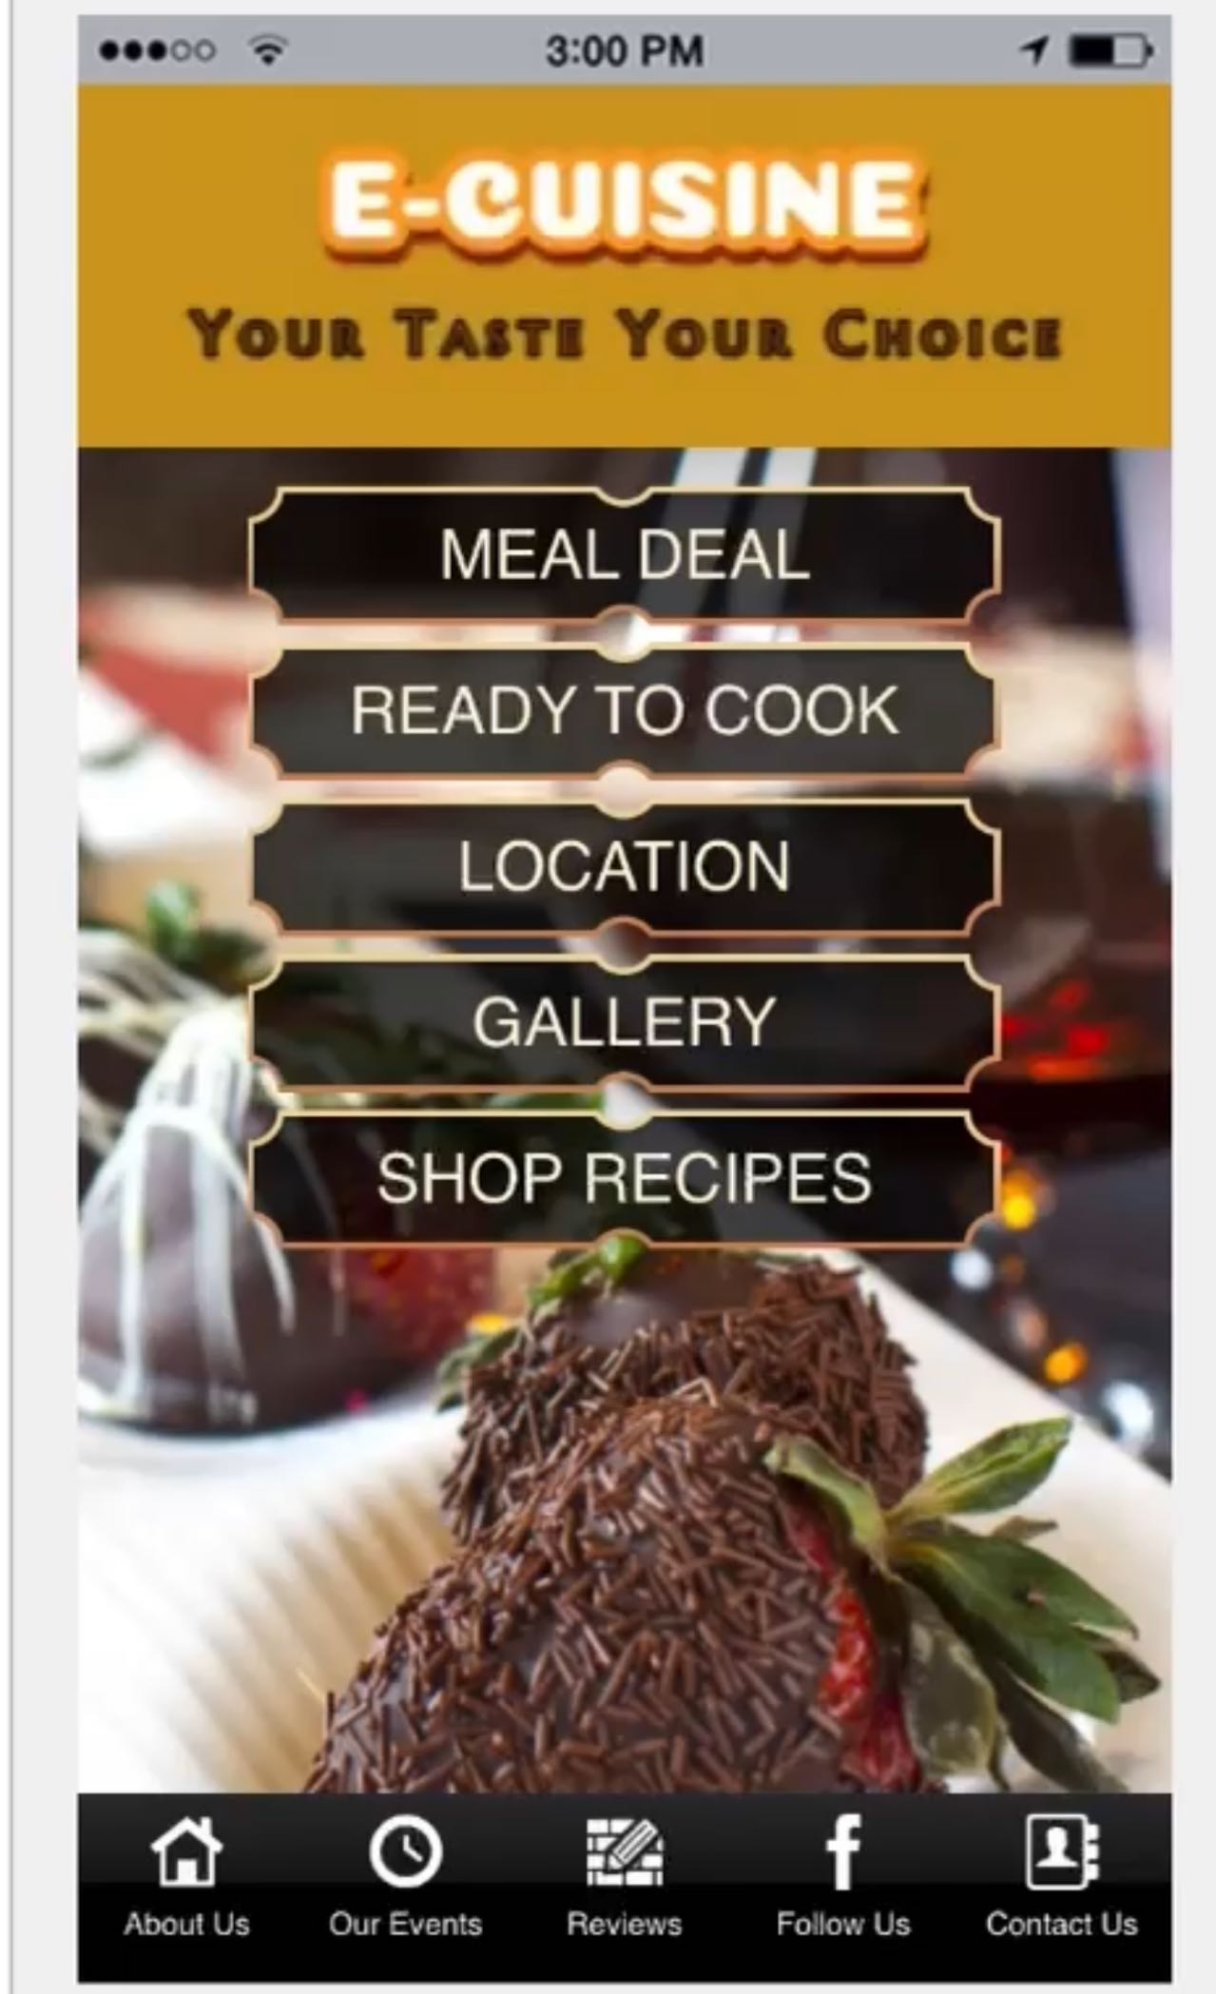
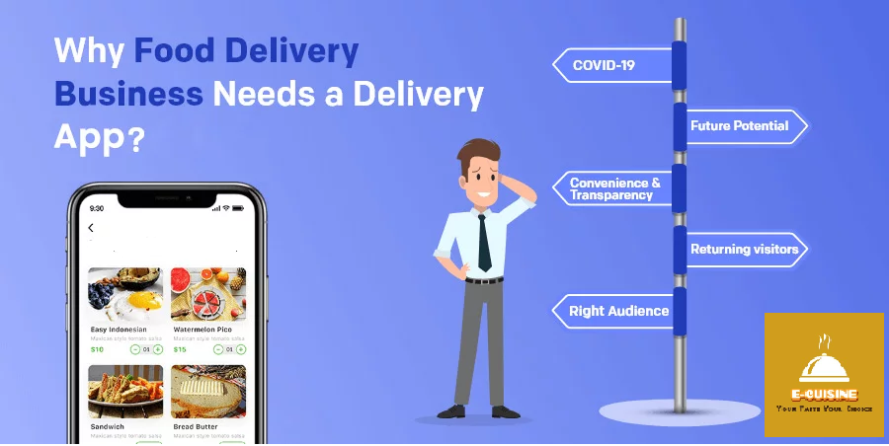
Why food delivery app?
This is our app
-It is the most convenient option available.
-You can order food for any occasion, like; children's birthdays, student parties, company celebrations, weddings and even the daily food.
-It helps people to save time, energy and fuel and they can order their favourite
meal at any point of time.
-Being too tired to cook and not wanting to cook or go out.
(Renner, J. 2020).

Slide 7
Situation Analysis
Microenvironment
Macro Environment
Political | Might be affected by changing policies in transitioning governments. Following lifestyle diseases & ongoing health crisis. Might demand more supplier compliance. (Government food strategy. GOV.UK. 2022)
Economical | Due to inflation prices might go higher than expected.
Social | Constantly changing customer needs & preferences. Tastes towards healthy and organic food. Ethical & religious needs to be met.
Technological | Smart phone development Customer subscriptions Customer feedback
Environmental | Providing perishable food with potential health dangers. To preserve the environment and reduce carbon emissions. The use of recyclable packaging boxes.
Legal | Complying regulatory issues
Customer | 60% of them are busy women. 25% of them are professionals 15% of them are students(Blumtritt, 2022)
Competitor | Hello fresh, Gusto, Blue Apron, ODD Box
Hello Fresh
GUSTO
ODD BOX
Blue Apron
Green Chef
Sun Basket

Slide 8
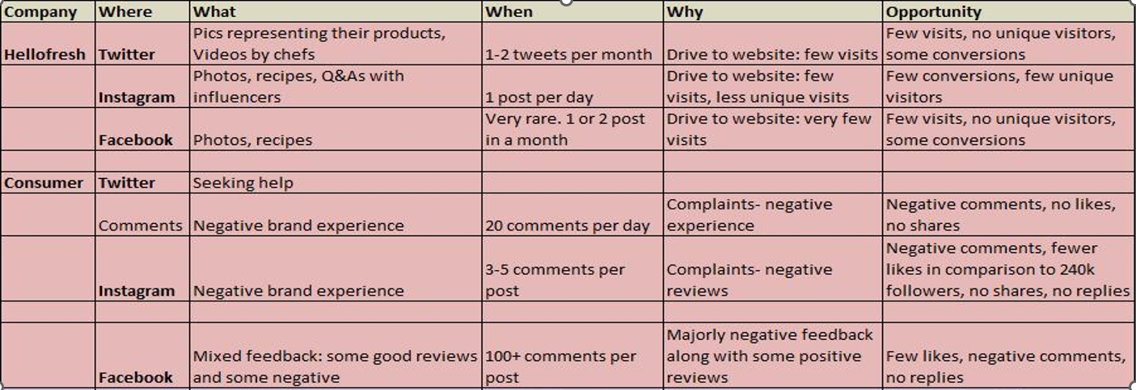
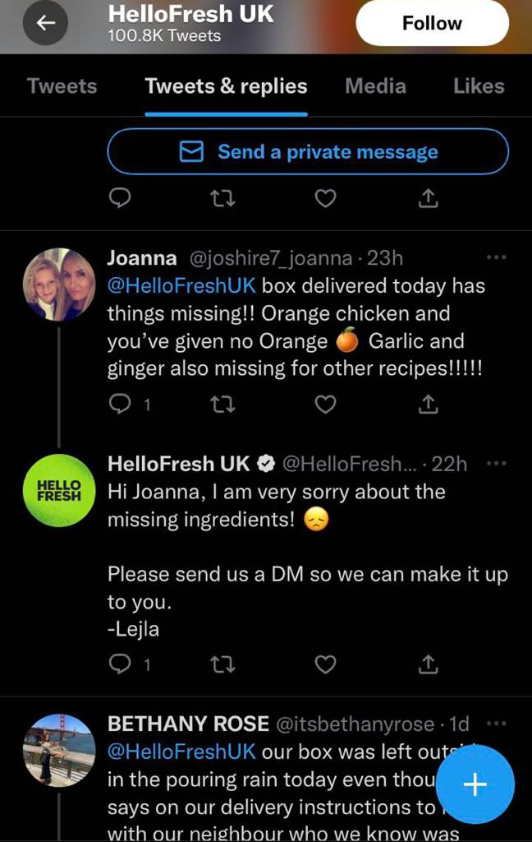
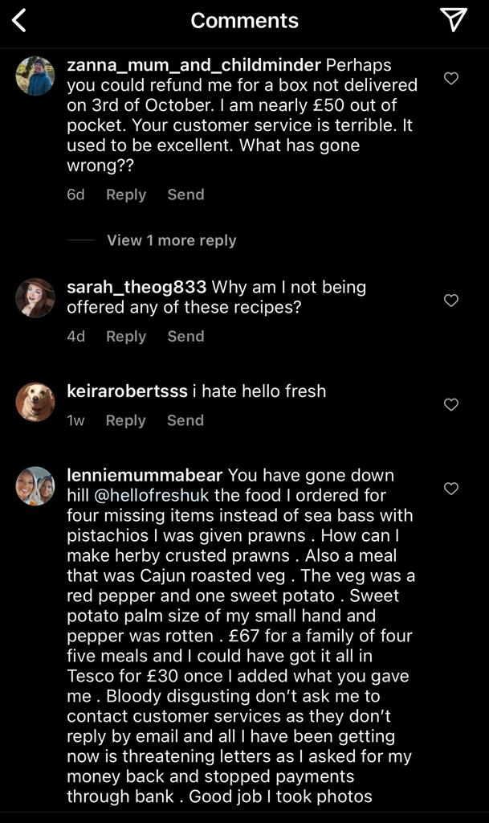
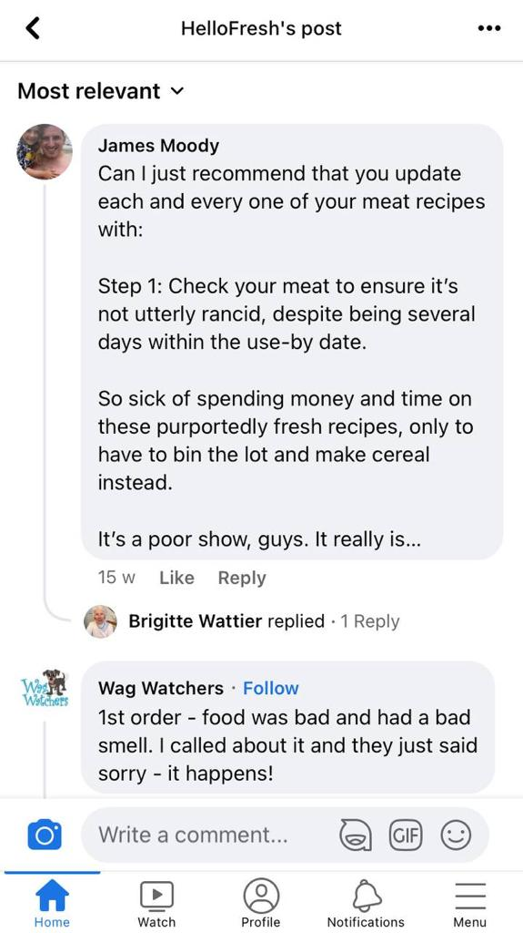
Social Media Audit (Part-1)
(SimilarWeb Identity, n.d.)
(Instagram, 2022)
(Facebook, 2022)
(Twitter, 2022)

Slide 9
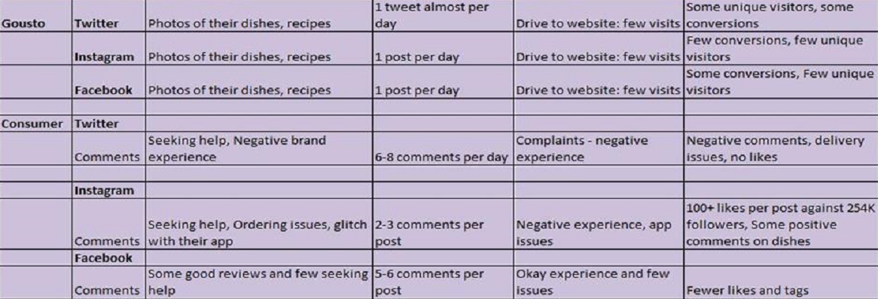
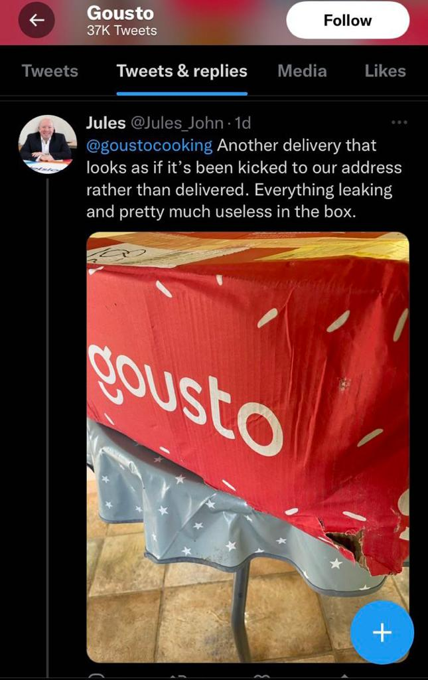
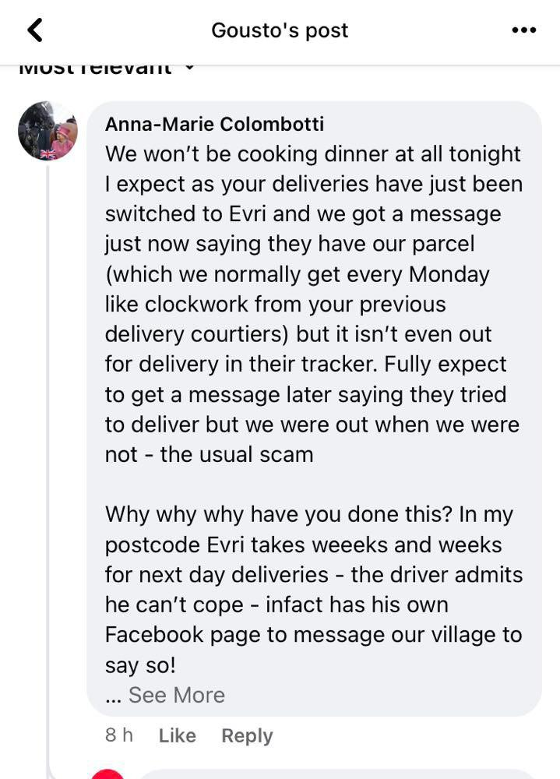
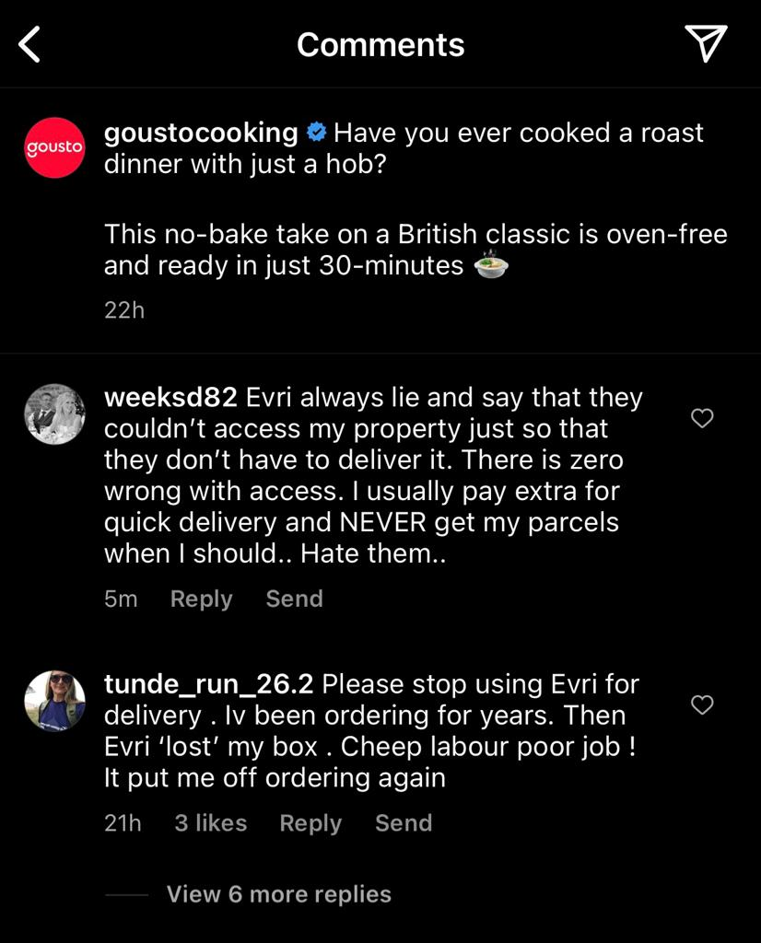
(SimilarWeb Identity, n.d.)
(Twitter, 2022)
(Instagram, 2022)
(Facebook, 2022)

Slide 10
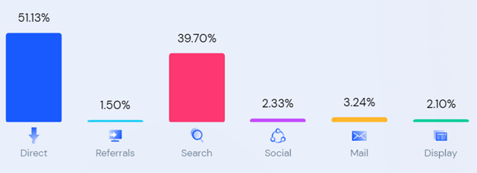
Social Media Audit (Part-2)
 | Hello Fresh | Gusto | Odd Box
Monthly traffic volume | 554K | 526K | 451K
Bounce Rate |  |  | 33.64%
URL Link | User friendly & Easily readable | User friendly & Easily readable | User friendly & Easily readable
Usability | D. Need to reduce user bounce back. | C+ | B
Page Speed (page content) | 6.0 Sec | 2.8 Sec | 7 Sec
Social Result | A+ | F ( Social need improvement)
Facebook | Connected | Connected | Connected
Instagram follower | 241K | 254K | 117K
Twitter Follower | 40,030 | Connected | Connected
YouTube follower | 4,580 | Connected | Connected
YouTube view count | 9,77,338 | Not connected
Amount of Content (word count) | 538 | 563 | 696
Keyword Consistency | Medium | Low | Medium
On page SEO | A- | C+ | B
Overall Page Performance | A- | C- | B
SEO score | 64% | 56% | 91%
Marketing Channels
Hello
Fresh
Gusto
Odd Box
Social Media Audit
Hello
Fresh
Gusto
Odd Box
Source : seometer.com
Source : seometer.com

Slide 11
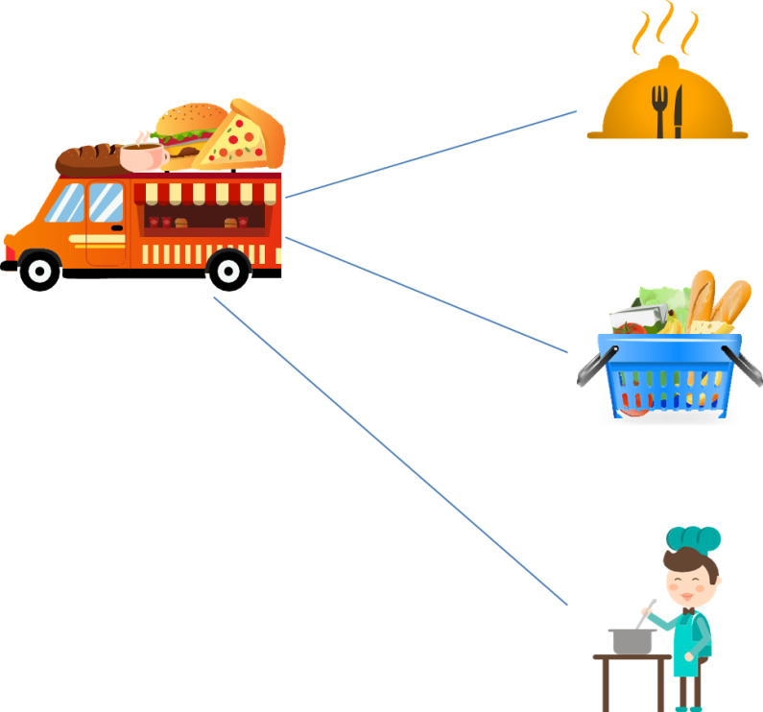
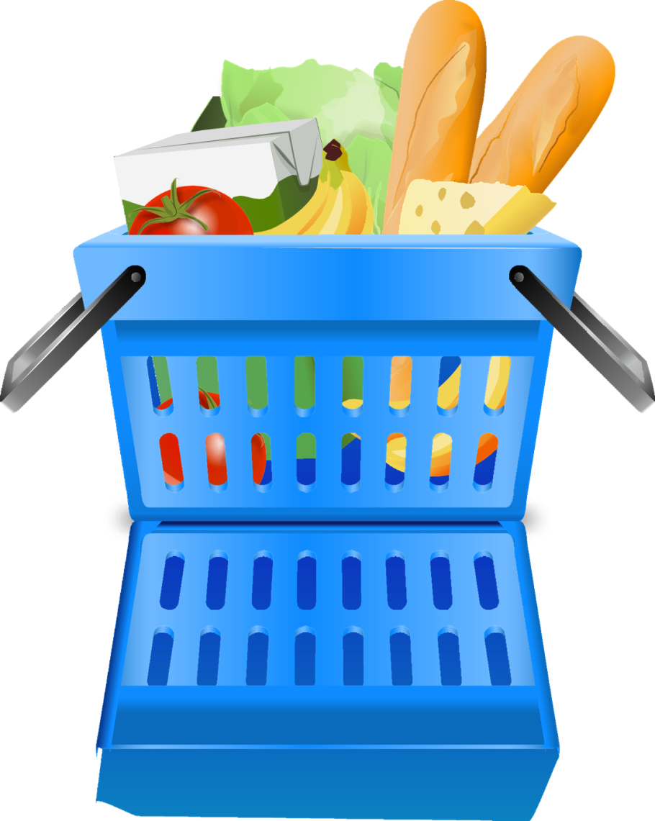
Type 1-Delivery of meals,
cooked meals
Type 3 - Combination of Ingredients And Recipe
Type 2- Grocery Delivery
-It can be household essentials, supply from the own warehouse. (Dillahunt et al., 2019)
-It can provide really quick delivery. (Tandon et al., 2021)
-It offers variety of loyalty programs and seasonal and festive discounts. (Bichler et al., 2002)
-Its an innovative approach to gain popularity
-User can make fresh meals and serve them
-With this app, users are delivered with all the required ingredients with the exact quantity.
-App provides the step-by-step instructions in pictures of how to prepare the selected dish.
-Within this type, We cook and sell your own dishes.
-Our food delivery app offers a limited range of choice.
-Services are deliver much faster and at a lower price.
-Till some particular bill value, we offer free delivery option
3 Types of Food Delivery Service

Slide 12
Brand Identity Honeycomb
Less Time On Maintenance(Silva et al., 2020)
Reduced The Number of tools
Product Development Perspective : Reduce Number of tools
From Platform Perspective : Got Rid Of Several Infrastructure
Our Tagline : Your Taste, Your Choice. (Wyshak, 2014)
BRAND | CORE PRODUCT | EXTENDED PRODUCT
E-CUISINE | Food Drinks Recipes Ingredients | Delivery Customer Reviews Community Events

Slide 13
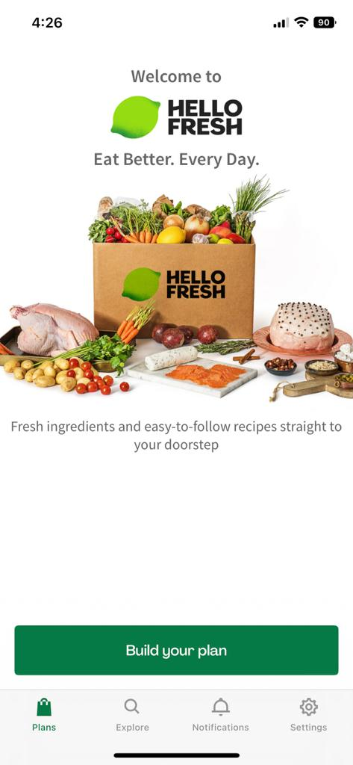
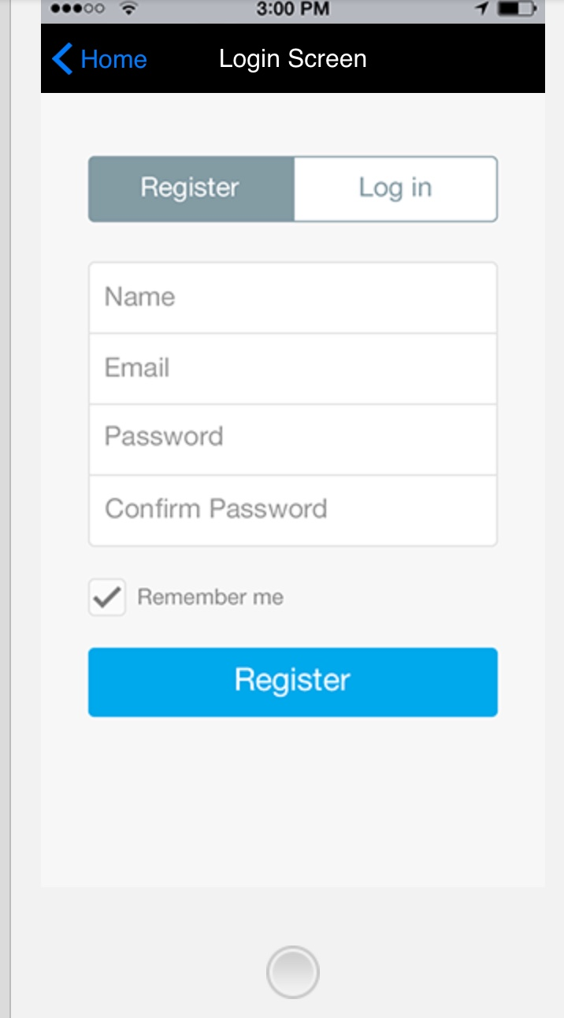
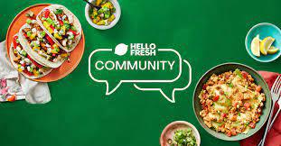
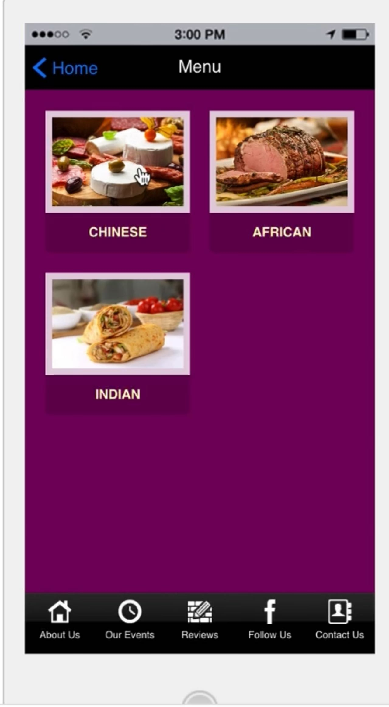
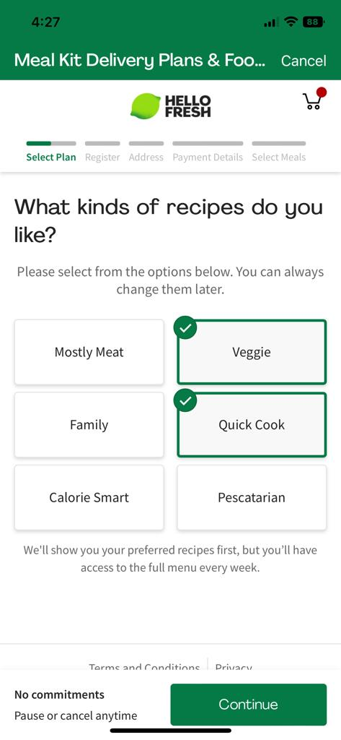
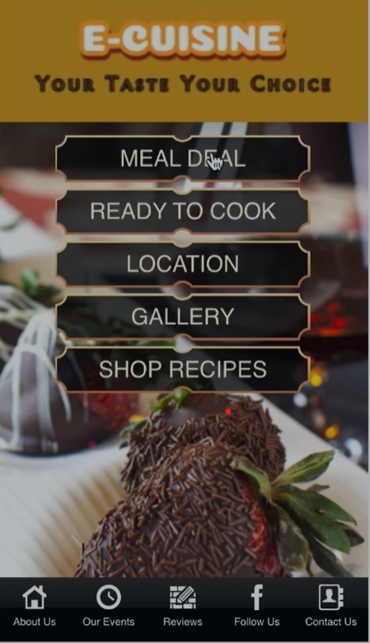
Customer Motivation Model To Define OVP
(YOUR TASTE YOUR CHOICE)
Convenience
Community
Customization
Creative App
Focusing on specific communities
Preference To Our Customer’s Choices
Creating Value Addition
Engaging With Customers
User Friendly
Easy Signup
(2f. Six C’s of Motivation, 2016)

Slide 14
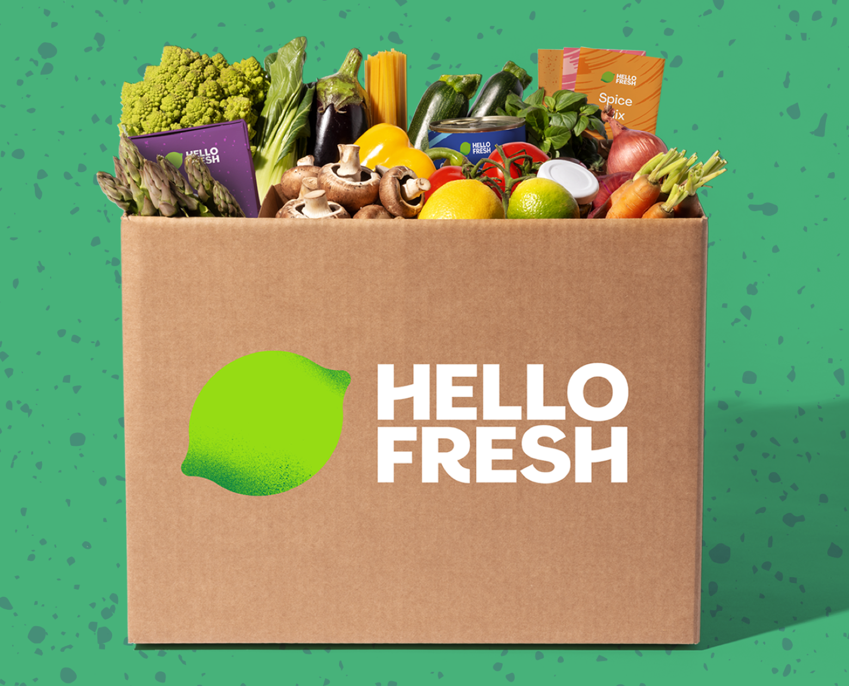
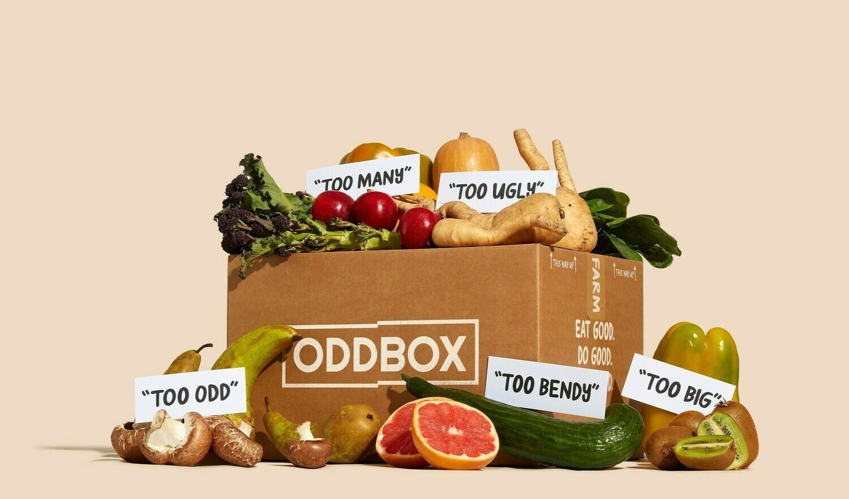
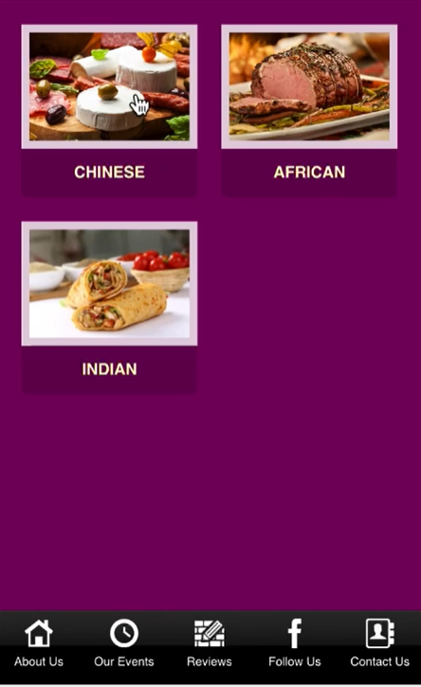
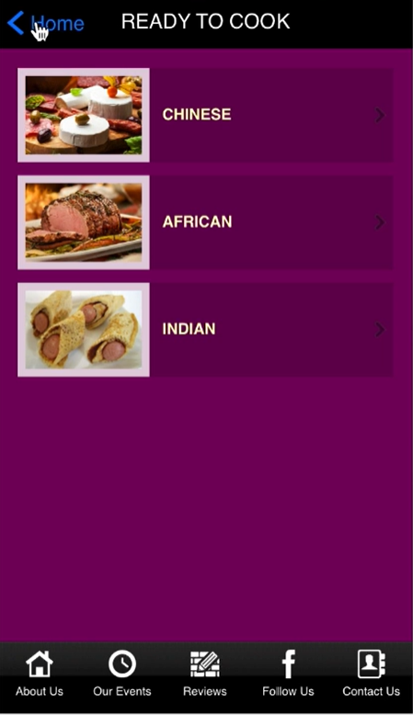
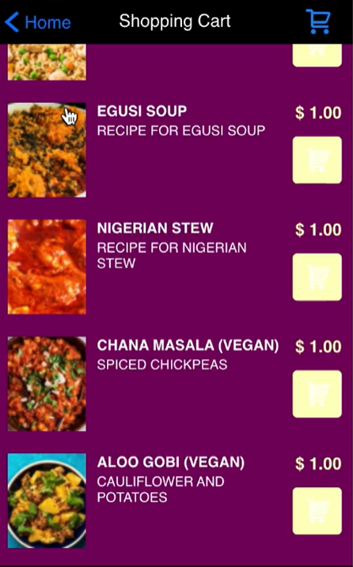
Red Ocean strategy
-Compete in Existing Market Space
-Beat The Competition
-Exploit Existing Demand
-Make The Value Cost Trade-Off
-Strategic Choice of Differentiation Or Low-Cost (Kim & Mauborgne, 2015)

Slide 15
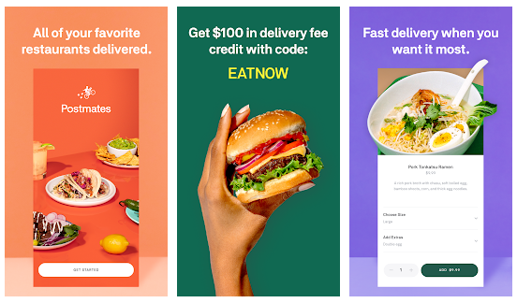
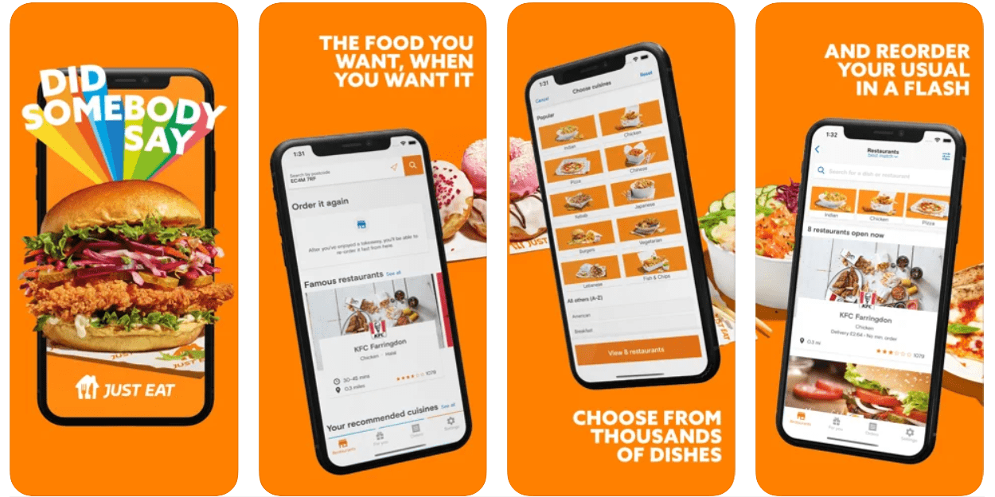
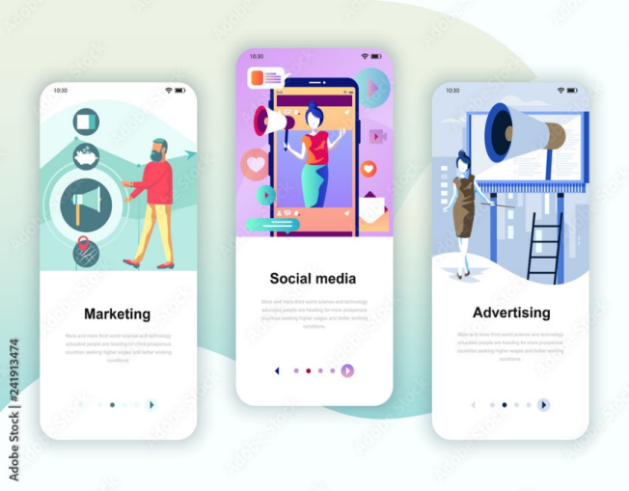
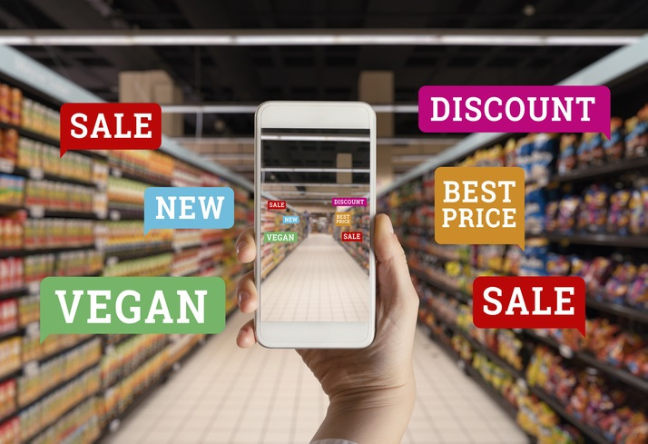
Race Model
REACH- Our goal will be to reach around 1000 subscribers in a month.
ACT- We will focus on customer’s likes and dislikes and will acknowledge their feedbacks.
CONVERT- We will start generating profits and advertise online & offline.Ex: Mukbang, Paid Ads, Banners, Ads in papers.
ENGAGE- Our aim will be to build long term relationship with our customers and encourage repeat business through rewards.
(Shout, 2021)

Slide 16
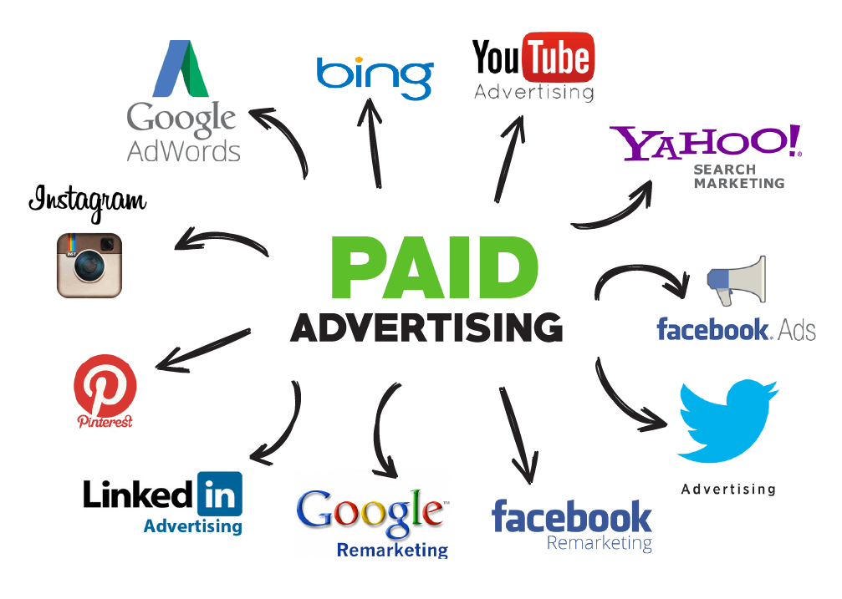
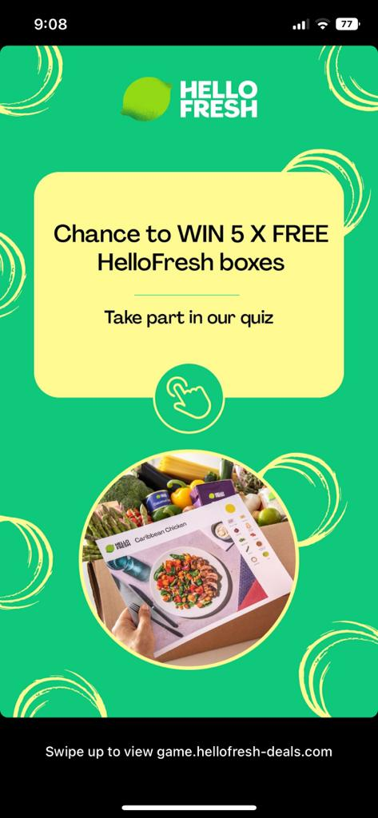
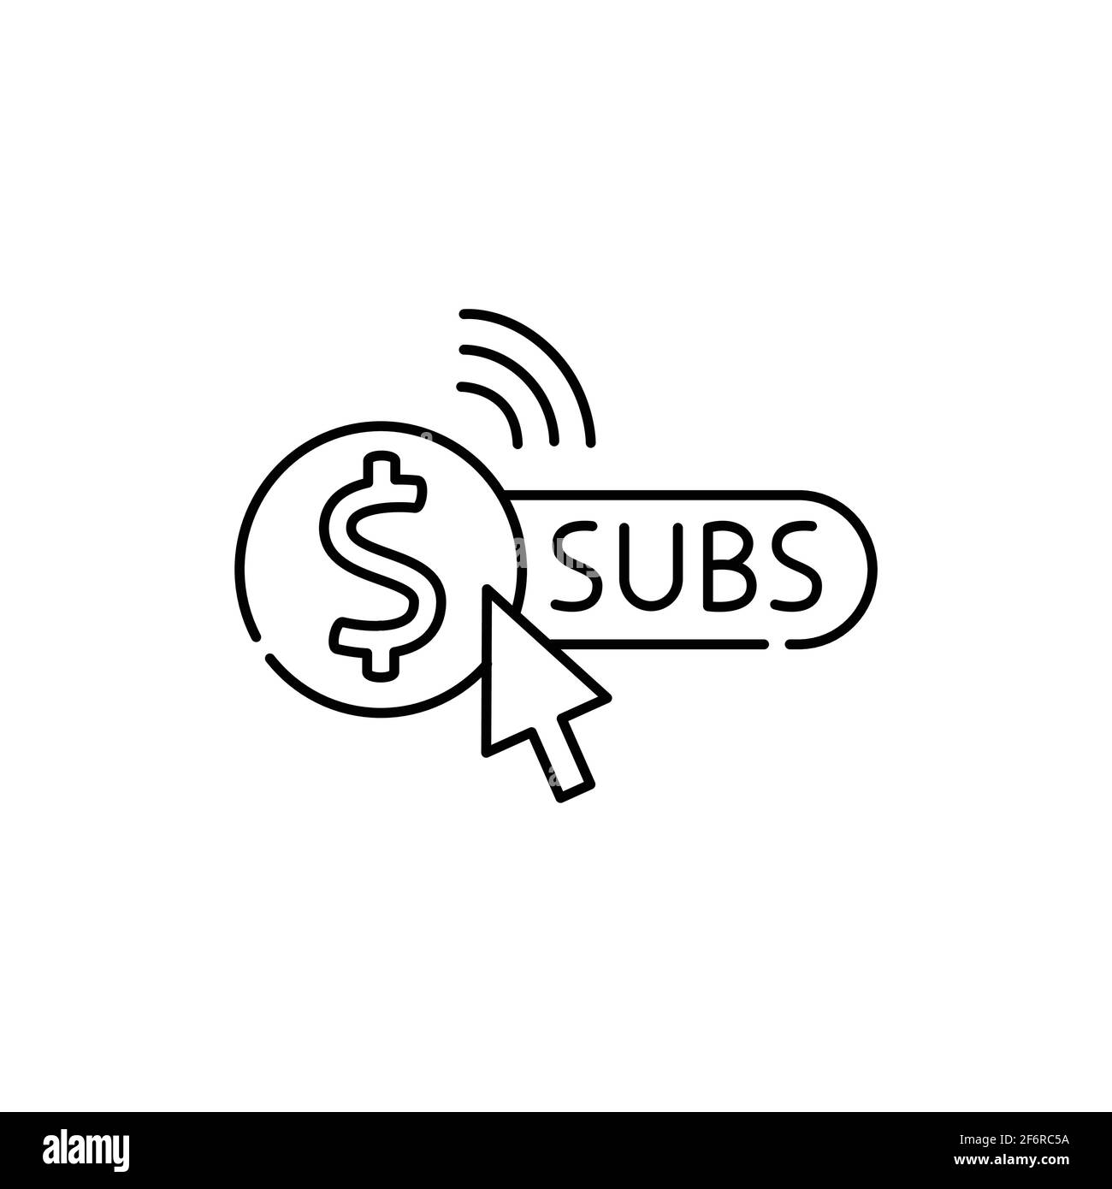
Monetization
DELIVERY CHARGES
PURCHASE FROM WHOLESALER
SELL AT RETAIL PRICE
PAID Ads
SUBSCRIPTIONS (10 Ways to Effectively Monetize Your Mobile App, 2016)
VOUCHERS
REFERRELS
LOYALTY POINTS ON PURCHASE
FREE DRINK ON BIRTHDAYS
MUKBANG (Schaefer, 2019)
(10 Ways to Effectively Monetize Your Mobile App, 2016)

Slide 17
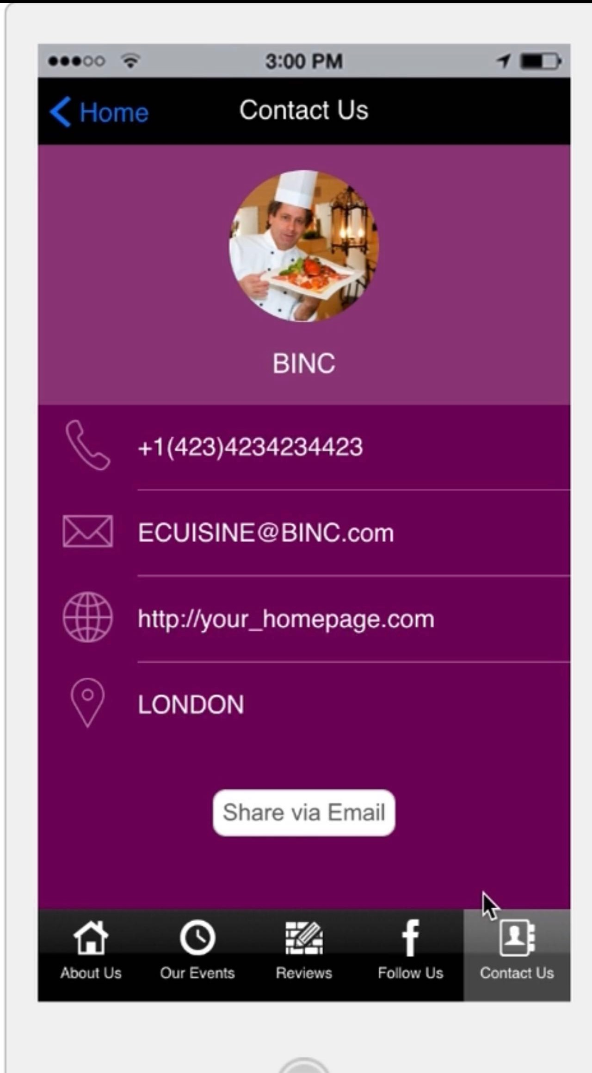
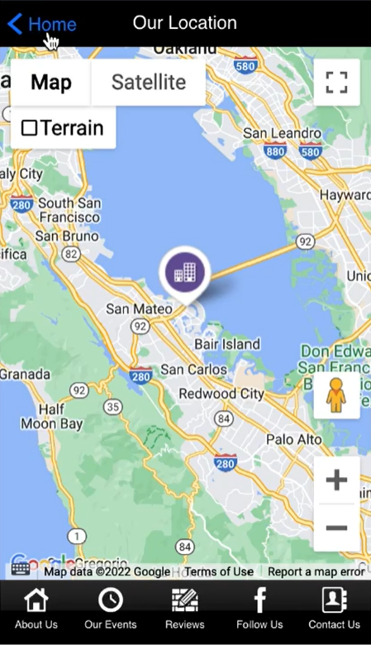
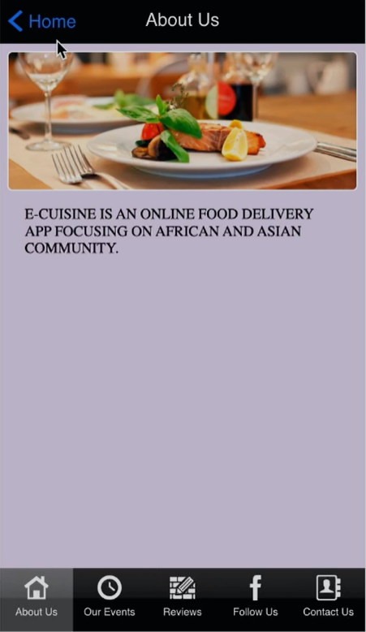
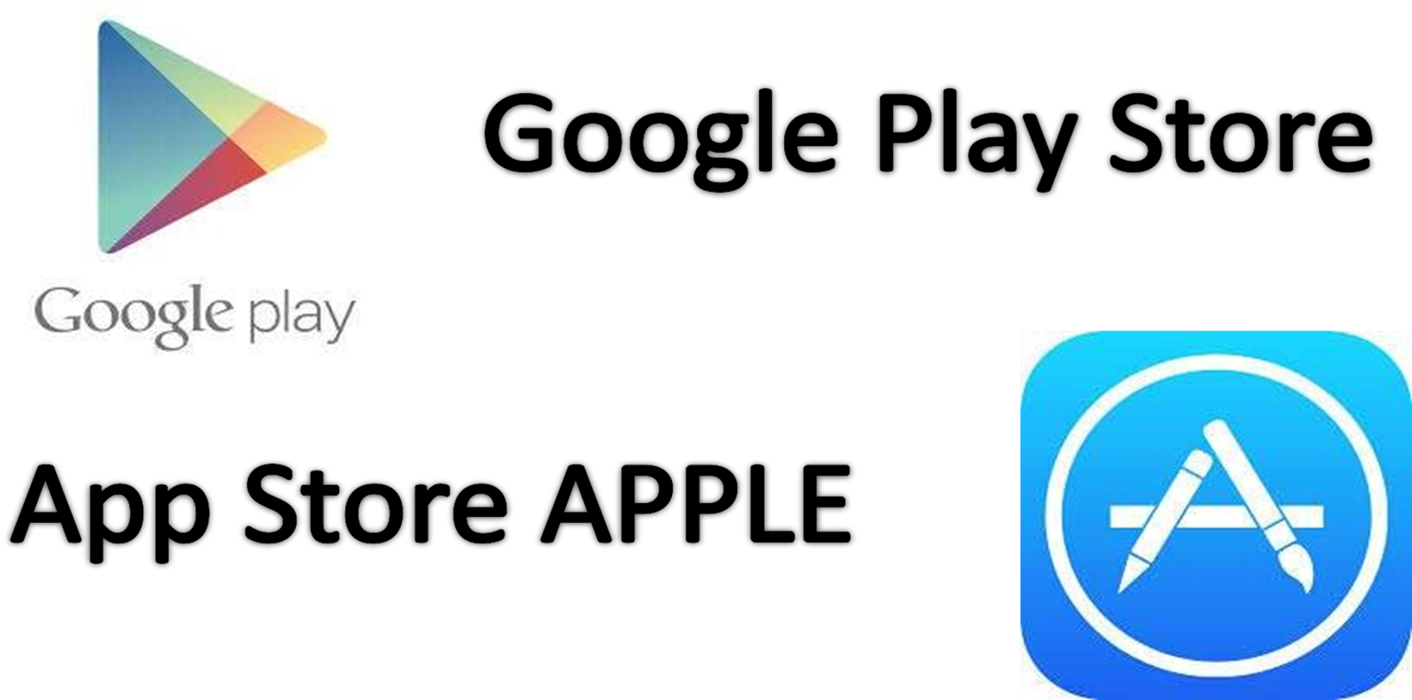
Application (User Interface)
Features of E-Cuisine
Catalogue /Menu
Online ordering
Online payments
Order tracking
Scheduled delivery
Push notifications
Loyalty programs
Customization
Geolocation

Slide 18
Opportunities & Challenges After Pandemic
Challenges | Opportunities
Unstable Pricing Model | Multiple Delivery Options (Online food delivery challenges and their potential solutions amid COVID-19,2020)
Unpredictable Food Quality | Awareness Notifications
Managing Logistics (Ganguly & Bhadale,n.d) | Cashless Payment Methods
Building A Stable Customer Base | Use product badging to help users make informed purchase decisions
Partnering With The Right Experts In The Market(Ganguly & Bhadale,n.d) | Make customers aware of the changing delivery timings & policies via push notifications
The Threat of Bigger Player | Encourage customers to share your food delivery portal’s content on social media platforms
Identifying The Most Suitable Marketing Strategy | Targeting Niche
To Cope With Customer Expectations | Focusing On Ethical & Religious Issues
Wavering Customers Loyalty | Engaging Influencer Marketing
Server Capabilities | Hospitality Marketing
Upholding Safety Standard
Changing Order Preferences

Slide 19
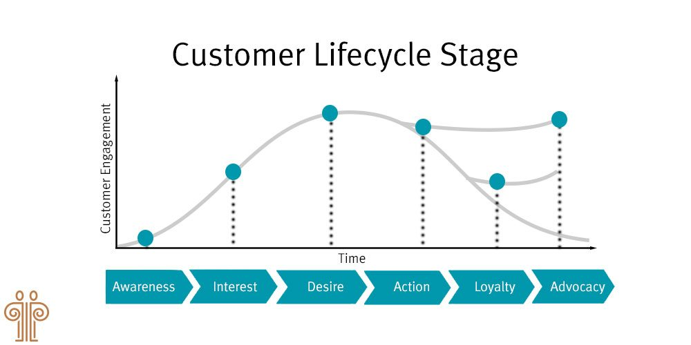
Business Development & Projection
2nd Fiscal Year
2,00,000+ Users
4
1st Fiscal year
1,00,000+ Users
3
1000+
Premium Users
2
5000+
Freemium Registered Users
1
2
3
4
1
App Launch

Slide 20
References
-Shout. (2021, July 13). The RACE Model: Improving your Digital Marketing Strategy. https://shout.com/digital-marketing/race-model-for-digital-marketing
-Senra, I. (2021, November 24). What is Model Race - Definition, meaning and examples. Arimetrics. https://www.arimetrics.com/en/digital-glossary/race-model
-2f. Six C’s of Motivation. (2016, November 29). Learn-U. https://learn-u.com/lesson/2f-six-cs-of-motivation/
-Blumtritt, C. (2022, January 21). Number of users in the online food delivery market in the United Kingdom 2024.Statista.Retrieved October 29,2022,from https://www.statista.com/forecasts/891085/online-food-delivery-users-by-segment-in-the-united-kingdom
-Government food strategy. GOV.UK. (n.d.). Retrieved October 25, 2022, from https://www.gov.uk/government/publications/government-food-strategy/government-food-strategy
-Hellofresh.com website traffic, ranking, analytics [September 2022]. Semrush. (n.d.). Retrieved October 29, 2022, from https://www.semrush.com/website/hellofresh.com/overview/
-Office for National Statistics. (2020, August 7). Population of england and Wales. GOV.UK Ethnicity facts and figures. Retrieved October 29, 2022, from https://www.ethnicity-facts-figures.service.gov.uk/uk-population-by-ethnicity/national-and-regional-populations/population-of-england-and-wales/latest#download-the-data
-Kaplan, A. M., & Haenlein, M. (2010). Users of the world,unite!the Challenges and Opportunities of Social Media.Business Horizons, 53(1), 59-68. https://doi.org/10.1016/j.bushor.2009.09.
-Labrecque, L. I. (2014). Fostering Consumer-Brand Relationships in Social Media Environments: the Role of Parasocial Interaction. Journal of Interactive Marketing,28(2),134-148. https://doi.org/10.1016/j.intmar.2013.12.003
-Machin-Mastromatteo, J. D., & Tarango, J. (2019). Participatory Action Research.The International Encyclopedia of Media Literacy, 1-8.https://doi.org/10.1002/9781118978238.ieml0178
-Mize, S. (2007, February 22). Social Network Benefits.EzineArticles; EzineArticles. http://ezinearticles.com/?Social-Network-Benefits&id=464645
-Helms, R. W., Booij, E., & Spruit, M. R. (2012).REACHING OUT:INVOLVING USERS IN INNOVATION TASKS THROUGH SOCIAL MEDIA. ECIS 2012 Proceedings https://aisel.aisnet.org/ecis2012/193

Slide 21
-handrasekhar, N., Gupta, S., & Nanda, N. (2019). Food Delivery Services and Customer Preference: A Comparative Analysis. Journal of Foodservice Business Research, 22(4),375-386. https://doi.org/10.1080/15378020.2019.1626208
-https://www.fatbit.com/fab/online-food-delivery-business-challenges-solutions-amid-covid-19/
-https://ijariie.com/AdminUploadPdf/ONLINE_FOOD_DELIVERY_AAPS_%E2%80%93_STUDYING_PANDEMIC_CHALLENGES_AND_SOLUTIONS_ijariie16650.pdf
-Food Delivery Services Market: Global Industry Analysis and Forecast (2022-2029). (n.d.). Maximise Market Research. Retrieved October 28, 2022, from https://www.maximizemarketresearch.com/market-report/global-food-delivery-services-market/112152/#:~:text=Food%20Delivery%20Services%20Market%20size%20was%20valued%20at
-Food Delivery App Revenue and Usage Statistics (2022). (2020, October 29). Business of Apps. https://www.businessofapps.com/data/food-delivery-app-market/#:~:text=Food%20delivery%20revenue%20by%20country%20China%20is%20ahead
-Briggs, F. (n.d.). Quick service food takes off in the UK, new NPD Group data reveals. Retail Times. Retrieved October 28, 2022, from http://www.retailtimes.co.uk/quick-service-food-takes-off-in-the-uk-new-npd-group-data-reveals/
-How Many Takeaways Do You Have A Week? (n.d.). Charlton Life. Retrieved October 28, 2022, from https://charltonlife.vanillacommunity.com/discussion/87628/how-many-takeaways-do-you-have-a-week (2016).
-Nationalarchives.gov.uk.https://webarchive.nationalarchives.gov.uk/ukgwa/20160105160709/http://www.ons.gov.uk/ons/resources/figure2_tcm77-290553.png
-Roh, M., & Park, K. (2019). Adoption of 020 food delivery services in South Korea: The moderating role of moral obligation in meal preparation. International Journal of Information Management, 47, 262-273.https://doi.org/10.1016/j.ijinfomgt.2018.09.017
-Cairns, S. (1996). Delivering alternatives: Successes and failures of home delivery services for food shopping. Transport Policy,3(4),155-176. https://doi.org/10.1016/S0967-070X(96)00021-2

Slide 22
THANK YOU

