Slide 1
CS332/532 Lab5

Slide 2
Assignment
Hw 2 (Due Date: 2 Oct) . Have Fun, Start Early
Lab5

Slide 3
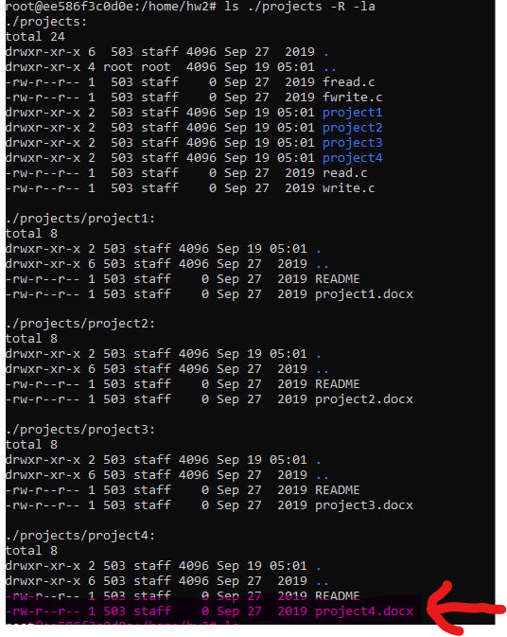
Hw2
Implement a program similar to “Find” command

Slide 4
Hw2
NOT asking you to use command line argument(e.g. ls, find) in your program

Slide 5
Hw2(contd.)
Support command-line options: (Undergrad)
-S : list file in hierarchy , including size, permissions and last access time
-s <file size in byte>: list file with file size <= value specified
-f <string pattern> <depth>: list file satisfy following condition
File name contains the substring in the string pattern option
Depth of file relative to start directory <= depth , ( starting directory depth == 0)
Support a combination of flag. E.g. -S -s 1024 –f jpg

Slide 6
Hw2(contd.)
Support command-line options: (Grad)
All flag command from previous slide AND;
-t f : list regular file
-t d : list directory only

Slide 7
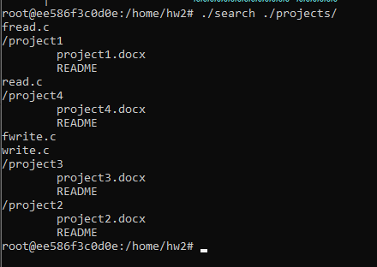
Hw2(contd.)
Without
any arguments

Slide 8
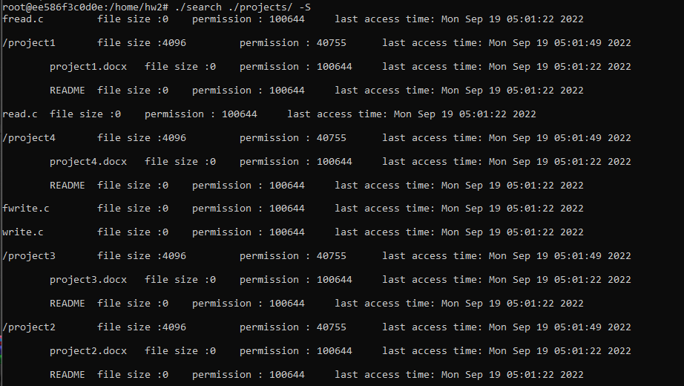
Hw2(contd.)
S : list file in hierarchy , including size, permissions and last access time

Slide 9
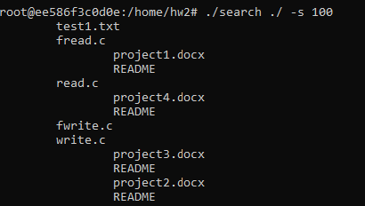
Hw2(contd.)
-s <file size in byte>: list file with file size <= value specified

Slide 10
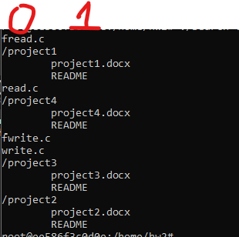
Hw2(contd.)
-f <string pattern> <depth>: list file satisfy following condition
File name contains the substring in the string pattern option
Depth of file relative to start directory <= depth , ( starting directory depth == 0)

Slide 11
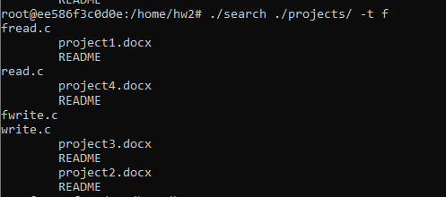
Hw2(contd.)
-t f : list regular file

Slide 12
Hw2(contd.)
-t d : list directory only

Slide 13
Hw2(contd.)
Combining different arguments
e.g. ./search ./ -S -s 10000 -t f -f “readdir 2”

Slide 14
Hint
Design the structure and logic of program then start coding
When in doubt , please check man page
Getopt():https://man7.org/linux/man-pages/man3/getopt.3.html
(Read the description and example)
lstat():https://man7.org/linux/man-pages/man2/lstat.2.html

Slide 15
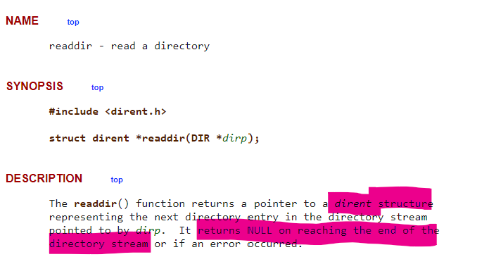
Lab 5
opendir(): open folder
readdir():
Reference :https://man7.org/linux/man-pages/man3/readdir.3.html

Slide 16
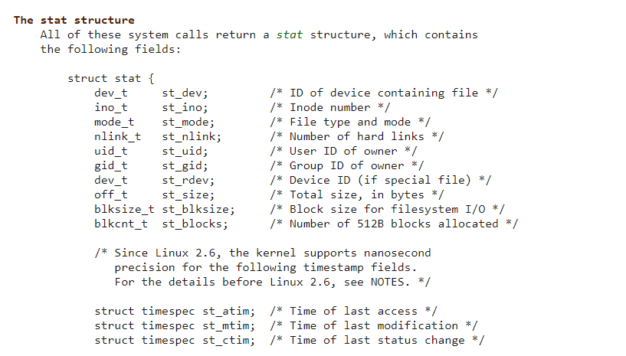
Lab 5(contd.)
lstat: return information about a file, in the buffer pointed to by statbuf
Reference:https://man7.org/linux/man-pages/man2/lstat.2.html

Slide 17
Lab 5 Assignment
Modify readdir.c or readdir_v2.c
Traverse the file hierarchy recursively and list all the sub directories and the files in these sub directories
Submit 1) .c file , 2) pdf version of source code , 3) README, 4) Independence submission form (missing ➔ penalty)

Slide 18
Good luck with midterm

Slide 19
Questions?

