Slide 1
Permissions
Gurdeep Kaur (8736862)
Ranjana (8730441)
This Photo by Unknown Author is licensed under CC BY-SA
This Photo by Unknown Author is licensed under CC BY-SA

Slide 2
aGENDA
How to manage Permissions
Default Permission Levels
User Permissions

Slide 3
introduction
In an organization or an enterprise, there are some sites contain data that should not be available to all users.
For example: Econestoga account should be available only to students and professors whereas homepage of Conestoga college can be accessible by any user.
Permissions control access to sites and site contents
Manage permissions by using SharePoint groups, which control membership
Notes:
Personal Protective Equipment (PPE) is used to control the hazard if there is no other effective technique that can be used to control it.This should be applied at last to protect employees from hazard. The PPE is used depending on the type of work an employee do.

Slide 4
Default permission Levels
View Only
Enables users to view application pages.
Limited Access
Enables users to access shared resources and a specific asset.
Read
Enables users to view pages and list items, and to download documents.
The View Only permission level is used for the Excel Services Viewers group.
Enable users to access a specific list, document library, folder, list item, or document, without enabling them to access the whole site.
Notes:
Responsivities of employers
Employer has the responsibility to assess workplace to identify hazards and to provide appropriate PPE for work.
Employer is responsible to determine when PPE is needed
Employer must provide Assistance to workers on how to use it appropriately.
Employer is obliged to give PPE training and instruction for proper use to workers

Slide 5
Default permission Levels
Contribute
Enables users to manage personal views, edit items and user information, delete versions in existing lists and document libraries,
Edit
Enables users to manage lists.
Design
Enables users to view, add, update, delete, approve, and customize items or pages in the website.
Add, remove, and update personal Web Parts.

Slide 6
Default permission Levels
Full Control
Enables users to have full control of the website.

Slide 7
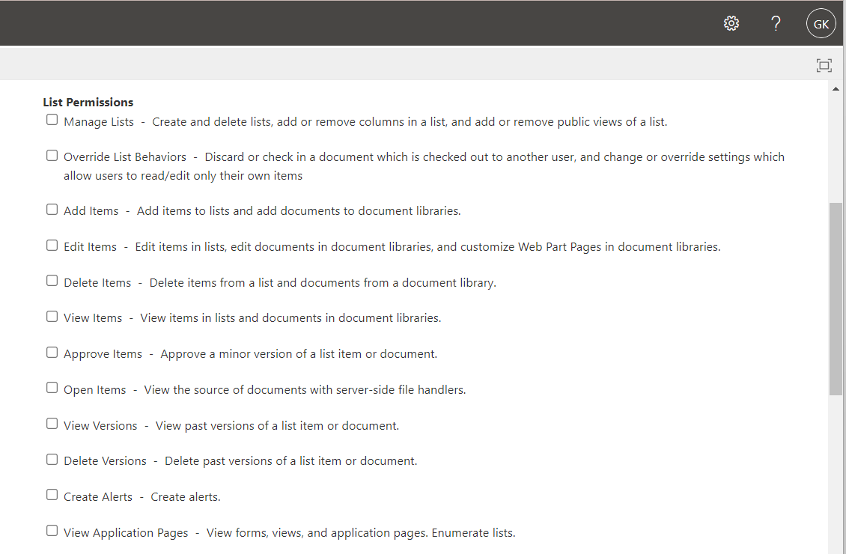
USER permissions

Slide 8
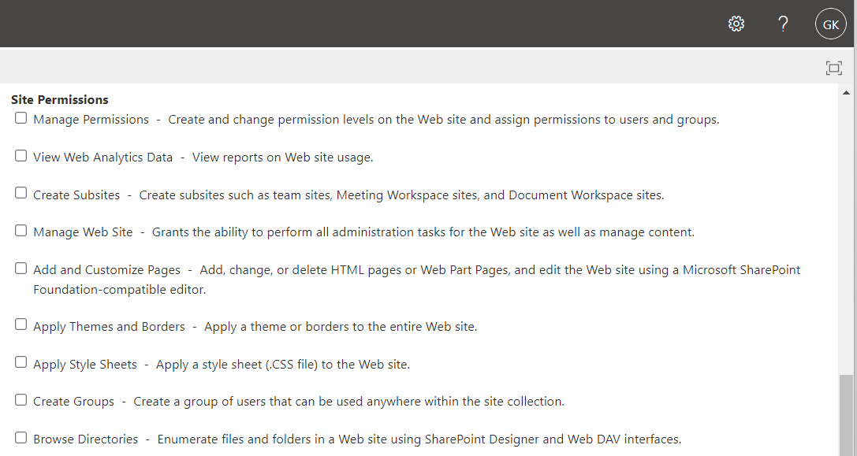
USER permissions

Slide 9
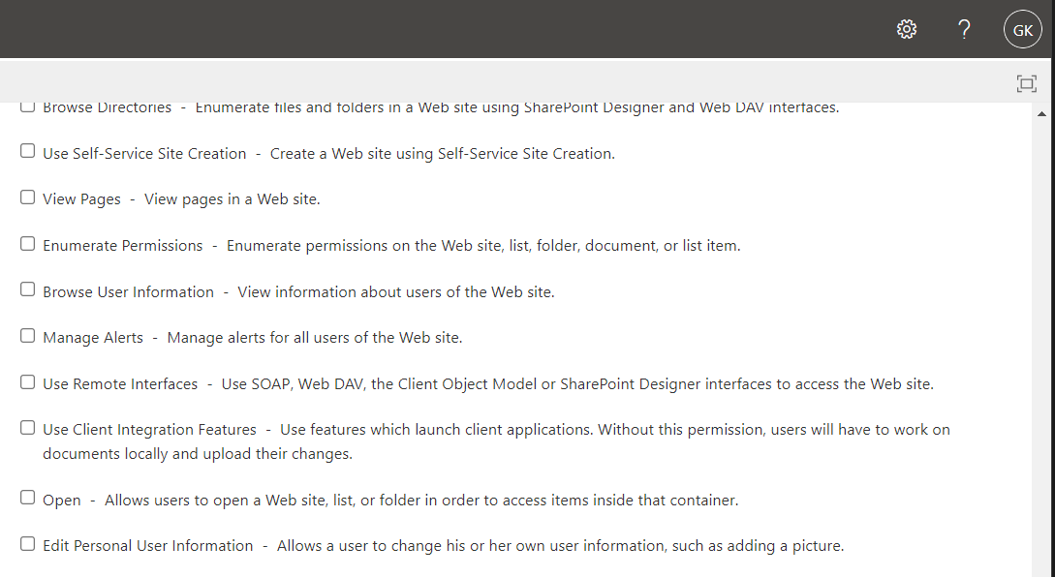
USER permissions

Slide 10
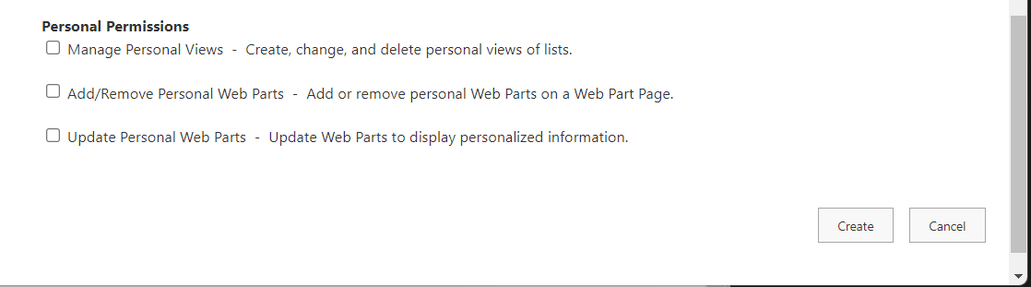
USER permissions

Slide 11
SUMMARY
Today, we have learned about how to manage permissions, default permission levels and user permissions
Notes:
Joint health and safety committee role
JHSC gives the recommendations for work in order to protect workers from some accidents, injuries and/or illness that might occur at workplace.
Authority to take action and liability for noncompliance stays with employers or management team.

Slide 12
References
User permissions and permission levels in SharePoint Server. (2022, February 02).
Retrieved from https://docs.microsoft.com/:
https://docs.microsoft.com/en-us/sharepoint/sites/user-permissions-and-permission-levels

Slide 13
THANK YOU

