Slide 1
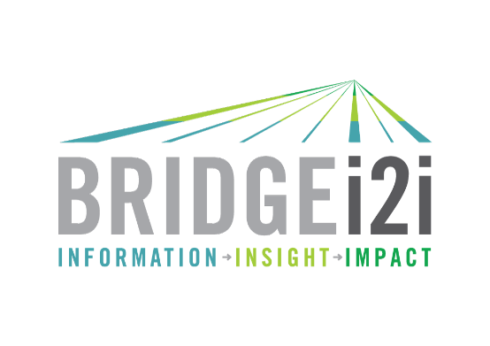
E Account intel
Citibank 8th Jan 2021

Slide 2
Summary

Slide 3
Intel summary
Citigroup overview
Citi is the 3rd largest bank in the US and the 13th largest bank in the world.
City Bank was founded in 1812 and was later renamed as Citigroup in 1998 due to the merger of Citicorp and Travelers Group in 1998. The Travelers was subsequently spun off from the company in 2002.
Citigroup has three lines of businesses: 1) Global Consumer Banking (GCB), 2) Institutional Clients Group (ICG), and 3) Corporate / Others.
Citibank operates as the consumer division of Citigroup and overlooks the Global Consumer Banking.
GCB is segmented into three business units: 1) North America GCB, 2) Latin America GCB, and 3) Asia GCB. GCB has 2 revenue streams – cards and retail banking
Overall Group performance
In 2019, Citi delivered its most profitable year since 2006.
Not only was there a underlying revenue growth of 4% across Consumer and Institutional franchises, but also grew loans and deposits for 16 consecutive quarters.
The intel in this deck is based on the 2019 Annual Report and the company will be announcing its year end results on the 15th of January, 2021.
Global Consumer Banking performance
Revenue growth realized from all three regions; US, Mexico and Asia.
In the U.S., Citibank’s largest consumer market, the strategy of unifying Branded Cards and Retail Banking yielded a steady stream of new products and value propositions, from digital lending to flexible payments.
Strong revenue growth was realized in Branded Cards and $6 bn in US digital deposit sales – 5 times that of 2018.
At December 31, 2019, GCB had approximately $407 billion in assets and $291 billion in deposits.

Slide 4
Intel summary
Citigroup overview
Citi is the 3rd largest bank in the US and the 13th largest bank in the world.
City Bank was founded in 1812 and was later renamed as Citigroup in 1998 due to the merger of Citicorp and Travelers Group in 1998. The Travelers was subsequently spun off from the company in 2002.
Citigroup has three lines of businesses: 1) Global Consumer Banking (GCB), 2) Institutional Clients Group (ICG), and 3) Corporate / Others.
Citibank operates as the consumer division of Citigroup and overlooks the Global Consumer Banking.
GCB is segmented into three business units: 1) North America GCB, 2) Latin America GCB, and 3) Asia GCB. GCB has 2 revenue streams – cards and retail banking
Overall Group performance
In 2019, Citi delivered its most profitable year since 2006.
Not only was there a underlying revenue growth of 4% across Consumer and Institutional franchises, but also grew loans and deposits for 16 consecutive quarters.
The intel in this deck is based on the 2019 Annual Report and the company will be announcing its year end results on the 15th of January, 2021.
Global Consumer Banking performance
Revenue growth realized from all three regions; US, Mexico and Asia.
In the U.S., Citibank’s largest consumer market, the strategy of unifying Branded Cards and Retail Banking yielded a steady stream of new products and value propositions, from digital lending to flexible payments.
Strong revenue growth was realized in Branded Cards and $6 bn in US digital deposit sales – 5 times that of 2018.
At December 31, 2019, GCB had approximately $407 billion in assets and $291 billion in deposits.

Slide 5
Intel summary
Risk Management and Compliance program overhaul - ICG
In Oct 2020, Citigroup faced an $400 mn enforcement action since its Institutional Clients Group (ICG) division failed to address risk and compliance failures.
In a statement made by the bank, Citigroup pledged to spend $1 bn over several years to transform its risk and control environment. In light of this incident, Bradford Hu, Chief Risk Officer, decided to leave the company.
In 2013, The Federal Reserve had found deficiencies in Citigroup’s anti-money laundering compliance programme, and in 2015, deficiencies were identified in its compliance and control infrastructure related to its foreign exchange programme and designated market activities.
Setting up a new division – Strategy Advisory Solutions
In June 2020, Citigroup created a new unit to help its investment bankers to use big data to advise corporate finance clients.
Muir Paterson was named the head of this new division called Strategy Advisory Solutions and this new unit means that its financial strategy group, shareholder advisory and data science capabilities come together under one roof.

Slide 6
Intel summary
Adoption of Digital Capabilities
The bank’s CEO, Michael Corbat, frequently highlights the importance of technology and has even stated that Citi is not a traditional bank, but a technology firm with a banking license.
Big Data analytics has been an important factor in driving Citi’s growth through client acquisition and retention. Lot of efforts to create a 360 degree view.
Focused on digital customer interactions, digital marketing, moving people to self service digital channels
Digital products – moving away from plastic cards to digital cards.
Expected saving with the help of automation - Citibank claims itself as a Digital Bank and places a huge precedence over adoption of the latest digital capabilities. In Jan 2020, it was reported that Citi’s banking group expects to save $600 mn this year through various advances in automation.
Partnerships with Vendors
Citibank has partnered with several vendors, with a huge focus on Customer experience.
Some of the vendors with whom the company has partnered with are as follows: Analytics8, Amenity Analytics, TCS and Flybits.
Recently, it made a strategic investment in data management platform Solidatus and the bank will be implementing it at a pan enterprise level.
COVID-19 impact
In response to poor Q2 2020 results as Net Income dropped by 73% YoY, the bank had set aside about $8 bn for a potential surge in loan defaults
Q3 2020 was no different as Net Income dropped by 34% YoY, with strong performance in markets and investment banking being offset by lower card volumes and lower interest rates.

Slide 7
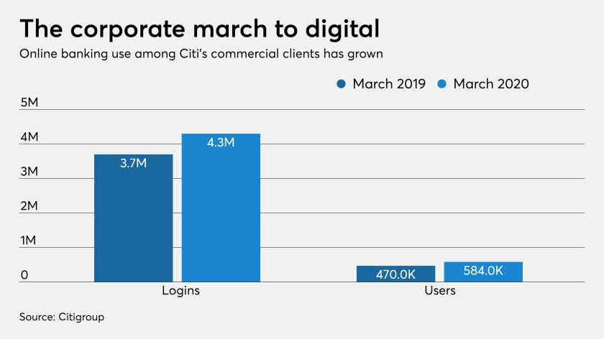
Intel summary
Increased digital penetration
On 5th June, Citi‘s Treasury and Trade Solutions (TTS) reported that its customers have increased their utilization of the firm’s digital banking technology, CitiDirect BE.
CitiDirect BE helps large organisations and SMEs to take in funds, pay suppliers, ensure sufficient cash flow and pay taxes and bills.
App and web users on the system increased to 584,000 this March from 470,000 in the same month last year, while the number of logins rose 18% to 4.3 million this March from 3.7 million in the same month last year.
Citi provides digital onboarding to corporate clients in 42 nations and foresees growing to 50 nations by the close of this year.
Very few banks offer digital account opening for corporate clients given the complexity. Citi has been proactively addressing security threats and increasing investments in customer service features such as live chats to make the onboarding process more convenient.
Citi says it addresses security threats proactively. The company uses machine-learning algorithms to spot unusual logins, transactions and system navigations (such as different typing cadences) that deviate from a client’s typical activity.
They've strongly gravitated toward digital onboarding. Clients opened more than 1,000 accounts online in March, up 300% from a year earlier, and the number was similar in April and May.

Slide 8
Details

Slide 9
Agenda
Business Overview
Operating segments
Global Consumer Banking (GCB) Business units
Partnerships
Analytics Initiatives
Impact of COVID-19 and Initiatives undertaken

Slide 10
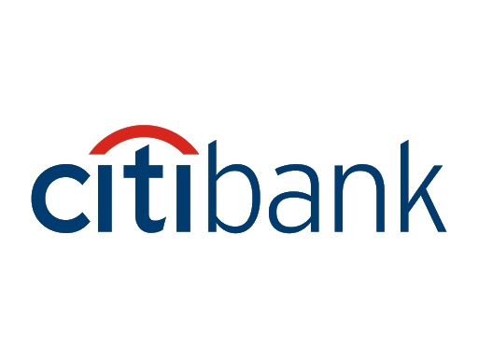
Business overview
Back
Citigroup is a multinational investment bank and financial services corporation that was formed by the merger of Citicorp and Travelers Group in 1998. The Travelers was subsequently spun off from the company in 2002.
Citibank is the consumer division of financial services multinational Citigroup.
For the purpose of management reporting, Citigroup operates in three segments: 1) Global Consumer Banking (GCB), 2) Institutional Clients Group (ICG), and 3) Corporate / Other
Global Consumer Banking (GCB) has two revenue streams: 1) Retail Banking, 2) Cards
Headquarters: New York City, USA
Founded: 1812
Employees: ~ 200,000 as of 31st December 2019 (2019 Annual Report)
Note: The financial metrics are based on the 2019 Annual Report. Citi will be announcing its year end results on the 15th of Jan, 2021.

Slide 11
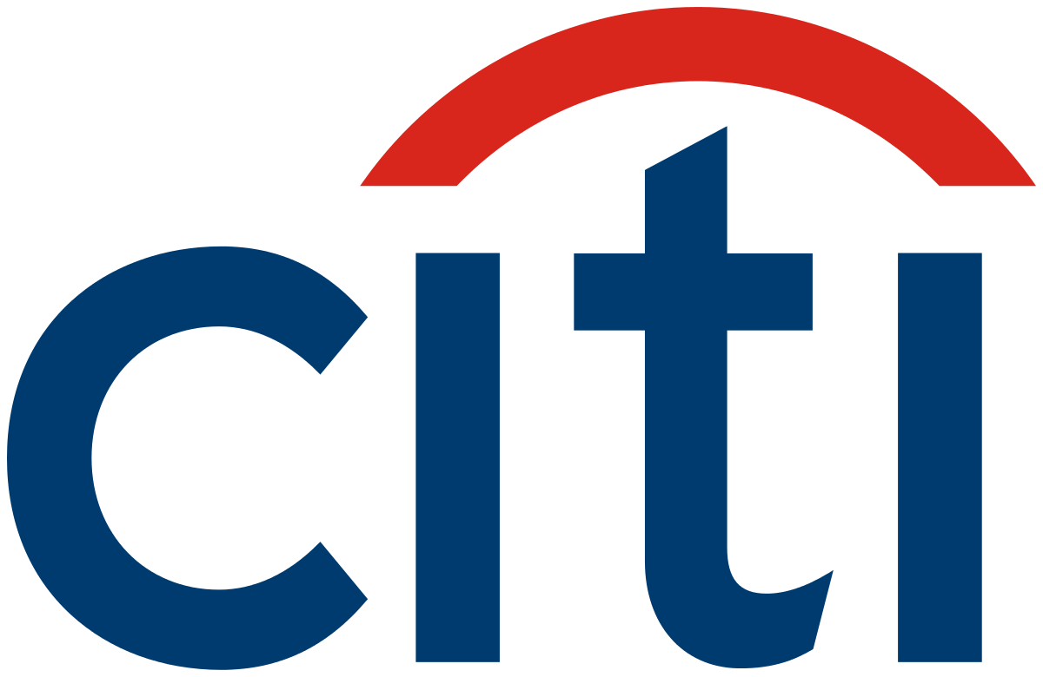
Operating segments
Back
Citigroup operates via two main segments: 1) Global Consumer Banking, and 2) Institutional Clients Group, with the remaining operations in Corporate / Other.
The presentation will solely focus on Citigroup’s Global Consumer Banking, the division focused on Retail Banking.
Citigroup
Global Consumer Banking (GCB)
Institutional Clients Group (ICG)
Corporate / Other
North America
Latin America¹
Asia²
Consisting of:
Retail banking and wealth management, including:
Resident real estate
Small business banking
Citi-branded cards in all regions
Retail services in North America
Banking
Investment banking
Treasury and trade solutions
Corporate lending
Private bank
Markets and securities services
Fixed income markets
Equity markets
Securities services
Corporate Treasury
Operations and Technology
Global staff functions and other corporate expenses
Legacy non-core assets:
Consumer loans
Certain portfolios of securities, loans and other assets
Discontinued operations
Note: ¹ Latin America GCB consists of Citi’s consumer banking business in Mexico
² Asia GCB includes the results of operations of GCB activities in certain EMEA countries for all periods presented

Slide 12
Global Consumer Banking (GCB) Business units
Back
Business Unit | % of revenues | Overview
North America GCB | 62% | Provides traditional retail banking and Citi-branded and Citi retail services card products to retail and small business customers The cards product portfolio includes: Proprietary portfolio (including the Citi Double Cash, Thank You and Value cards) Co-branded cards (including, among others, American Airlines and Costco) within Citi-branded cards Co-brand and private label relationships (including, among others, Sears, The Home Depot, Best Buy and Macy’s) within Citi retail services As of Dec 31st 2019: Retail banking loans: $50.3 bn Deposits: $160.5 bn Outstanding card loan balances: $149.2 bn
Latin America GCB | 16% | Provides traditional retail banking and Citi-branded card products to retail and small business customers in Mexico through Citibanamex, one of Mexico’s largest banks. As of Dec 31st 2019: Retail banking loans: $11.7 bn Deposits: $23.8 bn Outstanding card loan balances: $6 bn
Asia GCB | 22% | Provides traditional retail banking and Citi-branded card products to retail and small business customers Included within Asia GCB, traditional retail banking and Citi-branded card products are also provided to retail customers in certain EMEA countries, primarily Poland, Russia and the United Arab Emirates. The divisions most significant revenues came from Hong Kong, Singapore, South Korea, Australia, India, Taiwan, Thailand, Philippines, Indonesia and Malaysia. As of Dec 31st 2019: Retail banking loans: $62.8 bn Deposits: $106.7 bn Outstanding card loan balances: $19.9 bn

Slide 13
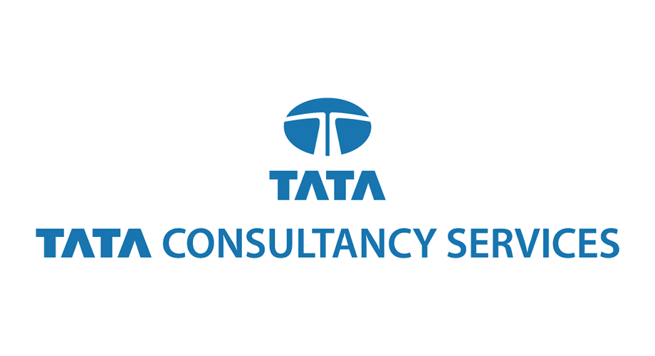
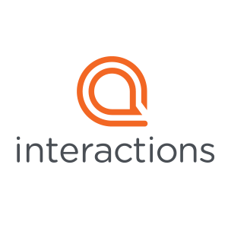
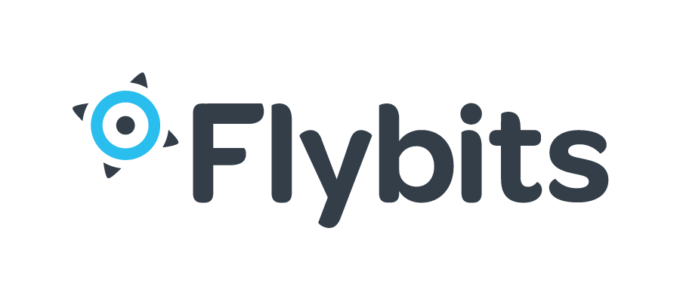
Partnerships (1/3)
Back
Partner | Area | Overview
 | CX & Digital capabilities | In Mar 2017, Citibank UK partnered with TCS to improve digital banking and offer more options to their customers. Though online transactions cost 100 times less than brick-and-mortar activities, only 22 percent of their customers were using the website, ATMs, or kiosks. Citibank UK wanted more customers to adopt online banking by making it user-friendly and easy. TCS suggested implementation of Interactive Voice Response (IVR) messages and ATM screen promotions to boost awareness of digital banking options. TCS had also revamped the website for people to navigate easily by adding user-friendly features such as quick links and online banking demos
 | CX | Salesforce’s Innovation & Transformation Center team helped modernize Citi through introducing Outcomes-based thinking and new ways to drive digital transformation to become the Digital bank of the future. The company has a long-standing relationship with Salesforce since 2007, whereby the first project was pertaining to CRM implementation.
 | CX - Chatbots | ClickZ spoke with Gonca Latif-Schmitt, Managing Director at Citi, to discuss their technologically-savvy approach to improving customer experience (CX) for their business card holders and clients. Citi engaged work with Interactions for their Citi Commercial Card initiative. Interactions is a provider of intelligent virtual assistants (IVAs) focused on helping companies improve CX via the use of AI chatbot technology. They offers several products that fall within the customer experience space, including an IVA tool. Currently the chatbot initiative is still a pilot program. The tool addresses five relatively simple issues that can be easily addressed with an automated agent: lost and stolen cards, updating email information, updating the card holder phone number, updating the card holder mailing address, handling ID and authentication.
 | Operational efficiency (OE) | In Feb 2020, New York headquartered Nammu21, the developer of a digitization and analytics platform for the finance ecosystem, has announced a second round of financing from Citi. Nammu21's proprietary technology generates operational efficiencies across transaction lifecycles, creates digital data sets to generate new value by unlocking previously "hidden" and inaccessible data, and provides the tools required for the emerging digital ecosystem. As a market neutral, end-to-end transaction management platform, Nammu21 aims to eliminate the disparate, time intensive and inefficient transaction processes existing in the market.
 | CX - Personalisation | In July 2019, Citi Ventures invested in Flybits for its series C funding. Flybits personalizes customer experiences by combining bank data, like balances and investments, with contextual data like location, weather, and calendar availability. This enables the firm’s customers to surface investment options for people who received bonuses, for instance, or extend credit card holders access to exclusive lounges and travel insurance when they arrive at the airport. Flybits’ Concierge integrates with digital channels and sends alerts and notifications that promote relevant products, services, and offers. Before, after, and during campaigns, Flybits’ analytics dashboard records and surfaces metrics like reach, impressions, engagement, and top-performing plugins. AI and machine learning algorithms use the captured data to optimize future experiences.
Notes:
Sources:
https://www.tcs.com/citibank-uk-enhances-customer-experience-transforming-its-digital-services
https://www.salesforce.com/video/1691446/
https://www.clickz.com/how-citi-commercial-cards-is-using-conversational-ai-to-improve-cx/260607/
https://www.prnewswire.com/news-releases/nammu21-closes-financing-with-citi-for-digitization-and-analytics-platform-301010061.html
https://citywireamericas.com/news/citi-signs-onto-blackrock-s-aladdin-platform-to-boost-fund-services/a1379961
https://www.businesswire.com/news/home/20200923005369/en/Citi-Enhances-Middle-Office-Services-with-New-Client-Reporting-Solution
https://www.retailbankerinternational.com/news/citibank-invests-in-data-management-platform-solidatus/

Slide 14
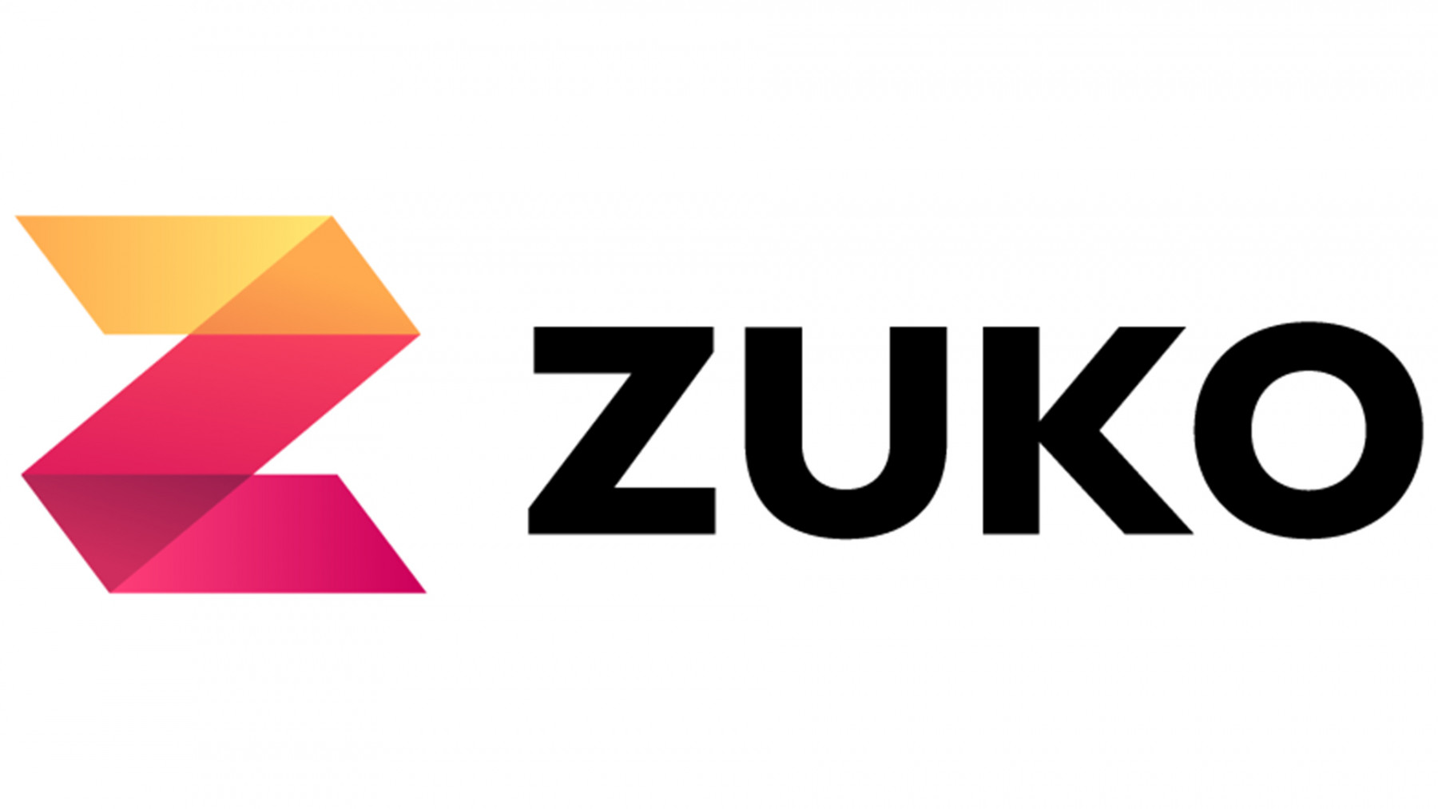
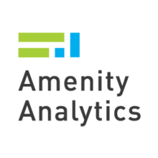
Partnerships (2/3)
Back
Partner | Area | Overview
 | CX - Content Analytics | In 2012, Citi partnered with IBM to integrate IBM’s Watson technology with consumer banking solutions. Under the partnership the two enterprises were to research how Watson's content analysis and evidence-based learning abilities can improve customer transactions and simplify the overall banking service.
 | OE - Location Analytics | Citibank needed a way to identify where its customers and potential customers were coming from in relation to its numerous branch offices. They wanted to determine whether locations were meeting population needs, and where there might be branch service redundancies or over saturations. Analytics8 implemented QlikMaps, a location analytics engine, and Citibank was able to analyze geographical market penetration and compare it against competitor banks by specific regions. Using QlikMaps, Citibank could determine market coverage for its own branches compared against its competitors. As a result, they could identify underserved markets and minimize the cannibalization of areas with multiple Citibank branches.
 | CX - Form analytics | Citi has partnered with Formisimo for its form analytics platform, Zuko. Zuko measures form behavior and visualizes information pertaining to custom segmentation, custom events, behavioural alerting, etc.
 | NLP | It is reported that Citi is a client of Amenity Analytics. The firm is a New York based startup that describes itself as a text-mining AI platform for enterprises. It develops cloud-based text analytics solutions using NLP and ML.
 | Risk | In Jul 2020, Citi expanded its relationship with BlackRock to gain access to BlackRock’s Aladdin investment management platform. Aladdin is BlackRock’s end-to-end investment management platform that combines risk analytics with portfolio management, trading and operations tools.
 | Reporting | In Sept 2020, Citi launched a new client reporting solution to enhance its middle officer services. The new reporting service was built on Factset’s Vermilion Reporting Suite, a global client reporting platform, coupled with Citi’s own Clarity data and analytics platform.
Notes:
Sources:
https://www.tcs.com/citibank-uk-enhances-customer-experience-transforming-its-digital-services
https://www.salesforce.com/video/1691446/
https://www.clickz.com/how-citi-commercial-cards-is-using-conversational-ai-to-improve-cx/260607/
https://www.prnewswire.com/news-releases/nammu21-closes-financing-with-citi-for-digitization-and-analytics-platform-301010061.html
https://www.pathmotion.co/case-studies/citi
https://www.zdnet.com/article/ibm-citi-aiming-to-use-watson-to-improve-customer-service/
https://www.analytics8.com/experience/.case-study/citibank/
https://venturebeat.com/2019/07/16/flybits-raises-35-million-to-personalize-customer-experiences-with-ai/
https://citywireamericas.com/news/citi-signs-onto-blackrock-s-aladdin-platform-to-boost-fund-services/a1379961
https://www.businesswire.com/news/home/20200923005369/en/Citi-Enhances-Middle-Office-Services-with-New-Client-Reporting-Solution
https://www.retailbankerinternational.com/news/citibank-invests-in-data-management-platform-solidatus/

Slide 15
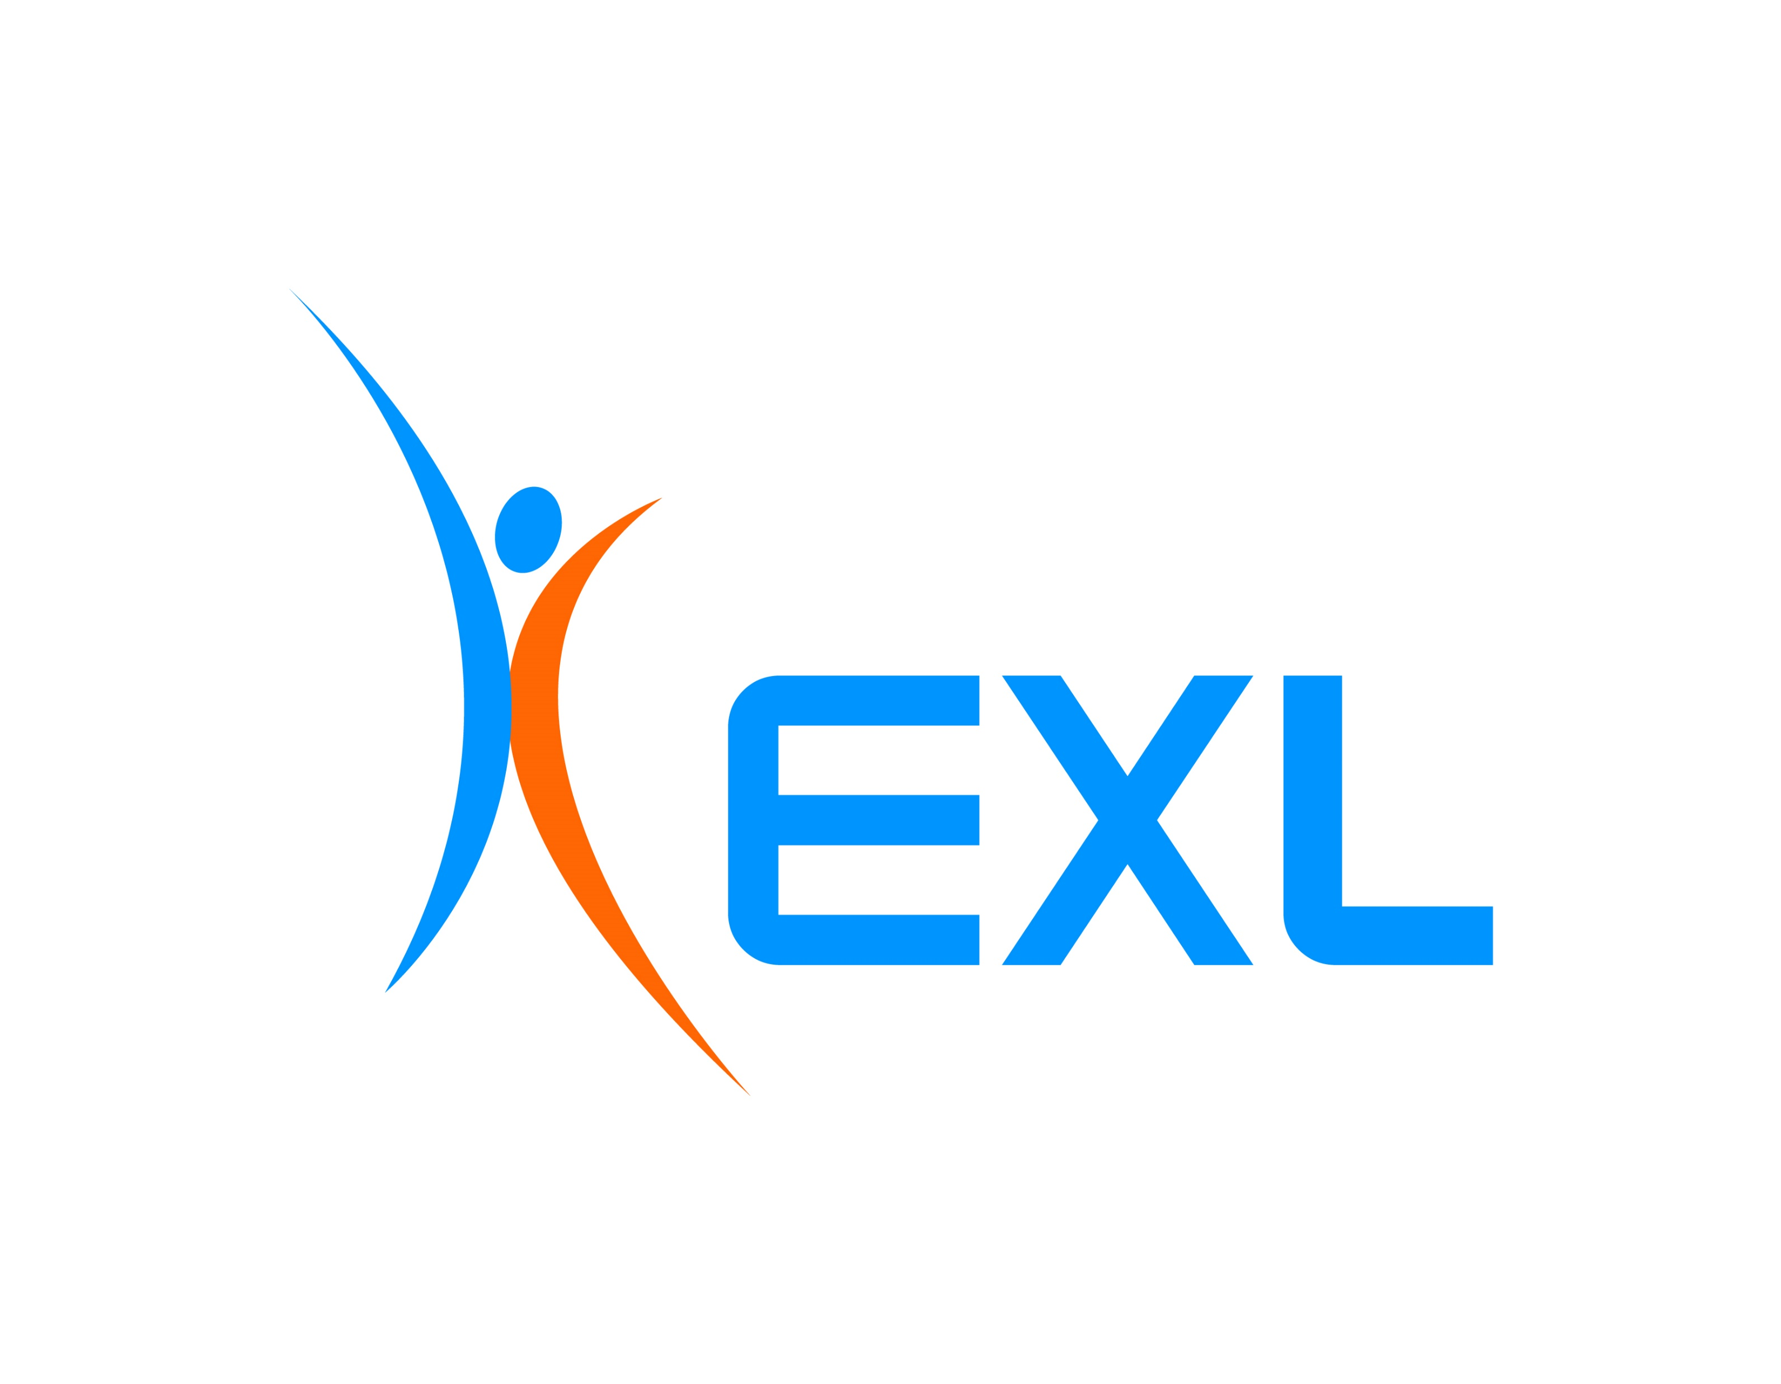
Partnerships (3/3)
Back
Partner | Area | Overview
 | Analytics & Operations management | In Aug 2020, Citibank made a strategic investment in metadata management software provider Solidatus. Citi will be deploying the Solidatus platform at a global enterprise level. The platform helps in managing data, workforce, and operations by mitigating risks through transparency, automation, and collaboration.
 | Analytics & Operations management | It is reported that Citi is a client of EXL, an American multinational professional services company mainly involved in the operations management and analytics.
 | Recruitment | Citi EMEA implemented the PathMotion platform in 2014 to improve engagement with participating candidates in live chat events and discussions. The combined effect of generating discussions and hosting live chats is the cultivation of better relationships with candidates while reducing recruiting costs and time to recruit by replacing campus recruiting events with online live chats. Citi implemented Candidate Engagement features alongside Employer Branding features including SEO, social media, plug-ins, for candidates to better engage with the content, resulting in improved conversion of high quality, diverse talent.
Notes:
Sources:
https://www.tcs.com/citibank-uk-enhances-customer-experience-transforming-its-digital-services
https://www.salesforce.com/video/1691446/
https://www.clickz.com/how-citi-commercial-cards-is-using-conversational-ai-to-improve-cx/260607/
https://www.prnewswire.com/news-releases/nammu21-closes-financing-with-citi-for-digitization-and-analytics-platform-301010061.html
https://www.pathmotion.co/case-studies/citi
https://www.zdnet.com/article/ibm-citi-aiming-to-use-watson-to-improve-customer-service/
https://www.analytics8.com/experience/.case-study/citibank/
https://venturebeat.com/2019/07/16/flybits-raises-35-million-to-personalize-customer-experiences-with-ai/
https://citywireamericas.com/news/citi-signs-onto-blackrock-s-aladdin-platform-to-boost-fund-services/a1379961
https://www.businesswire.com/news/home/20200923005369/en/Citi-Enhances-Middle-Office-Services-with-New-Client-Reporting-Solution
https://www.retailbankerinternational.com/news/citibank-invests-in-data-management-platform-solidatus/

Slide 16
Analytics initiatives (1/4)
Back
Risk Management and Compliance program overhaul
In Oct 2020, Citigroup faced an $400 mn enforcement action for failing to address risk and compliance failures.
The Office of the Comptroller of the Currency (OCC) and the Federal Reserve each issued orders outlining steps the bank should take to rectify long-standing deficiencies in generating and evaluating its customer data, as well as weaknesses and deficiencies in its risk management programs and internal controls.
Previously, The Federal Reserve had found deficiencies in Citigroup’s anti-money laundering compliance programme, and in 2015, deficiencies were identified in its compliance and control infrastructure related to its foreign exchange programme and designated market activities.
Therefore, Citigroup pledged to spend $1 bn over several years to transform its risk and control environment.
In light of this incident, Bradford Hu, Chief Risk Officer, decided to leave the company.
And in Dec 2020, Citibank appointed Silas Findley as its Chief Governance Office for the Institutional Clients Group.
Setting up a new division – Strategy Advisory Solutions
In June 2020, Citigroup created a new unit to help its investment bankers to use big data to advise corporate finance clients.
Muir Paterson was named the head of this new division called Strategy Advisory Solutions, which combines three business lines including Citi’s unit advising companies on how to defend against activist investors and its data science unit.
The new unit means that its financial strategy group, shareholder advisory and data science capabilities come together under one roof.
Becoming a Digital Bank
The bank’s CEO, Michael Corbat, frequently highlights the importance of technology and has even stated that Citi is not a traditional bank, but a technology firm with a banking license.
In June 2018, it was reported that Citi started to “digitize” the way it runs its credit cards business. Sergio Zanatti, Citibank’s Head of Cards and Personal Loans for Asia, mentioned that the usage of digital channels and data analytics allowed the bank to target the right customers more efficiently and improve retention. He has also emphasised on increasing spending of its advertising budget on digital ads whilst forming partnerships with e-commerce players and social media platforms and building systems that allow people to apply for cards online.
Many of the digital initiatives that Citi rolled out in recent years started in Asia, where it caters to its largest consumer banking business outside of North America.
Powered by Citi’s digital lab, Citi is striving for digital transformation in financial industry. Its infrastructure not only delivered on customer demand for online products, but it also enabled the company to gather intelligent data from its digital channels. The more data Citi gathered - whether from digital advertising, smart e-commerce partnerships or site traffic, the bank used such insights to target and retain its ideal customers more effectively.
Notes:
Sources:
https://www.complianceweek.com/grapevine/citigroup-chief-risk-officer-to-depart-amid-risk-management-overhaul/29684.article
https://www.institutionalinvestor.com/article/b1lxd583p7kgk3/Citi-Forms-Strategic-Advisory-Group-in-Data-Science-Push
https://www.cnbc.com/2018/06/26/going-digital-citibank-on-growth-in-consumer-banking-credit-cards.html
https://info.templafy.com/blog/go-evergreen-or-go-obsolete-digital-transformation-in-banking-and-financial-services-industry-sectors

Slide 17
Analytics initiatives (2/4)
Back
Focus on Digital Cards business
Sergio Zanatti, Citibank’s Head of Cards and Personal Loans for Asia, commented on the Digital cards: “The transformation into a digital cards business clearly is the future. The cards business will become less paper, will become more digital, will become less plastic and will continue to evolve in that direction,”. “When we started this journey probably three years ago, building the capabilities, building the technology, probably one out of 10 cards was digitally sourced. Now, it’s three out of 10 and hopefully soon four out of 10 will be sourced digitally,”
Benefits of Digital Capabilities and expected savings
In Jan 2020, it was reported that Citi’s banking group expects to save $600 mn this year through various advances in technology and automation. In its latest effort to advance its tech strategy, Citigroup has announced it will be adding 2,500 coders to its team. Earlier this year, the bank confirmed they are ramping up research in quantum finance, which would allow them to more accurately quantify their risk.
Citigroup has also recently partnered with PayPal in Dec 2019 to launch a digital wallet payment option, which now enables customers to seamlessly move money across wallets and countries without having to incur large wire transfer fees.
The bank has partnered with Google to offer digital checking accounts, which will provide the added benefit of access to Google’s ability to work with large sets of data and turn that information into value-add products.
Citigroup allocates about $8.5 billion per year, or 20% of its expenses, toward technology, slightly less than its major competitors.
Customer retention & acquisition
One area of Citi’s operations where Big Data analytics has been implemented successfully is in customer retention and acquisition.
This involved analysing data and targeting promotional spending using ML algorithms.
Another initiative was to scan transactional records to spot anomalies, which in the case of Citi’s customers, can mean incorrect, unusual or fraudulent charges. The costs resulting from these anomalies are far easier to manage if the problem is spotted quickly – or even before it happens, through predictive modelling.
Notes:
Sources:
https://www.cnbc.com/2018/06/26/going-digital-citibank-on-growth-in-consumer-banking-credit-cards.html
https://info.templafy.com/blog/go-evergreen-or-go-obsolete-digital-transformation-in-banking-and-financial-services-industry-sectors

Slide 18
Analytics initiatives (3/4)
Back
Customer Experience
Alice Miligan, previously a MD and Chief Customer and Digital experience office at Citi, emphasized on transforming Citi into an institution that elevates experience above all. “In the coming years, customer experience will overtake price and product as a key brand differentiator ,” she says. “[Citi’s] extensive analysis shows that engaged customers will use our products, drive more spend and are more likely to have multiple cards instead of just one. Engaging customers directly correlates to driving the long-term growth and health of our business. Customer experience is key to sustained loyalty and essential to the bottom line.”
During Miligan’s stint at Citi, she executed strategies to elevate Citi’s customer experience around three pillars:
Improve and streamline product offerings: Over the past few years, Citi has increased its focus on core products. “Our biggest challenge initially was managing and streamlining hundreds of different products worldwide. We’ve since reduced our number of product variations by over 60 percent,” Ms. Milligan says. In tandem, investments were also made in improving and marketing those core products.
Build a strong brand: “To us, this means ensuring that all customer touch points and communications reflect our brand purpose, enabling us to make a human connection with customers,” Ms. Milligan says. For more than 200 years, Citi’s brand promise has been to “enable progress.” To help bring that promise to life, Citi has conducted extensive customer research, including interviews and surveys, to inform the redesign of customer journeys and help define the voice, language and personality of the company’s customer communications.
Focus on service via all channels: Ms. Milligan realized early on in her tenure that an omnichannel experience was the only way Citi could truly serve its entire customer base. “Customers want a seamless, real-time and personalized experience from channel to channel ,” she says. “They have higher expectations to be able to complete activities online, on their own, without having to call us. As we looked at how our customers were behaving, we observed a great deal of channel switching, with a significant portion of inquiries to our call center coming from customers who had been online and unable to complete what they wanted to do.”
Chatbots
In 2018, Citi released its first chatbot, called Citi Bot SG, for Facebook Messenger in Singapore. The chatbot was available for all consumer banking customers after a beta testing period involving 600 customers and employees.
While the initial release was for Singapore customers exclusively, Citi claims they will be rolling out the chatbot for other markets such as North America and parts of China. The company claimed Citi Bot is able to help customers with a variety of needs, such as account specific questions like account balances. This also includes inquiries about recent transactions, bill summaries, and reward point balances. In order to leverage natural language processing (NLP) with this kind of conversational interface, Citi will emphasize on developing an ML model trained on hundreds of thousands of customer service questions and their correct responses.
In July 2019, Citi Bot SG was replaced with Citigroup’s new mobile app aimed at global consumer banking customers. They claim this app features all of the same services Citi Bot SG users came to appreciate during its run. According to Citi’s website, users can now automatically offset their spending with their virtual points, find discounts, and withdraw cash from credit cards on this new version.
Notes:
Sources:
https://www.cnbc.com/2018/06/26/going-digital-citibank-on-growth-in-consumer-banking-credit-cards.html
https://info.templafy.com/blog/go-evergreen-or-go-obsolete-digital-transformation-in-banking-and-financial-services-industry-sectors
https://quarterly.insigniam.com/transformation/citis-customer-experience-transformation/
https://www.zawya.com/mena/en/press-releases/story/Citi_launches_next_generation_mobile_app_in_the_UAE-ZAWYA20190324092616/
https://www.borndigital.com/2020/01/08/citibank-to-save-600-million-in-2020-through-digital-investments

Slide 19
Analytics initiatives (4/4)
Back
Citi Mobile App
Citi Mobile App: The Citi Mobile App includes several features such as in-app account opening, a 360-degree view across all financial accounts and spending insights to help banking customers improve their financial wellness. Most importantly, they will allow non-customers to access the same capabilities through the app.
Apart from these, some of the other features are as follows:
Track rewards points and manage outstanding balances, available limits, transaction details and bill payments. Customers can quickly activate new or replacement cards.
Easy view of card statements and download a copy, and for qualified customers convert their latest credit card statement balance to instalments by simply tapping a “Convert” button.
Security features including biometric authentication (Face ID, Touch ID, and Android Fingerprint) and for customers with only cards, they can pair the user ID to the mobile device.
Eligible cardholders can get cash from their credit cards, which can be repaid in monthly instalments with various tenors for option.
Citi Velocity Clarity
In June 2017, Citi announced the rollout of Citi Velocity Clarity, a comprehensive data and analytics platform using Big Data technology delivered through an integrated suite of advanced online functionalities.
The platform consolidates and analyzes data across multiple Citi Custody and Fund Services (CFS) products, whilst leveraging Citi’s private, cloud-based, big data on demand infrastructure to enable fast and efficient consumption of information drawn from multiple sources.
Awards and accolades
In Nov 2019, Citi was named the World’s Best Digital Bank by Global Finance Magazine for the 18th consecutive year.
In addition to being recognized as the World’s Best Digital Bank, Citi received the top honor in a no. of global and regional award categories.
Selection criteria included strength of strategy for attracting and servicing online customers, success in getting clients to use digital offerings, growth of online customer base, breadth of products offered, evidence of tangible benefits gained from digital initiatives, and web site design and functionality.
Notes:
Sources:
https://www.businesswire.com/news/home/20191121005091/en/Citi-Wins-Top-Honor-World%E2%80%99s-Digital-Bank

Slide 20
Impact of COVID-19 and Initiatives undertaken (1/2)
Back
Quarter | Overall Financial Performance | Business performance
Q3 2020 | While Revenues were down by 7%, Net Income dropped by 34% on a YoY basis. Citi stated that credit costs had stabilized and deposits continued to increase. Focus will be on modernizing governance, processes, and risk management. | GCB: Revenues decreased by 12% YoY, driven by lower card volumes and lower interest rates across all regions, partially offset by strong deposit growth ICG: Revenues went up by 17% YoY, primarily driven by strong performance in market, investment banking, and private banking. Corporate: Down by 91% YoY, reflecting the winddown of legacy assets, the lower rate environment and marks on securities.
Q2 2020 | While Revenues were up by 5%, Net Income dropped by 73% on a YoY basis. Michael Corbat, Citi CEO, mentioned that the first quarter was significantly impacted by the COVID-19 pandemic. Expenses were managed effectively and the economic shocks caused by the pandemic weren’t felt until late in the quarter. | GCB: Revenues declined by 7% YoY, driven by lower loan volumes and lower interest rates across all regions, partially offset by strong deposit growth. ICG: Revenues were up by 21% YoY, driven by strong performance in markets and securities. Corporate: Revenues were down by 49% YoY, reflecting wind-down of legacy assets and lower rate environment
Individual and Small Business Customers
Citi customers who have been impacted by COVID-19 may be eligible for following additional assistance measures, upon request:
Retail Bank: Fee waivers on safe deposit box fees and non-Citi ATM usage fees. The company is also extending few waivers on monthly service fees as well as penalty waivers for early Certificate of Deposit withdrawals until 8th May
Credit Cards: Fee waivers on late fees and deferral of minimum payments for two months. Delinquent accounts before the waiver period will be reported as current to the credit bureaus.
Small Business: Fee waivers on monthly service fees and remote deposit capture fees, as well as penalty waivers for early Certificate of Deposit withdrawals. The company is participating in the Small Business Administration’s Paycheck Protection Program.
Credit Cards: Citi is offering a range of collection forbearance programs
Mortgage: Citi’s mortgage sub-servicer Cenlar FSB is offering 90-day forbearance for Citi’s mortgage loans where the borrower is experiencing hardship. Furthermore, foreclosures and evictions have been paused for 60 days
Student Loans: Through its subservicer Firstmark, Citi is providing forbearance programs for student loans
Notes:
Sources:
https://www.citigroup.com/citi/news/2020/200306a.htm
https://www.citigroup.com/citi/news/2020/200420a.htm
https://www.citigroup.com/citi/investor/data/qer120.pdf?ieNocache=126

Slide 21
Impact of COVID-19 and Initiatives undertaken (2/2)
Back
Support to Community
On 29th June 2020, Citi announced that Citi and the Citi Foundation committed more than $100 million to date in support of COVID-19-related community relief and economic recovery efforts globally. This includes $35 mn in new funding, adding to the previously announced $65 mn in grants and charitable contributions.
On 20th April, Citi and Citi Foundation had committed over $65 mn until then in support of COVID-18 related community relief efforts:
$36 mn in charitable contributions from Citi
$30 mn in grants from Citi Foundation
The Citi Foundation committed $10 mn to Community Development Financial Institutions (CDFIs) in the US to serve small, diverse entrepreneurs who may not fully qualify for federal government stimulus funding.
The company launched a new employee donation campaign called “Double the Good”. For every $1 donated by a Citi employee in support of COVID-19 relief, Citi will donate $1 to one of four organisations selected by each of Citi’s regions to address unique challenges:
United Nations Development Programme (APAC)
International Rescue Committee (Europe, Middle East, and Africa)
International Organisation for Migration (LatAm)
Direct Relief (North America)
Donations made between 1st January and 31st May 2020 were eligible. Moreover, Citi donated up to $500 k to each organization.
Notes:
Sources:
https://www.citigroup.com/citi/news/2020/200306a.htm
https://www.citigroup.com/citi/news/2020/200420a.htm
https://www.citigroup.com/citi/investor/data/qer120.pdf?ieNocache=126

