Slide 1
Siobhan McNiff
Academic Skills Workshop
MGT 1301

Slide 2
Overview of today’s session
Academic language
Academic writing conventions
Structuring your writing – creating an argument
Paragraphing
Editing your work
Referencing

Slide 3
The Process of Academic Writing
PREPARE | RESEARCH | WRITE
Make a time-line Analyse the question | Read (broadly) Take a stand Read (narrowly) | Plan Draft Re-draft Final edit

Slide 4
Step1-Prepare:
Make a time-line
When is the due date?
Works backwards-how much time do you have?
How much time will you need
Are there any upcoming events/distractions that you need to consider?
Analyse the question
to research?
to write
to edit

Slide 5
The Brief
Question 1: Outline McDonald’s organisational structure and provide an explanation of why the organisation is structured in this way.
Question 2: Outline how Toyota Motor Corporation applies the principles of ‘Scientific Management’ and why.

Slide 6
The Brief
Question 1:
Outline McDonalds’ organisational structure and provide an explanation of why the organisation is structured in this way.
Question 2:
Outline how Toyota Motor Corporation applies the principles of ‘Scientific Management’ and why.

Slide 7
The Brief
TASK
-This is an assignment in which you apply business and management theories to a particular organisation
-Review how the management concepts have been applied in the particular organisation and why
If you fail to answer the question in your report, you will fail the entire report

Slide 8
What is a Report? Purpose
A report is not just a discussion of different ideas or theories
A report is a formal written document written for a specific audience/s which aims to:
inform clearly and accurately about something that has happened
inform clearly and accurately about something that needs to be solved
provide clear and accurate information which can then be acted on in some way

Slide 9
The Brief
Minimum of 10 sources: 5 academic & 5 REPUTABLE non-academic
1500 words (+/- 10%)
References and appendices not included in the word count
Due date: March 25th 2022

Slide 10
Business Report Marking Criteria Rubric
Section/ criteria | 1-4 (70-100%) | 5-8 (60-69%) | 9-12 (50-59%) | 13-16 (40-49%) | 17-20 (0-39%)
Introduction: A clear rationale for the topic choice | Outstanding discussion and justification of topic selected | Thorough discussion and justification of topic selected | Evidence of some discussion and justification of topic selected | Adequate discussion and justification of topic selected | Discussion and justification of topic selected is inadequate
Discussion: Content: relevant and informative, applying depth of knowledge and understanding | Excellent and well-informed understanding of theories and concepts involved | Good understanding of theories and concepts involved | Demonstrates satisfactory knowledge and understanding theories and concepts | Adequate content; limited depth of knowledge and understanding shown | Inadequate content; limited depth of knowledge and understanding shown
Conclusion: Clear conclusions from the literature | Tightly structured, logical and draws coherent conclusions to the topics covered | Undertakes a systematic analysis of the issues and draws coherent conclusions to the topics covered | Sound conclusions to the topics covered | Adequate conclusions to the topics covered | Inadequate conclusions to the topics covered
References: Reference to sources including directions for further study | Broad and relevant readings examined and used selectively in the work | Good range of appropriate references used during the review | Conventional references and readings used within the review | Adequate but limited use of references during review | Review relies on no or one reference; evidence of unexamined personal opinion
Presentation: Clearly presented with limited spelling and grammatical errors | Very well expressed and understanding of content with limited spelling or grammatical errors | Very well expressed; good understanding of content with some spelling and/ or grammatical errors | Well expressed; understanding of content with several spelling and/ or grammatical errors | Unclear expression of information; little understanding of content; several spelling and grammatical errors | Several spelling and grammatical errors

Slide 11
What should you focus on in the ‘preparation’ stage?
Your assignment brief
The marking criteria
Learning outcomes for the module
Any other information that your lecturers provide you regarding the task
You should also:
be able to identify some important theories that relate to your assessment
have a list of sub-topics or themes that you want to research.

Slide 12
You may have written reports in the past. What subheadings did you use in your reports?
Notes:
Students can confer. Tutor to record answers on the whiteboard, then compare them with the next slide

Slide 13
Structure of your Report
Title page Suggested Structure (1,500 words):
Executive summary
Table of contents
Introduction
Describe the specific management concept/theory (organizational structure or scientific management)
Provide background (context) information on the organization (Tesla or Amazon)
Outline how/why Tesla or Amazon applies the specific management concept/theory at their organisation,
Conclusion
References
Appendices (for any extra tables, graphs, etc.)

Slide 14
Title Page
This should show:
The title
Your name
Your MISIS Number
An explanation of what the report is on and who it is for, e.g. ‘An External Environment Analysis Report for [tutor's name]
The date

Slide 15
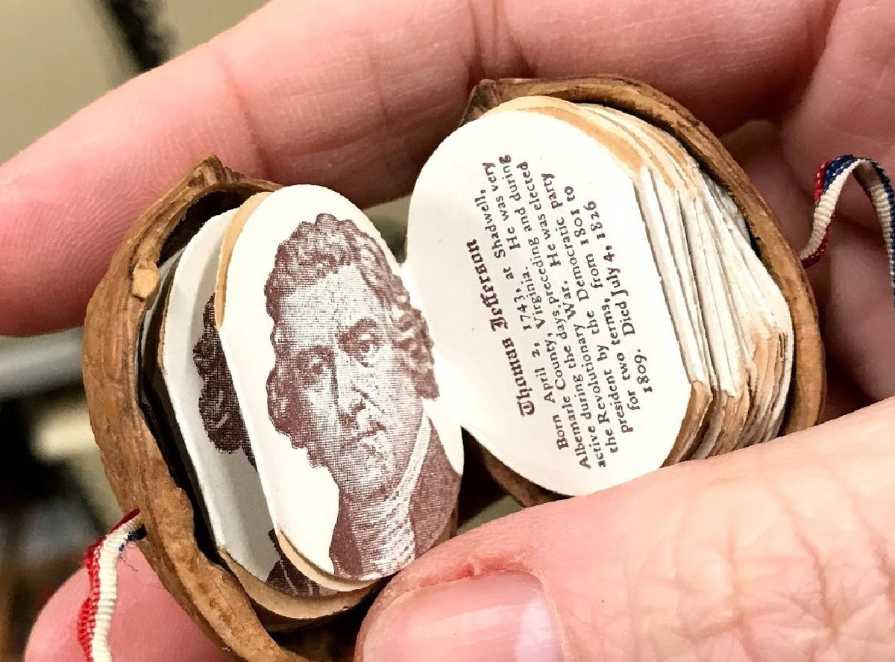
Executive Summary
The Executive Summary should contain:
The purpose of the report
The major findings
The main conclusions
In
a
nutshell

Slide 16
Example Executive Summary
This report provides an analysis and evaluation of the current and prospective profitability, opportunities and risks of the UK ice cream industry. The report also outlines different strategic decisions made by the main companies (Unilever/Walls birds Eye, Nestle/Lyons Maid and Mars) in the industry. It finds that the two most important decision made were the decisions by Unilever to supply CTN’s with freezer cabinets, and Mars’s decision to enter the market with their chocolate bar ice cream. The report concludes with an update of the market showing how consumers’ tastes have changed to become more health conscious and how the positions of the companies have changed.

Slide 17
Example Executive Summary
Read the executive summary below. Is it good? How might you improve it?
This report analyses the business environment of EasyJet at multiple levels. Firstly, the report analyses the competitive environment in
the airline industry, with a focus on short haul service providers.
Secondly, the report analyses the strategies that EasyJet is using
to effectively compete in the industry, not only domestically
but internationally. Lastly, the report analyses the factors that
have contributed to the internationalisation of the company.

Slide 18
Table of contents
This should show
The full list of sections within the report (including any appendices, reference or bibliographic lists, etc.)
The page number on which each section begins

Slide 19
An Example Table of Contents
1. Introduction …………………………………………………………………..3
2. IKEA Background.................................................................3
3. The internal and External environment of IKEA.................4
3.1 External environment…………………………..5
3.2 Internal environment…………………..……….7
3.3 PEST Analysis of Internal Environment….9
4. Limitations of Report……………………………………………………..11
5. Conclusions / Recommendations…………………………………...12
6. Bibliography……………………………………………………………………13
7. Appendices………….……………………………………………………..….15

Slide 20
Introduction
This should give a succinct explanation of the aims/context of the report, and should include brief details of any information necessary for the reader to understand it, e.g. industry size; structure; main activities; scope of the report ; limitations; methods used.
Introductions should include a brief breakdown of report structure

Slide 21
Example Introduction
As globalization is the main trend nowadays, a lot of companies expand aggressively, such as IKEA which is the world’s largest furniture retailer and manufacturer with its successful expansion into more than 30 countries. This report aims at discussing IKEA as a successful global expanded model to analyze and evaluate its international strategies. Firstly IKEA’s internal environment will be analysed using resource-based view and SWOT, and external environment by the method of PEST in order to evaluate whether IKEA’s strategies reflect the organizational environment and cater to the external trends. Subsequently, the motivation for IKEA using five forces to expand internationally in order to identify its objectives for its international business and geographic pattern of international expansion strategy will be explored. Finally, the market entry strategy is discussed by specifying the case of Japan in order to illustrate how IKEA adopts to a particular country.

Slide 22
Introduce the general topic
As globalization is the main trend nowadays, a lot of companies expand aggressively, such as IKEA which is the world’s largest furniture retailer and manufacturer with its successful expansion into more than 30 countries. This report aims at discussing IKEA as a successful global expanded model to analyze and evaluate its international strategies. Firstly IKEA’s internal environment will be analysed using resource-based view and SWOT, and external environment by the method of PEST in order to evaluate whether IKEA’s strategies reflect the organizational environment and cater to the external trends. Subsequently, the motivation for IKEA using five forces to expand internationally in order to identify its objectives for its international business and geographic pattern of international expansion strategy will be explored. Finally, the market entry strategy is discussed by specifying the case of Japan in order to illustrate how IKEA adopts to a particular country.

Slide 23
Focus
As globalization is the main trend nowadays, a lot of companies expand aggressively, such as IKEA which is the world’s largest furniture retailer and manufacturer with its successful expansion into more than 30 countries. This report aims at discussing IKEA as a successful global expanded model to analyze and evaluate its international strategies. Firstly IKEA’s internal environment will be analysed using resource-based view and SWOT, and external environment by the method of PEST in order to evaluate whether IKEA’s strategies reflect the organizational environment and cater to the external trends. Subsequently, the motivation for IKEA using five forces to expand internationally in order to identify its objectives for its international business and geographic pattern of international expansion strategy will be explored. Finally, the market entry strategy is discussed by specifying the case of Japan in order to illustrate how IKEA adopts to a particular country.

Slide 24
Focus on the purpose
As globalization is the main trend nowadays, a lot of companies expand aggressively, such as IKEA which is the world’s largest furniture retailer and manufacturer with its successful expansion into more than 30 countries. This report aims at discussing IKEA as a successful global expanded model to analyze and evaluate its international strategies. Firstly IKEA’s internal environment will be analysed using resource-based view and SWOT, and external environment by the method of PEST in order to evaluate whether IKEA’s strategies reflect the organizational environment and cater to the external trends. Subsequently, the motivation for IKEA using five forces to expand internationally in order to identify its objectives for its international business and geographic pattern of international expansion strategy will be explored. . Finally, the market entry strategy is discussed by specifying the case of Japan in order to illustrate how IKEA adopts to a particular country.

Slide 25
Signposting, map
As globalization is the main trend nowadays, a lot of companies expand aggressively, such as IKEA which is the world largest furniture retailer and manufacturer with its successful expansion into more than 30 countries. This report aims at discussing IKEA as a successful global expanded model to analyze and evaluate its international strategies. Firstly IKEA’s internal environment will be analysed using resource-based view and SWOT, and external environment by the method of PEST in order to evaluate whether IKEA’s strategies reflect the organizational environment and cater to the external trends. Subsequently, the motivation for IKEA using five forces to expand internationally in order to identify its objectives for its international business and geographic pattern of international expansion strategy will be explored. Finally, the market entry strategy is discussed by specifying the case of Japan in order to illustrate how IKEA adopts to a particular country.

Slide 26
Signposting, map
As globalization is the main trend nowadays, a lot of companies expand aggressively, such as IKEA which is the world largest furniture retailer and manufacturer with its successful expansion into more than 30 countries. This report aims at discussing IKEA as a successful global expanded model to analyze and evaluate its international strategies. Firstly IKEA’s internal environment will be analysed using resource-based view and SWOT, and external environment by the method of PEST in order to evaluate whether IKEA’s strategies reflect the organizational environment and cater to the external trends. Subsequently, the motivation for IKEA using five forces to expand internationally in order to identify its objectives for its international business and geographic pattern of international expansion strategy will be explored. Finally, the market entry strategy is discussed by specifying the case of Japan in order to illustrate how IKEA adopts to a particular country.

Slide 27
Signposting, map
As globalization is the main trend nowadays, a lot of companies expand aggressively, such as IKEA which is the world largest furniture retailer and manufacturer with its successful expansion into more than 30 countries. This report aims at discussing IKEA as a successful global expanded model to analyze and evaluate its international strategies. Firstly IKEA’s internal environment will be analysed using resource-based view and SWOT, and external environment by the method of PEST in order to evaluate whether IKEA’s strategies reflect the organizational environment and cater to the external trends. Subsequently, the motivation for IKEA using five forces to expand internationally in order to identify its objectives for its international business and geographic pattern of international expansion strategy will be explored. Finally, the market entry strategy is discussed by specifying the case of Japan in order to illustrate how IKEA adopts to a particular country.

Slide 28
Activity
Put the sentences below in the correct order to create a coherent introduction to the topic of the report:
The market can be described as an oligopoly as there are around six mobile phone companies in the UK which control the whole industry and regulate prices.
Competition within the UK mobile phone market has increased in the last few years; one reason is the introduction of the smartphone (Clark, 2011).
Furthermore, the offered products, the handsets and services of the mobile phone industry, show similar characteristics.

Slide 29
Activity
Solution:
Competition within the UK mobile phone market has increased in the last few years; one reason is the introduction of the smartphone (Clark, 2011). The market can be described as an oligopoly as there are around six mobile phone companies in the UK which control the whole industry and regulate prices. Furthermore, the offered products, the handsets and services of the mobile phone industry, show similar characteristics.

Slide 30
Main Body of the Report
This is where you present your main account of the problem or issue you are writing about.
It should be based on analysis, not intuition, e.g. avoid writing “I feel that...”
You must back up what you write with evidence and/or argument. This means using a range of relevant sources in your writing e.g. appropriate theory, extracts from the company annual report, news reports from credible and authoritative newspapers, extracts from industry reports etc.
All evidence must be referenced appropriately

Slide 31
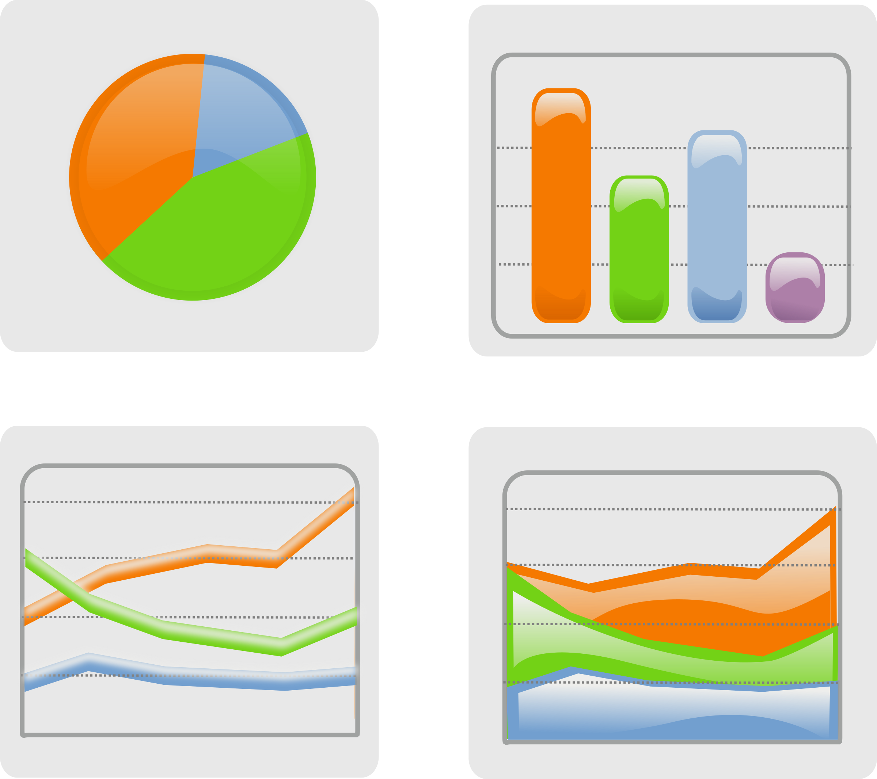
Main Body of the Report
Ideally, this section should be divided into numbered paragraphs that show which section the paragraph belongs to.
Headings for each sub-section, underlined or in bold are also a good idea.
Consider presenting material in the form of diagrams, charts, etc., wherever appropriate. These are not only easier to grasp, but reduce the word count.

Slide 32
Main Body of the Report – Analytical Paragraph Structure
Topic sentence
Evidence, examples & explanation
(from your research)
Critically reflect on what you’ve just said
(so what?)
Point
Evidence
Explanation

Slide 33
Main Body of the Report – Analytical Paragraph Structure
Product Development Strategies
Product development aims to create new products for existing markets. EasyJet started operating a website in 1997 with facilities to book tickets the following year (EasyJet Plc, 2013). In 2012, they introduced a service called ‘seating allocation’, which enables its customers to reserve their own seats while booking, rather than the traditional first come first serve method (Milmo, 2012). Furthermore, they have started offering holiday packages through their website, as well as car rental services across Europe by forming a partnership deal with Europcar (PR LOG, 2009) and customers are now able to book these services through a mobile application which can also hold electronic boarding passes (Dennis, 2013). Therefore by developing and enhancing their prevailing market status through internal technological advancement as well as external partnerships, EasyJet demonstrated innovative product development strategies.

Slide 34
Main Body of the Report – Analytical Paragraph Structure
Clear and concise Point sentence
Product Development Strategies
Product development aims to create new products for existing markets. EasyJet started operating a website in 1997 with facilities to book tickets the following year (EasyJet plc, 2013). In 2012, they introduced a service called ‘seating allocation’, which enables its customers to reserve their own seats while booking, rather than the traditional first come first serve method (Milmo, 2012). Furthermore, they have started offering holiday packages through their website, as well as car rental services across Europe by forming a partnership deal with Europcar (PR LOG, 2009) and customers are now able to book these services through a mobile application which can also hold electronic boarding passes (Dennis, 2013). Therefore by developing and enhancing their prevailing market status through internal technological advancement as well as external partnerships, EasyJet demonstrated innovative product development strategies.
POINT

Slide 35
Main Body of the Report – Analytical Paragraph Structure
Product Development Strategies
Product development aims to create new products for existing markets. EasyJet started operating a website in 1997 with facilities to book tickets the following year (EasyJet plc, 2013). In 2012, they introduced a service called ‘seating allocation’, which enables its customers to reserve their own seats while booking, rather than the traditional first come first serve method (Milmo, 2012). Furthermore, they have started offering holiday packages through their website, as well as car rental services across Europe by forming a partnership deal with Europcar (PR LOG, 2009) and customers are now able to book these services through a mobile application which can also hold electronic boarding passes (Dennis, 2013). Therefore by developing and enhancing their prevailing market status through internal technological advancement as well as external partnerships, Easyjet demonstrated innovative product development strategies.
Evidence
Use of sources to develop the topic

Slide 36
Main Body of the Report – Analytical Paragraph Structure
Product Development Strategies
Product development aims to create new products for existing markets. EasyJet started operating a website in 1997 with facilities to book tickets the following year (EasyJet plc, 2013). In 2012, they introduced a service called ‘seating allocation’, which enables its customers to reserve their own seats while booking, rather than the traditional first come first serve method (Milmo, 2012). Furthermore, they have started offering holiday packages through their website, as well as car rental services across Europe by forming a partnership deal with Europcar (PR LOG, 2009) and customers are now able to book these services through a mobile application which can also hold electronic boarding passes (Dennis, 2013). Therefore by developing and enhancing their prevailing market status through internal technological advancement as well as external partnerships, EasyJet demonstrated innovative product development strategies.
Explanation

Slide 37
Conclusions
This is where you sum up the general conclusion/s you have reached, such as "The very low staff morale is a result of an autocratic management style".
Don't confuse conclusions (where you draw together the threads of the preceding discussion to make some overall point/s) with recommendations (where you say what should be done about the conclusions you have reached).

Slide 38
Example conclusion
Conclusion
Analysis of EasyJet has shown that the company is aiming to increase its customer base not only by increasing travel routes, but also by increasing additional services available through the company. Around 60 million passengers annually travel through the airline. Evidence from Porter’s Five Forces emphasises that EasyJet is attempting to continuously increase market share despite the intense competition it is facing from other short haul competitors. Due to homogeneous customer needs, EasyJet holds a market share of around 8% in the intra-European market (EasyJet, 2013). However, EasyJet is currently only involved in a small number of growth strategies. Further improvements might lead to diversification in the future. Deregulation of the industry and increased establishment of EasyJet across Europe, as seen in the analysis of Yip’s drivers of internationalisation, attracts further expansion opportunities within Europe. EasyJet is continuously expanding by increasing routes and services, thereby giving tough competition to other rivals in the industry.

Slide 39
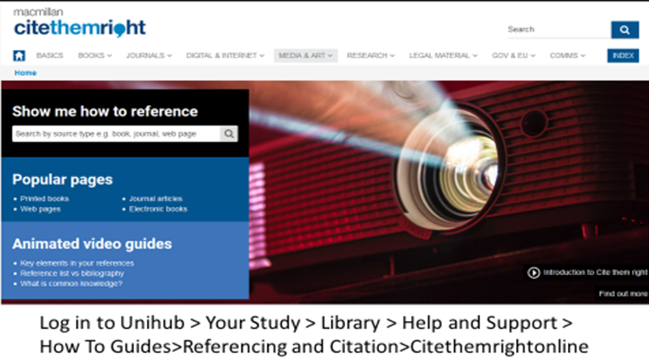
List of References
This is the list of sources referred to directly in your report. You must give full details here of all the sources you have used in your report.
Harvard system of referencing =
in-text citations + reference list at the end
We will discuss referencing techniques in a minute!

Slide 40
Appendices (if any)
This is where you place any information whose inclusion is not central to the main body of the report but which explains, amplifies or puts in context the arguments and evidence you have presented there.
Its main purpose is to allow you to include important information that, if it were included in the main body of the report, would interrupt the flow of the argument you are developing there.
Any material in an appendix does not count towards the word length for the report, nor will it attract any marks.
Examples of material suitable for an appendix include:
set of complex figures or statistics
supporting documents, e.g. extracts from company reports

Slide 41
Layout of your Report
the report should look like a single coherent document
consistency of visual style [e.g. font, line-spacing, underlining of headings]
justify margins
the report should read like a single coherent document
Sections should be linked (“bridging”)
information needs to be unified
attitude / approach to information needs to be unified
writing style needs to be consistent
Remember your cover page
Remember simple aesthetics

Slide 42
Differences between reports and essays
Report | Essay
Presents information | Presents argument
Uses numerical headings and subheadings | Doesn’t usually use headings
Uses graphics and illustrations | Rarely uses graphics
Usually has an abstract or executive summary | Only has an abstract if it is very long (or is requested by lecturer
Conveys specific information | Addresses a specific question and shows how well you have answered it
Description of events or results of research | Usually some form of argument or discussion in response to a question
Contains conclusion and sometimes recommendations | Contains conclusion but not usually recommendations

Slide 43
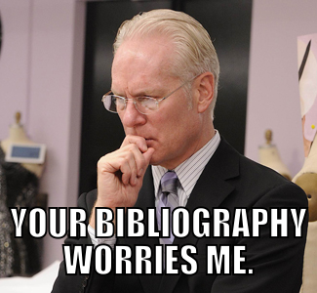
Expectations for any type of academic writing
https://www.pinterest.com/pin/175499716702105254/
Notes:
Formal
Based on research
Well referenced
Structured

Slide 44
Free proof reading tool - Grammarly

Slide 45
Grammarly Edu
Go to https://www.grammarly.com/edu/signup
Use MDX email address only
Choose any password
Grammarly will send you a link by email
Your account is now set up – copy/paste and Word documents and it will take a few moments to give suggestions for possible amendments

Slide 47
Things to watch out for
Grammarly does NOT like the ‘passive voice’, however, this is considered good academic style; consider ignoring this suggestion
Commas; Grammarly tends to ask you to use these too often – treat with caution!
Please do not rely on the plagiarism detection feature. It is misleading as it does not have access to the same wide range of databases that Turnitin does.

Slide 48
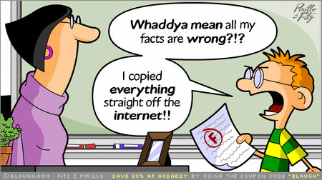
REFERENCING AND AVOIDING PLAGIARISM
http://guides.library.vu.edu.au/referencing

Slide 49
Some tricky ones!
https://misfortuneofknowing.wordpress.com/2013/06/17/whos-the-victim-of-self-plagiarism/
https://www.pokerschoolonline.com/blogs/CanuckMonkey/collusion-busters
http://thewritersadvice.com/tag/ghost-writing/
http://www.kowalkecoaching.com/academic-paper-writers-block/
Extreme Paraphrasing!
‘Spinning the assignment’
Notes:
Discussions on each one of these with examples of personal experiences

Slide 50
Ummm…what???
Notes:
Result of using a paraphrasing software!

Slide 51
Turnitin
An enhanced assignment drop-box where students can submit their essays.
It can check students’ assignments for originality against:
Current and past internet resources
A repository of previously submitted papers
Ideal for teachers to give a grade and feedback through:
In-text annotations
Voice notes
Detailed remarks/explanations/observations

Slide 52
Turnitin-teach them or catch them?
Here at Middlesex, we refer to it more as an online text-matching software, which can be used by the lecturers as a tool for detecting plagiarism.
Turnitin does NOT determine whether a student has plagiarised – this is done by the lecturer.

Slide 53
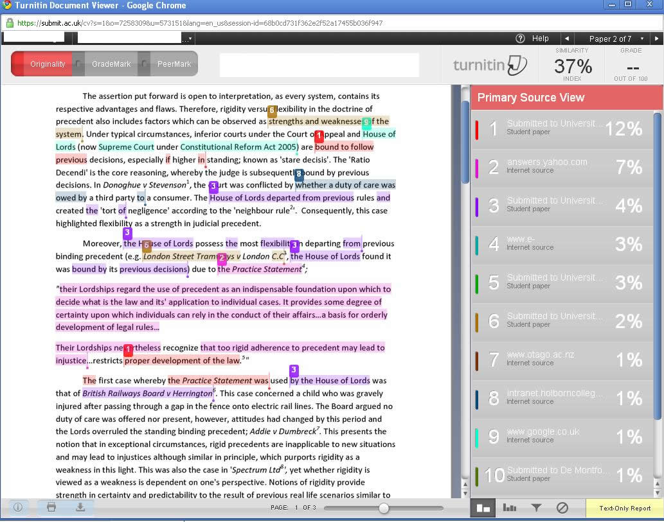
Notes:
In Disciplines like Law, the similarity rate can often be high as the students cannot paraphrase laws and policies; however, as can be seen above, the issue is not that of laws or policies not being paraphrased, it is the fact that the student has not cited the source. This suggests that the work has been used without proper acknowledgement, which is considered plagiarism.

Slide 54
How can you avoid plagiarism?
Make yourself aware of what can be considered plagiarism.
Follow these steps to avoid plagiarism:
Plan
Prepare
Paraphrase
Reference using Cite Them Right Online

Slide 55
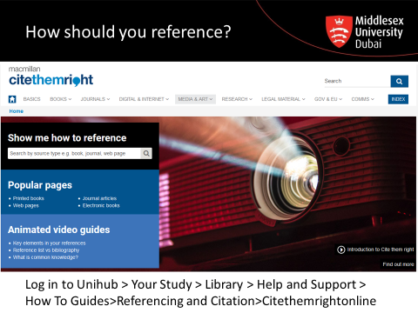
How should you reference?

Slide 56
In text citation – direct quotation
Include author’s surname, year, and page number (if available)
Put words taken from original in quotation marks ‘…’
Example:
‘In the tsunami-hit village of Kalikuppam in southern India, children with access to a hole-in-the-wall computer taught themselves basic biotechnology, reaching a test score of 30% in just two months.’ (Mitra, 2015).

Slide 57
In text citation – indirect quotation
Include author, date, page number (if applicable)
Paraphrase the original words
Example:
Mitra (2015,) suggests that the introduction of hole-in-the wall computers has resulted in huge educational improvements in a matter of months in some rural areas of India.

Slide 58
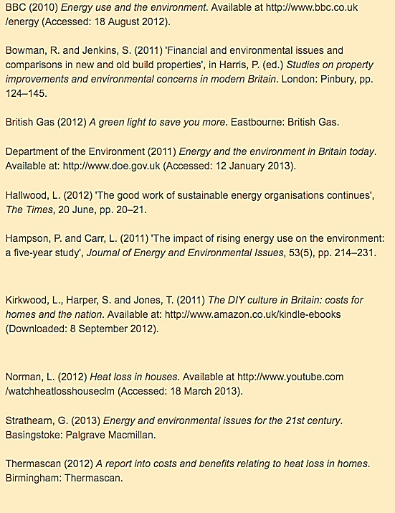
Sample Reference List

Slide 59
Referencing
Tools
Google Scholar
MANDATORY!
Zotero
www.mybib.com
Notes:
Whichever referencing tool you use, make sure you check it against CTR

Slide 60
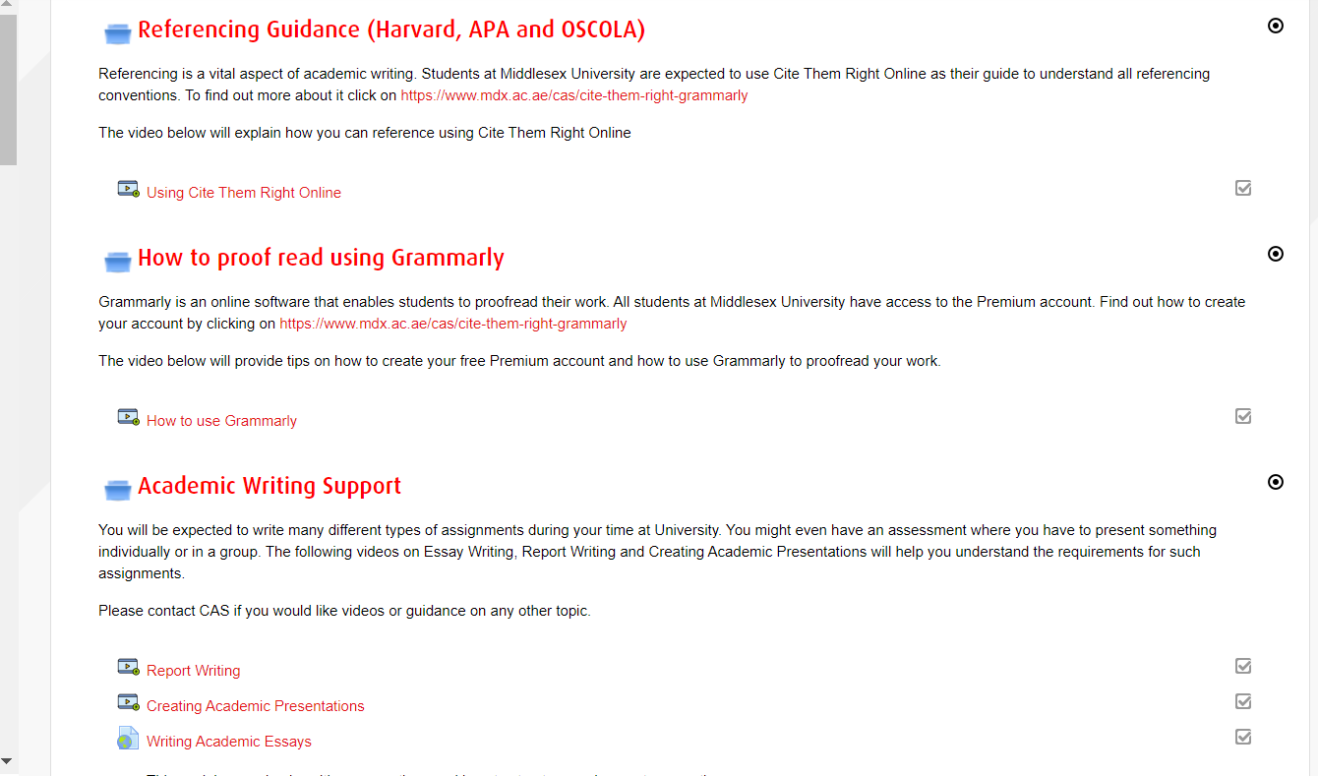
Dubai Teaching and Learning Support Page on Unihub
https://mdx.mrooms.net/course/view.php?id=24990
CAS drop-ins
CAS Videos

Slide 61
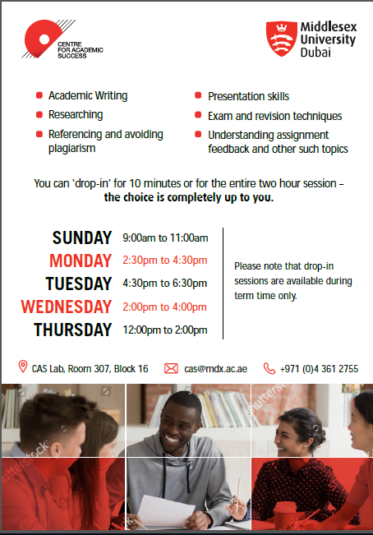
Need more help?
Sunday 10-12pm
Monday 2.30-4.30pm
Tuesday 2-4pm
Wednesday 4.30-6.30pm
Thursday 12-2pm

