Slide 1
Paradoxical Tensions and The Role of Paradox Mindset to Manage Sustainability Objectives among the social vs corporate sector leaders and their identity journey
Research Guide: Dr Soumya Rajan
-Submitted by
Sudipta Nayak
M2020ODC026

Slide 2
Presentation Agenda
1
2
Research Problem
Key Terms and Research Gap
3
4
Research Questions/ Hypothesis
Methods
5
6
Findings & Inferences
Limitations

Slide 3
01.
RESEARCH PROBLEM
Research on sustainability in India indicate cognitive frames aimed at tensions at the bottom of the pyramid projects (Sharma & Jaiswal, 2017). However, the acknowledgement and description of paradoxes in these observed tensions is absent from individuals\leaders who are working in these roles. Also the role of paradox mindset to cope with the paradoxes in the conditions of resources scarcity can be investigated and how it shaped leader’s identity

Slide 4
02.
Key Terms and Research Gap

Slide 5
Conceptual Map for Research

Slide 6
Sustainability Business Strategy And Perspectives
“﻿Sustainability business strategy is the integration of economic, environmental and social aims into a firm’s goals, activities and planning, with the aim of creating long-term value for the firm, its stakeholders and wider society. This means that strategy is formulated and executed so that the needs of the firm and its stakeholders are met today, while protecting, sustaining and enhancing the natural resources that will be needed in the future.” (Long, 2019)
Business Frame
Organization's primary responsibility is to create value for its owners and shareholders and pursue profit goals
Business Case
Proposes that pursuing certain specific social and economic goals are profitable for the business
Paradox Perspective
Competing yet complimentary missions are inherent in corporate sustainability
Win-Win
Both social and economic goals are achievable at the same time

Slide 7
Paradox Perspective of Corporate Sustainability
“﻿A paradox perspective on corporate sustainability accommodates interrelated yet conflicting economic, environmental, and social concerns with the objective of achieving superior business contributions to sustainable development.” (Hahn et al. (2017)
At its core, a paradox perspective on corporate sustainability embraces tensions to simultaneously accommodate competing yet interrelated economic, environmental, and social concerns that reside at different levels and operate in different logics and time frames and in different spatial scales (Hahn et al. 2014, 2015).
…a paradox perspective offers the conceptual foundations for a shift beyond the business case toward
‘‘management theory as if sustainability matters’’ (Gladwin et al. 1995, p. 896).
Paradox theory in management posits that paradoxes, i.e., ‘‘persistent contradiction between interdependent elements’’ (Schad et al. 2016, p. 6), are ubiquitous phenomena in organizations, resulting in tensions between various aspects that ‘‘seem logical in isolation but absurd and irrational when appearing simultaneously’’ (Lewis 2000, p. 760).

Slide 8
Aspects of Corporate Sustainability
Descriptive
Describing and explaining how firms and decision makers deal with paradoxical tensions?
Instrumental
To establish connection with the outcomes.
Normative
It is based on foundation that firms have responsibility that goes beyond financial performance and shareholder interests.
Better Understanding the antecedents and boundary conditions of paradoxical responses towards sustainability issues
Includes organisational, societal and environmental outcomes.
It also builds upon the idea that competing environmental and societal tensions have intrinsic value. It underpins the notion of a multi-objective corporation.

Slide 9
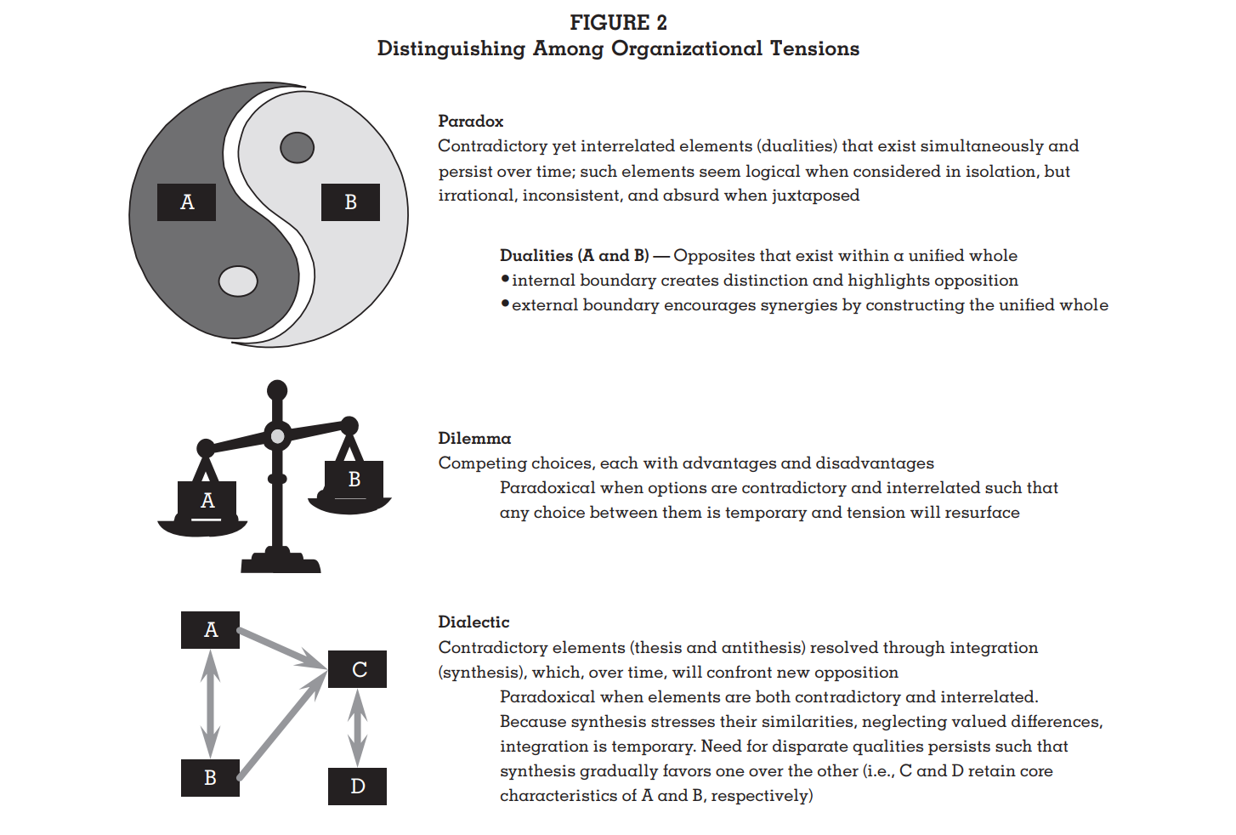
﻿Distinguishing Among Organizational Tensions

Slide 10
Paradox Mindset
Organisational paradoxes which are like double-edged swords, having the potential of innovation and peak performance, but also spurring anxiety that can lead to stress and counterproductive defences
Some people view tensions as dilemmas and likely to offer temporary reprieve, as it requires trade-offs according to them. But the tensions are likely to remain and resurface again.
View paradoxes as natural and persistent
Accept and embrace these constructs
Its ‘Both/and’ mentality
Perceive both the sides of paradoxes contains truth
Unleash innovation and creativity to deal with paradoxes

Slide 11
03.
RESEARCH QUESTIONS/ HYPOTHESIS

Slide 12
Research Questions/ Hypothesis
Are there inherit paradoxes in operationalizing sustainability goals? If yes, how can they be described?
Are the paradoxes experienced varying for the corporate vs the social sectors in the field of sustainability?
What motivated leaders to work in this field consistently and how it shapes their personal identity over the period?
Paradox mindset in the leaders positively influence the way leaders cope with the paradoxes at work

Slide 13
Purpose of the Research on Paradoxes in Sustainability
The premise of management as a process stands in optimizing the depleting and limited physical resources on the planet to meet the needs of society. Leadership as a process of managing paradoxical constraints could provide instrumental, normative and descriptive cues to the sustainability of societal institutions (Hahn, Figge et al, 2018). This research proposal is therefore to address the following aims, given the resource scarcity that underlies India’s socio-economic context and its dire needs for energy resources and utilities to achieve its socio-economic goals.
To explain how leaders in Indian organizations engage their paradoxes in influencing stakeholders of sustainability goals in their operating context
To understand variations and similarities across specific contexts in the process of managing paradoxes – e.g.
Social Sector Organizations
Corporate Sector Organizations

Slide 14
04.
Research Designs & Methods
Constructivist Worldview
Qualitative Design & Methods - Semi Structure Interviews
- LinkedIn Posts and activities analysis
- Thematic Analysis - Illustrative Case Studies
Reasons for choosing this design
The context and phenomenon can’t be separated
Data spread across the timeline
Progression individual identity & mindset
Indicators are not well pointed out for sustainability paradoxes and leaders journey

Slide 15
05.
Research Stages & Inferences
Piloting Stage
Listing the Individual, Organisational, Market paradoxes from social & corporate sector leader each
Data Collecting
Validating the Influence of mindset, individual background, identity journey, perspective on business and career, their leadership behaviour and personal lifestyle by focusing on Individual Paradoxes
Validation
Interviewing a mutual colleague and analysis of LinkedIn activities from past 6 months for validating the interpretation
Modelling & Theory Building
Maturity model for paradox integration for sustainability professionals

Slide 16
Sample Data Collection & Analysis
Individual Paradoxes
 | Strategic Decision Making | Contigent Decision Making | Personal Lifestyle | Organisational Performance | Sustainability Initiatives | Leadership Behaviour
Independent - autonomy oriented individualism |  |  |  |  |  |  | Inter-dependent - willingness to give up autonomy of self
Driven by Financial Outcomes |  |  |  |  |  |  | Driven by Sustainability Goals
Essential Need/ Frugal |  |  |  |  |  |  | Greed / Inessential consumption/ Spendthrift
Scarcity Mindset |  |  |  |  |  |  | Abundance mindset
Learning |  |  |  |  |  |  | Performing
Sticking to completing initiatives on hand |  |  |  |  |  |  | Experimenting new approaches

Slide 17
05.
Limitations & Future Scope
Needs to be tested in larger sample size of leaders in both corporate and social sector leaders of other organisations.
Can be referred to integrate the paradoxes of sustainability and as a professional guide to the maturity model

Slide 18
THANK YOU

Slide 19
Schedule
Sl. No. | Deliverable | Status
1 | Concept Map | Completed
2 | Research Questions | Completed
3 | Read on Research Questions | Completed
4 | Finalize schedule for Interviews | Completed
5 | Finish Interviews | In Progress
6 | Transcription | In Progress
7 | Coding of all the interviews | To be Started
8 | Write all the analysis of interviews | To be Started
9 | Another fresh Concept Map, Finish Literature writing, Research paper completion | To be Started
10 | Condense to a research paper | To be Started

