Slide 1
Today’s Agenda
Foundational Ideal/Paper
  Normal Accident Theory
  High Reliability Theory
Main Lecture
  Risk Assessment Guidance document
    United States Coast Guard Guide to Risk-based Decision Making
  Bow Tie Analysis
  Event Tree Analysis
  Fault Tree Analysis

Slide 2
Normal Accident Theory

Slide 3
Normal Accident Theory
Normal Accidents: Living with High-Risk Technologies
  1984 Charles Perrow
    Proposed a framework for characterizing complex technological systems…
      air traffic,
      marine traffic,
      chemical plants,
      nuclear power plants
    …according to their riskiness"
  Perrow says that multiple and unexpected failures are built into society's complex and tightly-coupled systems.
    Accidents become unavoidable and
    cannot be designed around,
    The accident within these systems should expected to become “normal” to the system

Slide 4
Normal Accident Theory
Normal Accident Theory
  Perrow's argument is based on
    human error,
    big accidents tend to escalate,
    technology is not the problem, the organization operating the system are the problem
  Thus, made the case for examining…
    Not just technological failures
    But organizational and management factors
  …as the main causes of failures.
  Simply put, technological disasters could no longer be ascribed to isolated equipment malfunction, operator error or acts of God.

Slide 5
Normal Accident Theory
Normal Accident Theory
  Perrow identifies two conditions that make a system likely to be susceptible to Normal Accidents
    The system is complex
      Not a linear system
      Includes feedback loops where small input yields disproportional output
      extent to which interactions among such components are unexpected, unplanned, or not visible
    The system is tightly coupled
      Degree of dependence among system components
      Rate at which system components respond is high
  The more complex and tightly coupled a system is, the more likely the accident will be
    Not necessarily because of failure of the system itself
    Instead, because of the failure of the human to
      Foresee all potential outcomes of design inputs
      Comprehend the impact of an action
      Absorb and respond all visual and auditory stimuli in a rational manner

Slide 6
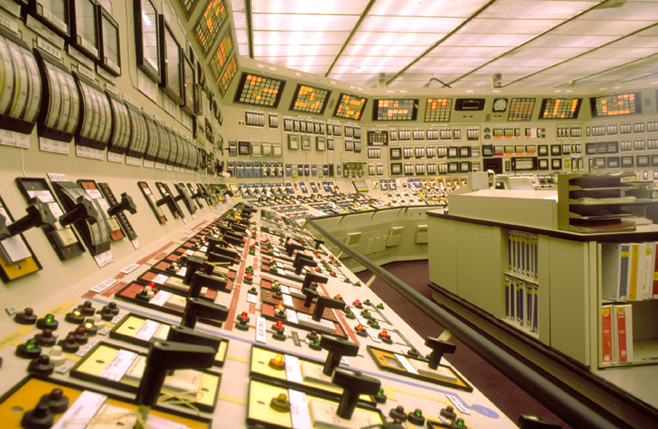
Normal Accident Theory
Older example:
  Control room of 1980’s Nuclear Powerplant

Slide 7
Normal Accident Theory
What Characterizes a Complex System?
  A system is complex if interactions between components are:
    Unfamiliar, unplanned, or unexpected sequences which are not visible or not immediately comprehensible
    Design features such as branching, feedback loops
    Opportunities for failures to jump across subsystem boundaries.
  A complex system is tightly coupled when it has:
    Time-dependent processes which cannot wait
    Rigidly ordered processes (as in sequence A must follow B)
    One or few pathways to a successful outcome
    Very little slack (requiring precise quantities of specific resources for successful operation).

Slide 8
Normal Accident Theory
So…we have lots of complex and coupled systems around us
  Nuclear Plants
  Financial systems
  Chemical processing plants
  Cities
….there must be lots of ‘accidents’ happening all the time…right?

Slide 9
Normal Accident Theory
Well, yes
  2008 financial crisis shutdown the global economy because of
    Complex financial instruments
      Collateralized Debt Obligations
      Interest Rate Swaps
    Lack of transparency
  When things started to go back in October 2008, no one knew
    Who directly held these now worthless CDO’s that held millions of home mortgages that were now worth less than owed
    Who was indirection exposed because of the Interest Rate Exchanges
  The global system of finance simply froze because know one new who was about to go under….
This was a classic example of NAT

Slide 10
Normal Accident Theory
So there are lot more examples…right?
  Well…not really
  Nuclear power plants … other than
    Chernobyl
    TMI
    Fukishima
  …have 60+ years of highly reliable operations, producing
    20% of US demand
    50% of European demand
So if NAT seems so intuitive….why are planes not falling out of the sky like raindrops?

Slide 11
High Reliability Organizations

Slide 12
High Reliability Organizations
One explanation of these “missing accidents” comes from the idea that in order to avoid catastrophic accidents occurring, systems designers and organizations have adapted to the complexity and coupling challenges by adopting the …
  Communication
  Redundancy
  Robustness
  Knowledge
  Learning Organization
….that are inherently required before such systems can exists
  And that each time there is an accident that is ‘normal’, the ‘culture’ adapts and updates requirements
  This ‘culture’ is generally referred to as High Reliability Organizations

Slide 13
High Reliability Organizations
From Wikipedia
  A high reliability organization (HRO) is an organization that has succeeded in avoiding catastrophes in an environment where normal accidents can be expected due to risk factors and complexity.
  Important case studies in HRO research include both studies of disasters
    Three Mile Island nuclear incident
    Challenger explosion
    Columbia explosion
    Bhopal chemical leak
    Mann Gulch forest fire
  As well as HROs like
    air traffic control system
    naval aircraft carriers
    nuclear power operations

Slide 14
High Reliability Organizations
From VA – Implementation of HRO Principles
  HRO was originally pioneered in extremely hazardous industries, such as nuclear power and commercial aviation, where even the smallest of errors can lead to tragic results.
  These industries have achieved and sustained extraordinary safety levels, thereby generating much interest in how to adapt HRO principles to health care and replicate this success.

Slide 15
High Reliability Organizations
From VA – Implementation of HRO Principles
  In their 2007 book “Managing the Unexpected,” Weick and Sutcliffe define the 5 principles of HROs and describe how these principles can be applied to improve reliability across diverse industries.
    (1) sensitivity to operations (ie, heightened awareness of the state of relevant systems and processes);
    (2) reluctance to simplify (ie, the acceptance that work is complex, with the potential to fail in new and unexpected ways);
    (3) preoccupation with failure (ie, to view near misses as opportunities to improve, rather than proof of success);
    (4) deference to expertise (ie, to value insights from staff with the most pertinent safety knowledge over those with greater seniority);
    (5) and practicing resilience (ie, to prioritize emergency training for many unlikely, but possible, system failures).

Slide 16
High Reliability Organizations
From VA – Implementation of HRO Principles
  See VA Document in Kodiak

Slide 17
NAT and HRO

Slide 18
NAT and HRO
See Paper in Kodiak

Slide 19
United States Coast Guard
Risk-Based Decision Making

Slide 20
USCG Risk-based Decision Making
After USCG Document
  Bowtie Analysis
    Using ISO 31010
  Event Tree Analysis
    Using USCG RBDM
  Fault Tree Analysis
    Using USCG RBDM

Slide 21
USCG – Risk-based Decision Making
This is one of the “Reference Guidance Documents” that we use in this course as a source of
  General guidance for Risk Management
  Source for instruction for specific Risk Assessment Method
So, what is “Risk-based Decision Making”, and why would the USCG want to produce an entire 4 volume document that governs how the USCG makes decisions?
  But first, since this is a USCG document, very clearly it will have a maritime perspective…..
  Do not let this distract you from the fact that the guidance document is an excellent resource for whatever Risk Management or Assessment environment you work in
  Replace the work “Maritime” with “Industry”, “Public Works”, “Financial” or any other risk perspective, and you will still use the same guidance….

Slide 22
USCG Risk-based Decision Making
There are 4 volumes to the document
  Volume 1 – Risk-based Decision Making Navigator
  Volume 2 – Introduction to Risk-based Decision Making
  Volume 3 – Procedures for Assessing Risk
  Volume 4 – Examples Risk Assessments
We will start with a review of
  Volume 1
  Volume 2 – Chapter 1
Then review two methods outlined in Volume 3, using Volume 4 examples to demonstrate
  Event Tree Analysis
  Fault Tree Analysis

Slide 23
Bowtie Analysis
See ISO 31010 – B.21 Bowtie Analysis

Slide 24
Bowtie Analysis
Release of Refrigerant from onboard refrigeration system

Slide 25
Event Trees

Slide 26
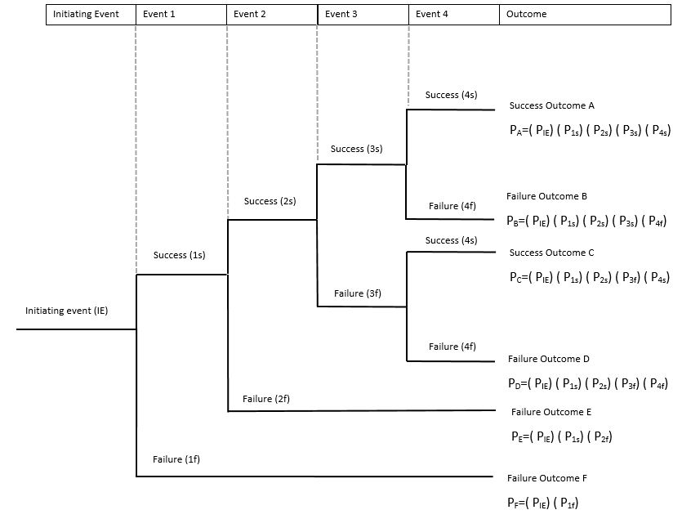
Event Tree Analysis
Event Tree (Wikipedia
  Event tree analysis (ETA) is a forward, bottom up, logical modeling technique for both success and failure that explores responses through a single initiating event and lays a path for assessing probabilities of the outcomes and overall system analysis.
  This analysis technique is used to analyze the effects of functioning or failed systems given that an event has occurred
  ETA is a powerful tool that will identify consequences of a system that have a probability of occurring after an initiating event that can be applied to a wide range of systems including
    nuclear power plants
    spacecraft
    chemical plants

Slide 27
Event Tree Analysis
Event Tree (Wikipedia
  Event tree analysis (ETA) is a forward, bottom up, logical modeling technique for both success and failure that explores responses through a single initiating event and lays a path for assessing probabilities of the outcomes and overall system analysis.
  This analysis technique is used to analyze the effects of functioning or failed systems given that an event has occurred
  ETA is a powerful tool that will identify consequences of a system that have a probability of occurring after an initiating event that can be applied to a wide range of systems including
    nuclear power plants
    spacecraft
    chemical plants

Slide 28
Event Tree Analysis
In the general sense
  We start with an initiating event (IE)
    Then there is a Secondary Event
      Probability of success or failure of secondary event
    Then a third event
    Then a fourth
    Etc…
    Until we have mapped the entire system
  We have also mapped….in theory… all of the possible consequences from the initiating event…
    ,…including the probability that each of these pathways will manifest
  But, Wait!!!
    …there’s more….

Slide 29
Event Tree Analysis
Event Tree Analysis can be presented and used
  Qualitatively
  Quantitatively
  Qualitative and Quantitative
We will present a mixed qualitative and quantitative Case Study
  United States Coast Guard ETA for
    Estimating probability of fatalities due to hypothermia deaths, given passengers must abandon vessel
    Estimating impact of risk mitigation efforts on probability of hypothermia
  “Gaming Vessels”
    Boats that leave port, and travel beyond 3 mile off shore so that they are outside “state waters”, and inside “federal waters”
    This allows them to have gambling or “gaming”
    The USCG is concerned with the capacity to rescue these people, given an accident occurs…

Slide 30
Event Tree Analysis
The paper (posted to Kodiak) presents
  Base Case
    600 people on board
    No life vests (Independent Buoyancy Apparatus – IBA)
    all 600 people must abandon ship (enter the water)
    Question 1
      What is the probability of saving 100% of the people before hypothermia deaths occurs?
    Question 2
      What is the probability of saving 97% of the people before hypothermia deaths occur?

Slide 31
Event Tree Analysis
The paper (posted to Kodiak) presents
  Base Case
    600 people on board
    No life vests (Independent Buoyancy Apparatus – IBA)
    all 600 people must abandon ship (enter the water)
    Question 1
      What is the probability of saving 100% of the people before hypothermia deaths occurs?
    Question 2
      What is the probability of saving 97% of the people before hypothermia deaths occur?
  Risk Mitigation Testing
    Case 1
      What is the impact on these probabilities if at least two vessels must be located near each other at all times (one vessel can help save the passengers from the other vessel)

Slide 32
Event Tree Analysis
The paper (posted) presents
  Base Case
    600 people on board
    No life vests (Independent Buoyancy Apparatus – IBA)
    all 600 people must abandon ship (enter the water)
    Question 1
      What is the probability of saving 100% of the people before hypothermia deaths occurs?
    Question 2
      What is the probability of saving 97% of the people before hypothermia deaths occur?
  Risk Mitigation Testing
    Case 1
      What is the impact on these probabilities if at least two vessels must be located near each other at all times (one vessel can help save the passengers from the other vessel)
    Case 2
      What is the impact on these probabilities if all vessels are required to have IBA’s for all passengers onboard?

Slide 33
Event Tree Analysis
The paper (posted) presents
  See paper

Slide 34
Event Tree Analysis
BASE CASE:
  There are, of course, specific conditions that will impact the probability
    Day time versus night time
    Warm water versus cold water
The USCG method outlines a fairly well defined process to consider these “system characteristics”
  Define the critical system parameters in binary format
    Event (600 in water)
      Physical Phenomena 1
        Probability of warm or cold water
      Physical Phenomena 2
        Day time or night time
      Mitigation Effort 1
        Second gaming vessel nearby
      Mitigation Effort 2
        Random vessel nearby

Slide 35
Event Tree Analysis

Slide 36
Event Tree Analysis
Base Case
  You can see here that the USCG modeled…
    Two Physical Phenomena
    Two Mitigation Efforts
  This resulted in 10 possible pathways / “Scenario”
      Scenario 1
        Warm water = yes (success)
        Day time = yes (success)
        Second gaming vessel = yes (success)
        Other vessel = yes (success)
      Given this scenario There is a 90% probability that no deaths will occur

Slide 37
Event Tree Analysis
Base Case
  You can see here that the USCG modeled…
    Two Physical Phenomena
    Two Mitigation Efforts
  This resulted in 10 possible pathways / “Scenario”
      Scenario 1
        Warm water = yes (success)
        Day time = yes (success)
        Second gaming vessel = yes (success)
        Other vessel = yes (success)
      Given this scenario There is a 90% probability that no deaths will occur

Slide 38
Event Tree Analysis
Base Case
  Further, notice that there is a 0.0054 probability that this scenario…
    including zero death
  …will occur

Slide 39
Event Tree Analysis
Base Case
  Finally…. You will also notice that
    Each of the 10 pathways spits to determine the probability of success or failure of each scenario
    Total of 20 results
  Given that each results is either a success of failure,
    We can determine the total probability of success or failure for the system
      Here we can see that this is
        10% chance for success
          No deaths
        90% chance for failure
          At least one death

Slide 40
Event Tree Analysis
Base Case
  Finally…. You will also notice that
    Each of the 10 pathways spits to determine the probability of success or failure of each scenario
    Total of 20 results
  Given that each results is either a success of failure,
    We can determine the total probability of success or failure for the system
      Here we can see that this is
        10% chance for success
          No deaths
        90% chance for failure
          At least one death

Slide 41
Event Tree Analysis
So, that is, in itself, very interesting information
  There is a 90% probability that passengers will die from hypothermia, given the Base Case Scenarios
But…..what happens if we require IBA’s?
  For this we must develop another Event Tree with this new Mitigation Effort

Slide 42
Event Tree Analysis
What is the impact of this new mitigation Effort?
  73% probability of no deaths

Slide 43
Event Tree Analysis
See USCG – ETA Case Study

Slide 44
Event Tree Analysis
The full paper describes the full study and analysis with
  3 questions
  4 scenarios
Paper is posted to Kodiak
  But in short
    Event Tree Analysis was used by the USCG to
      Model the system characteristics that are relevant to the consequences of the initiating event
      Determining the probability of each consequence occurring
      Combining similar consequence towards determining overall Success or Failure of the system
      Implementing some Risk Reduction/Mitigation Characteristic to the system
      Recalculate the total probability of success/failure
    This had the effect of determining the
      1) underlying “Risk” within the system
      2) impact of risk mitigation strategies to the system

Slide 45
Event Tree Analysis Example 2

Slide 46
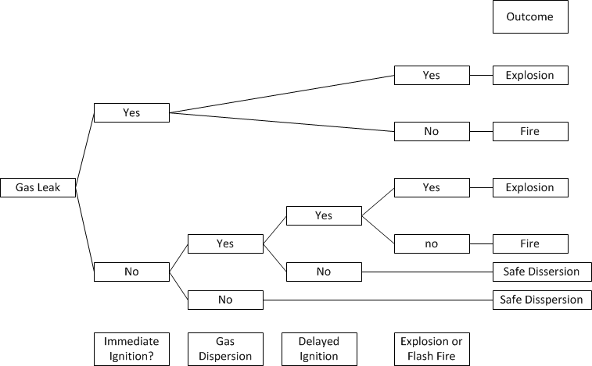
Event Trees
Lets look at another example:
  A gas leak in basement of commercial building, What is the probability that this will result in an explosion?
    This depends on subsequent events
      Will the gas disperse safety?
      Will there be a ignition source?

Slide 47
Event Trees
Lets look at another example:
  A gas leak in basement of commercial building, What is the probability that this will result in an explosion?
    This depends on subsequent events
      Will the gas disperse safety?
      Will there be a ignition source?
    Just in the same way that we “built out” the sinking of the boat into hypothermia deaths, and probability of success/failure…
    …where we can construct subsequent events (after the leak) to determine the probability that the event will result in an explosion (or other outcome we seek)
  Notice that we have to define the
    Preliminary event
      Example 1: boat sinks
      Example 2: Gas leak
    “Success” or “Failure”
      Example 1: rescue of 100% of people prior to hypothermia death
      Example 2: Explosion

Slide 48
Event Trees
First, we have to build out the scenario as we believe that it will occur
  Will there be an immediate ignition?
  Will the gas disperse, if not immediate ignition
  Will there be a delayed ignition if the gas does not disperse
  Will the ignition result in a fire or explosion?

Slide 49
Event Trees
First, we might want to visualize the event as an event tree

Slide 50
Event Trees
Second we determine or estimate the probabilities of each event
  Given a Gas Leak, what is the probability of Fire and Explosion in a residence?
    21% chance of a immediate ignition given leak
      82% chance of Explosion
      18% chance of fire
    79% of no immediate ignition, given leak
      44% chance of gas dispersion in confined space
        89% chance of delayed ignition
          22% chance of explosion
          78% chance of fire
        11% chance of safe dispersion
      56% chance of safe dispersion

Slide 51
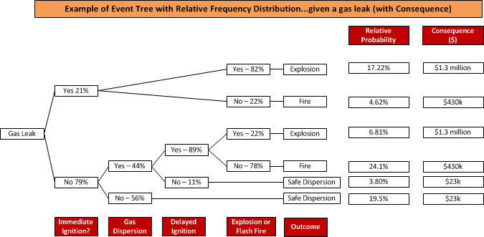
An event tree with probability and consequence

Slide 52
Event Trees
Third we calculate the probability of the “Success” or “Failure” that we are seeking.

Slide 53
Event Trees
Third we calculate the probability of the “Success” or “Failure” that we are seeking.
  Explosion = 17.2+6.8 = 24%
  Fire = 4.6+24.1 = 28.7%
  No fire or explosion = 100 – 24 – 28.7 = 57.2%

Slide 54
Event Trees
Event Trees are excellent for building up an initial event into a defined “success” or “failure” outcome
But, as you could imagine, this can get complicated quickly with all the perceived events that might occur from the initial trigger event, and subsequent follow-on events

Slide 55
Event Trees
Now… the burning question is….
  What is the probability of
    Boat sinking
    Gas leak
  For that…we introduce…

Slide 56
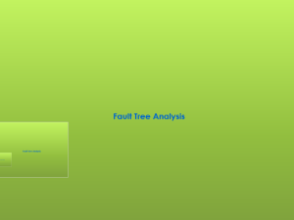

Fault Tree Analysis

Slide 57
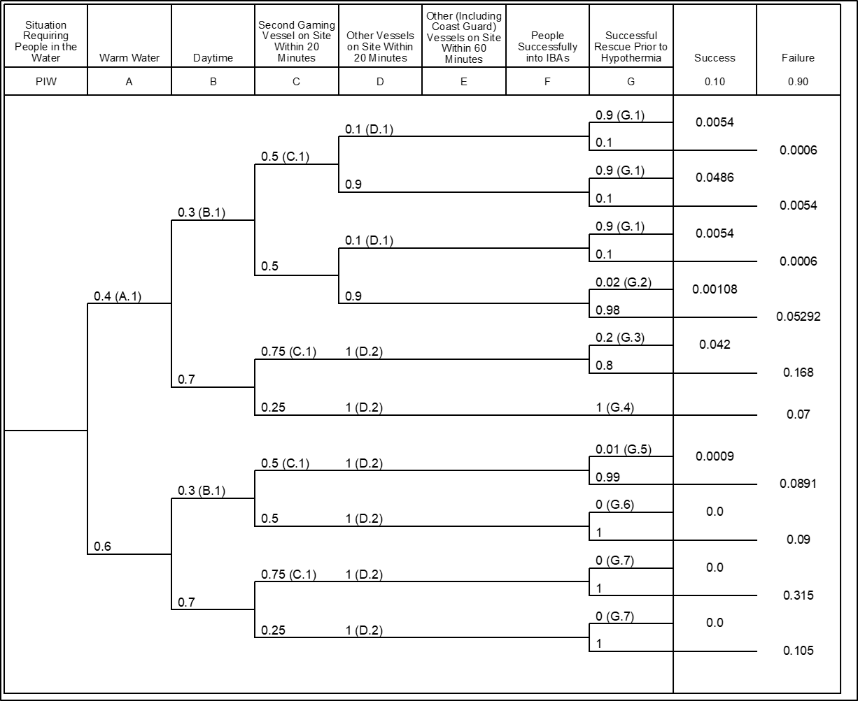
Fault Tree Analysis
Remember this?
  Well, here is a question for you….
    What is the probability that people will end up in the water?

Slide 58
Fault Tree Analysis
Good question…..
  What IS the probability that the will end up in the water?!
  And how do we figure it out????
Well… it ain’t easy, I can tell you that.
  There is an underlying concept of a “Causal Model”, wherein
    The entire operating environment is modeled
    Failure likelihoods of each component in that system is determined through
      Data
      Structured interview with SME
    The consequence of that component failure is determined
    And so on through the system
    Until some overall probability of system failure (such as the boat sinking) is determined

Slide 59
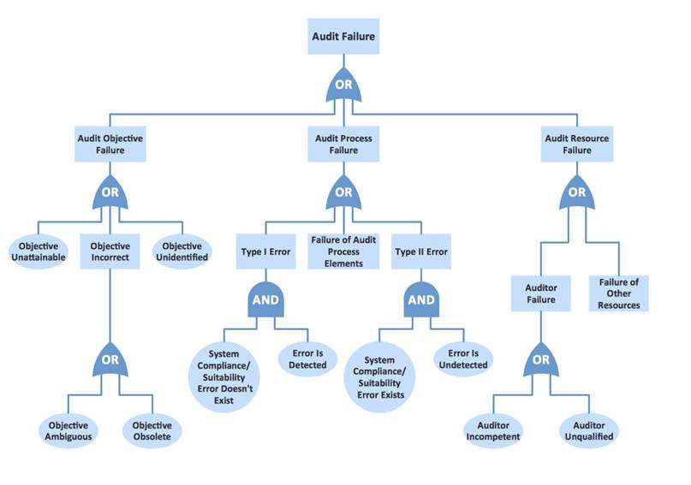
Fault Tree Analysis
One form of this ‘causal model’ commonly used by industry is the Fault Tree
  A common definition is “a deconstruction of a failure to basic causal components”

Slide 60
Fault Tree Analysis
One form of this ‘causal model’ commonly used by industry is the Fault Tree
  A common definition is “a deconstruction of a failure to basic causal components”

Slide 61
Fault Tree Analysis
In the general sense, FTA is a framework for deconstructing a complex system in order to
  Identify root causal factor of a failure
  Find pathways to failure
  Determine probability that a failure will occur
  Simplifying a complex system through Boolean Logic to identify “Minimal Cut Sets” in order to determine more relevant failure mitigation strategies

Slide 62
Fault Tree Analysis
Wikipedia:
  Fault tree analysis (FTA) is a top down, deductive failure analysis in which an undesired state of a system is analyzed using Boolean logic to combine a series of lower-level events.
  This analysis method is mainly used in the fields of safety engineering and reliability engineering to understand how systems can fail, to identify the best ways to reduce risk or to determine (or get a feeling for) event rates of a safety accident or a particular system level (functional) failure.
  FTA is used in the aerospace, nuclear power, chemical and process, pharmaceutical, petrochemical and other high-hazard industries
  but is also used in fields as diverse as risk factor identification relating to social service system failure

Slide 63
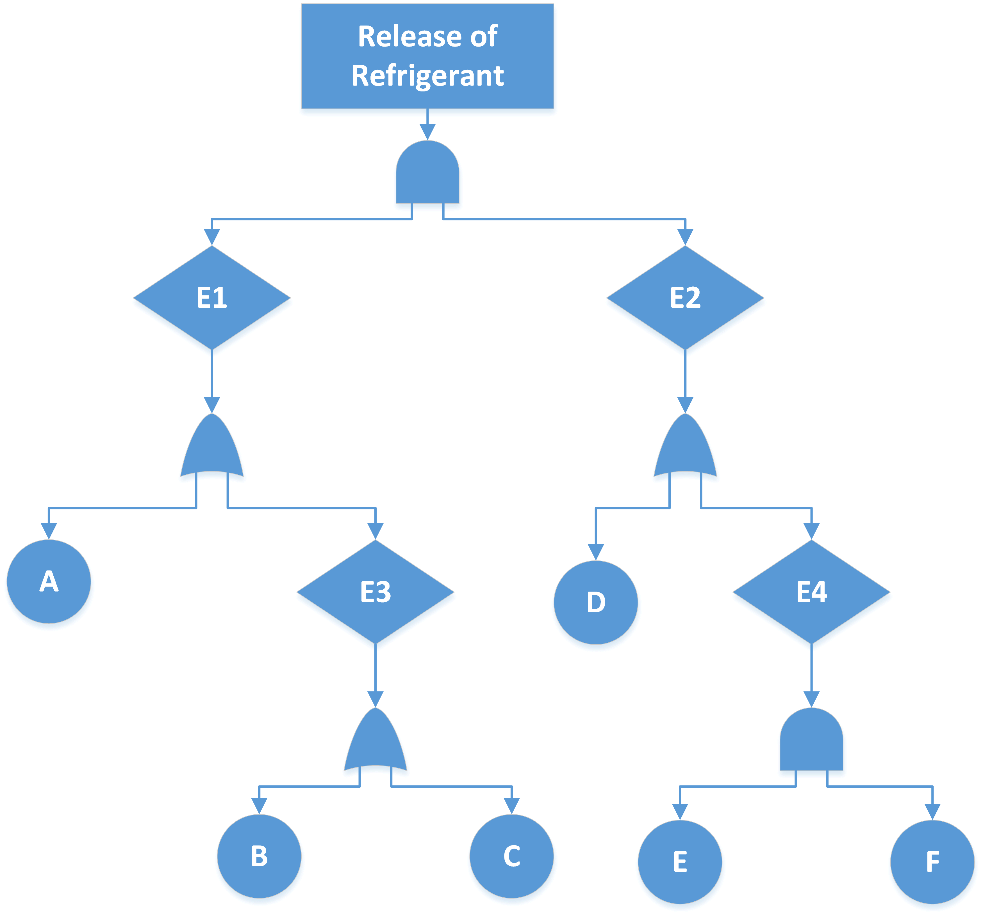
Fault Tree Analysis
A very basic Fault Tree Analysis might look like this
  An “Event” (failure of some system) is deconstructed into
    Preceding events
      Failure of process
      Failure of component
      Failure of design
      Failure of safety system
  Each of these are then deconstructed into preceding events
    This is continued until we get to basic root causal “basic” events
      Basic Events
      “AND” Gates
      “OR” Gates

Slide 64
Fault Tree Analysis
The “event” or “failure”

Slide 65
Fault Tree Analysis
In reality, there are many more
  Events
  Gates
  Conditions
But we will stick with simple examples
The remainder can be self-studied in a NASA Fault Tree Analysis Guidebook posted to Kodiak

Slide 66
Fault Tree Analysis
Lets repeat that with an example of the USCG with the “vessel taking on water” as “the event”

Slide 67
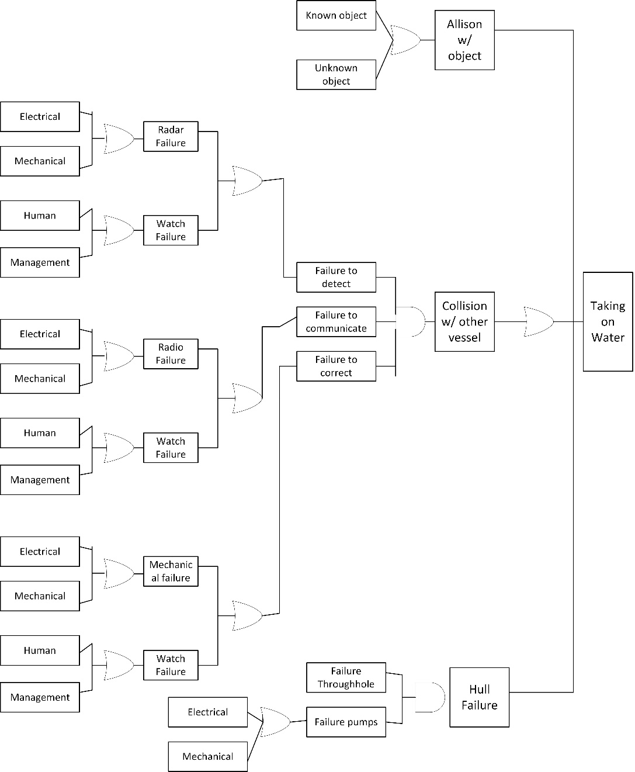
Fault Tree Analysis
Looking at it a bit cleaner
  This is just the first few steps.
  More complete FTA might have more layer
  And clearly it can get complicated…and needs high level expertise

Slide 68
Fault Tree Analysis
Lets take a look at another example:
  Event (T) = “Freon released into a confined space where individuals are at risk due to inhalation hazard and oxygen displacement hazard”
    Remember Week 2 HAZOP example
    Freon is an refrigerant that:
      Displaces oxygen in the space if not vented
      Can freeze lung innards if inhaled
      Carries secondary substances (oil particulates) that can cause breathing distress

Slide 69
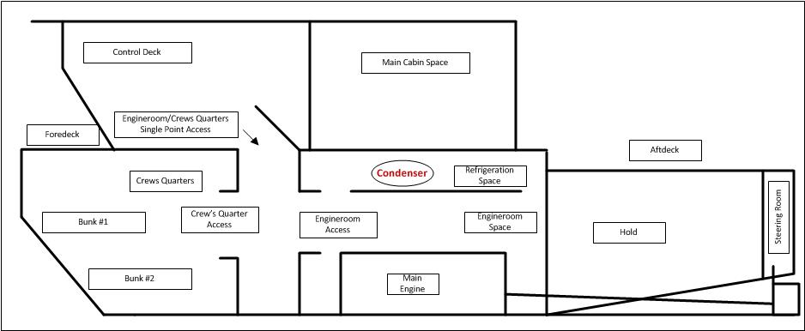
Fault Tree Analysis
Why a Freon leak?...because they kill.
  First, here is my cheesy schematic of a fishing boat
  Refrigeration system is in the same compartment as the engineroom, on the same deck as the crew’s quarters
  Freon displace oxygen…the stuff we need to breath

Slide 70
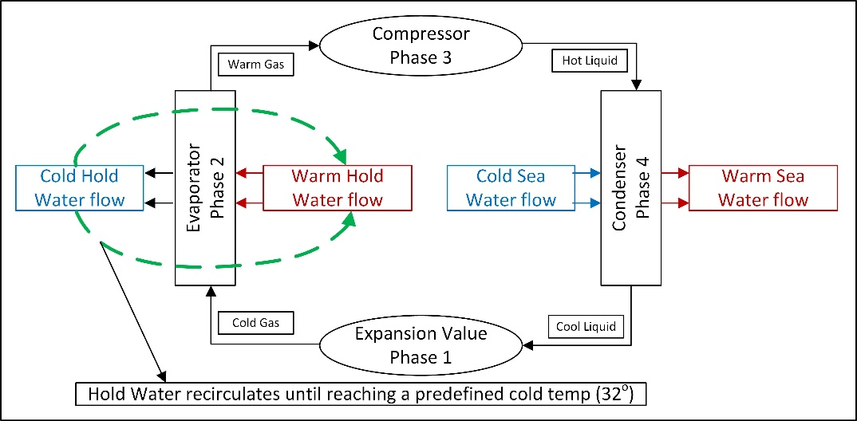
Fault Tree Analysis
Refrigeration system functional decomposition
  Can be envisioned as three separate systems
    System 1: Refrigeration system
      Evaporator
      Compressor
      Condenser
      Expansion
    System 2: Hold-water Circulating systems
      Pump
      Values
      Pipes
    System 3: Condenser-water Circulating system
      Pump
      Values
      Pipes

Slide 71
Fault Tree Analysis
Lets work through a simple example:
  Event (T) = “Freon is released into a confined space where individuals are at risk due to inhalation hazard”
  Step 1: “Deconstruct” this event as a series of preceding/antecedent events that must occur in order for Event (T) to occur
    Clearly there must be high quality knowledge of the system in order for this to be done
    Only possible with very knowledgeable Expert Judges
    Hopefully you will see from this just how important Subject Matter Experts (SME) are to Risk Analysis…
    …simple because the only “data” we have is the knowledge that experts have in the system

Slide 72
Fault Tree Analysis
Lets work through a simple example:
  Event (T) = “Freon is released into a confined space where individuals are at risk due to inhalation hazard”
  Step 1: “Deconstruct” this event as a series of preceding/antecedent events that must occur in order for Event (T) to occur
    Lets use our “Expert Judgement” to map these events as they must occur in order for Event (T) to occur
      Event 1 (E1)= Pressure in system increases to 300 psi

Slide 73
Fault Tree Analysis
Lets work through a simple example:
  Event (T) = “Freon is released into a confined space where individuals are at risk due to inhalation hazard”
  Step 1: “Deconstruct” this event as a series of preceding/antecedent events that must occur in order for Event (T) to occur
    Event 1 (E1)
      Pressure in system increases to 300 psi
    Basic Event A
      High Water Temp
We call this a “basic event” because from our knowledge of the system, we do not find benefit from exploring this pathway further…it might just be a natural state which we can not impact

Slide 74
Fault Tree Analysis
Lets work through a simple example:
  Event (T) = “Freon is released into a confined space where individuals are at risk due to inhalation hazard”
  Step 1: “Deconstruct” this event as a series of preceding/antecedent events that must occur in order for Event (T) to occur
    Event 1 (E1)
      Pressure in system increases to 300 psi
    Basic Event A
      High Water Temp
    Event 3 (E3)
      To much Freon in system
        Basic Event B
          Maintenance Failure 1
        Basic Event C
          Maintenance Failure 2

Slide 75
Fault Tree Analysis
Lets work through a simple example:
  Event (T) = “Freon is released into a confined space where individuals are at risk due to inhalation hazard”
  Step 1: “Deconstruct” this event as a series of preceding/antecedent events that must occur in order for Event (T) to occur
    Event 2 (E2)
      System Over Pressure Safety Cut-Off Switch Fails

Slide 76
Fault Tree Analysis
Lets work through a simple example:
  Event (T) = “Freon is released into a confined space where individuals are at risk due to inhalation hazard”
  Step 1: “Deconstruct” this event as a series of preceding/antecedent events that must occur in order for Event (T) to occur
    Event 2 (E2)
      System Over Pressure Safety Switch Failure
    Basic Event D
      Mechanical Failure (age related)

Slide 77
Fault Tree Analysis
Lets work through a simple example:
  Event (T) = “Freon is released into a confined space where individuals are at risk due to inhalation hazard”
  Step 1: “Deconstruct” this event as a series of preceding/antecedent events that must occur in order for Event (T) to occur
    Event 2 (E2)
      System Over Pressure Safety Switch Failure
    Basic Event D
      Mechanical Failure (age related)
    Event 4 (E4)
      Maintenance Failure
        Basic Event E
          System Bypassed by Operator (intentional)
        Basic Event F
          System Damaged by operator (not intentional)

Slide 78
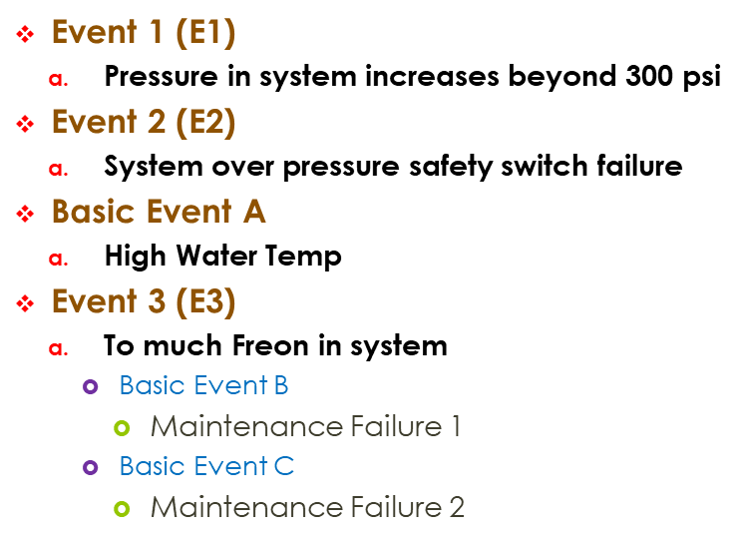
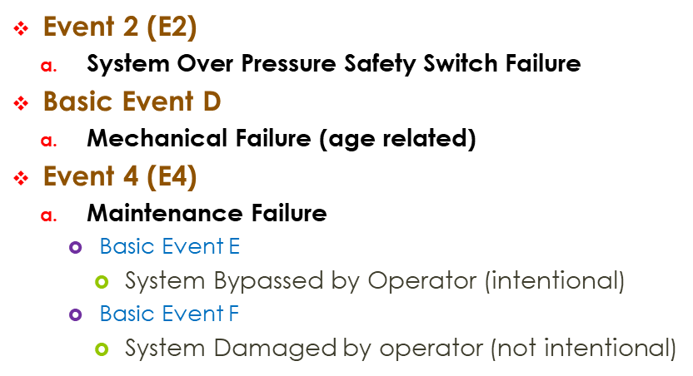
Fault Tree Analysis
Lets work through a simple example:
  Event (T) = “Freon is released into a confined space where individuals are at risk due to inhalation hazard”
    The result is the “failure” mapped as a series of events that must occur in order for the primary failure (T) to occur

Slide 79
Fault Tree Analysis
Lets work through a simple example:
  Step 2: Construct the Fault Tree
    In reality, we started with the Fault Tree,
    But in a normal analysis, the process starts with a deep discussion about the preceding events…
    …followed by a deep discussion about the nature of
      AND
      OR
      Exclusive OR
      And other gate options

Slide 80
Fault Tree Analysis
Lets work through a simple example:
  Step 2: Construct the Fault Tree
    To this point, we now have just repeated what we did for the USCG FTA from the point of people in the water
    Next, we are going to add in the layer of probability
      In ETA, this was binary
        Probability that Yes it will occur
        Probability that No it will not occur
      In FTA, this CAN be the same…but doesn’t have to be
        We still estimate probability but does not have to equal 1
          Will demonstrate why not = 1 later

Slide 81

Fault Tree Analysis
Step 3: Convert Fault Tree to Boolean Logical mathematics representation
  Note:
    AND Gate = Multiplication
    OR Gate = Addition
  $T=E1∗E2$
  $E1=a+E3$
  $E2=d+E4$
  $E3=b+c$
  $E4=e∗f$

Slide 82
Fault Tree Analysis
Step 4: Determine through research, or estimate through SME-EJE probability of each Basic Event occurring
  This is very interesting, because we …
    …Might have Quality Engineering data on
    Switch Pump Failure Rates
    Human Failure Rates
  …But, we might only have our experts to estimate these possibilities
    So again, we can see that SME’s are critical
Note that FTA can be
  Purely Quantitative
  Purely Qualitative
  Or combination of Qual and Quant

Slide 83
Fault Tree Analysis
Step 4: Determine through research, or estimate through SME-EJE that probability of each Basic Event occurring
  Lets say that we do have some solid Quality Engineering Data and Expert Judgement
    P(a) = 0.00023
      based on SME Judgement
    P(b) = 0.002
      based on Quality Engineering Data
    P(c) = 0.2
      based on SME Judgement
    P(d) = 0.02
      based on Quality Engineering Data
    P(e) = 0.01
      based on Quality Engineering Data
    P(f) = 0.001
      based on Quality Engineering Data
Let’s assume that these probabilities are from maintenance records , and so are quantitative

Slide 84
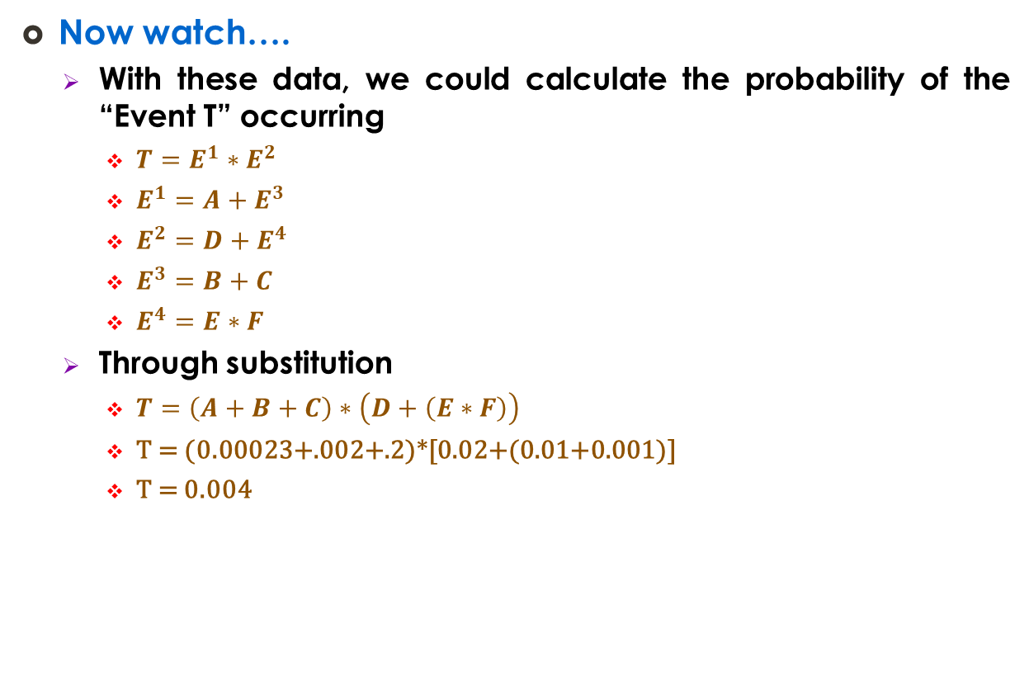
Fault Tree Analysis
Now watch….
  With these data, we could calculate the probability of the “Event T” occurring
    $T=E^{1}∗E^{2}$
    $E^{1}=A+E^{3}$
    $E^{2}=D+E^{4}$
    $E^{3}=B+C$
    $E^{4}=E∗F$
  Through substitution
    $T=\left(A+B+C\right)∗\left(D+\left(E∗F\right)\right)$
    T = (0.00023+.002+.2)*[0.02+(0.01+0.001)]
    T = 0.004
Event T

Slide 85

Fault Tree Analysis
With this information, we could calculate the probability of the “Event T” occurring
  $T=4.4E^{−5}$
Well that was easy….

Slide 86
Fault Tree Analysis
So what…you say….what do we do with this?
  Well…go back to the 5 Questions
    Q1: what can go wrong
      Refrigeration leak
    Q2: Likelihood that it will go wrong
      Well….we just used calculated that by deconstructing the system into pathways of failure
      Then we estimated the basic events failure in each pathway
      Finally, we combined the pathways to failure into a combined probability of event occurring through
        Expert estimate
        Maybe hard data
    Pretty cool…huh?!

Slide 87

Fault Tree Analysis
Ok, now…lets repeat that using the USCG …
  ETA
  FTA
…to see what happens in context of the 5 Questions and the Bowtie Diagram

Slide 88
Fault Tree Analysis
We can connect the two together!!!
  Does not mean that they MUST be connected…but we can in order to
    Q1: what can go wrong
      People in water due to vessel taking on water

Slide 89
Fault Tree Analysis
We can connect the two together!!!
  Does not mean that they MUST be connected…but we can in order to
    Q2: probability of this hazard (risk scenario) occurring
      See FTA
1.0x10⁻⁶

Slide 90
Fault Tree Analysis
We can connect the two together!!!
  Does not mean that they MUST be connected…but we can in order to
    Q3: consequence if it does go wrong
      See ETA

Slide 91
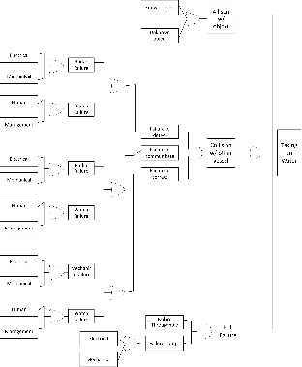
Fault Tree Analysis
We can connect the two together!!!
  Now this is were we can get really high resolution information
    If we have the estimate of the event occurring (from FTA)
      We can carry this through the ETA to determine the probability of each failure event AND consequence
    Example
      With 1x10(-6) probability of event occurring…
        We can calculate the probability of each consequence scenario occurring simply as product of
          Success
          Prob event occurring
        Absolute Probability of Success
          Relative prob of success = 0.1
          Prob of occurrence of Event T = 1x10(-6)
          0.1 x [1x10(-6)] = 1x10(-7)
1.0x10⁻⁶

Slide 92
Fault Tree Analysis
We can connect the two together!!!
  Now this is were we can get really high resolution information
    If we have the estimate of the event occurring (from FTA)
      We can carry this through the ETA to determine the probability of each failure event AND consequence
    Example
      With 1x10(-6) probability of event occurring…
        We can calculate the probability of each consequence scenario occurring simply as product of
          Success
          Prob event occurring
        Absolute Probability of Failure
          Relative prob of failure = 0.9
          Prob of occurrence of Event T = 1x10(-6)
          0.9 x [1x10(-6)] = 9x10(-7)
1.0x10⁻⁶

Slide 93
Fault Tree Analysis
We can connect the two together!!!
  So… by conducting a ETA & FTA, we can estimate the probability of a specific hazard scenario occurring
    In this case: probability of at least one person dying due to vessel taking on water
      P() = 9x10(-7)

Slide 94
Fault Tree Analysis
We can connect the two together!!!
  Q4: how do we feel about it?
    Well….less than one in a million [9x10(-7)] isn’t very much…so we are ok with it.
    But maybe we want to mitigate it a bit more so see if we can lower risk to < 1x10-7

Slide 95
Fault Tree Analysis
We can connect the two together!!!
  Q5: what are we going to do about it
    Just like we used the ETA to test impact of interventions…
    We can use the FTA to test impacts of likelihood reduction (barriers)

Slide 96
Fault Tree Analysis
Now let’s get really weird with the minimum cut set of FTA

Slide 97
Fault Tree Analysis
This was a very simple example
  Just a few events…
  …just a few pathways
Other systems …
  Mechanical
  Electrical
  Process
  Sociological
…are far more complex

Slide 98
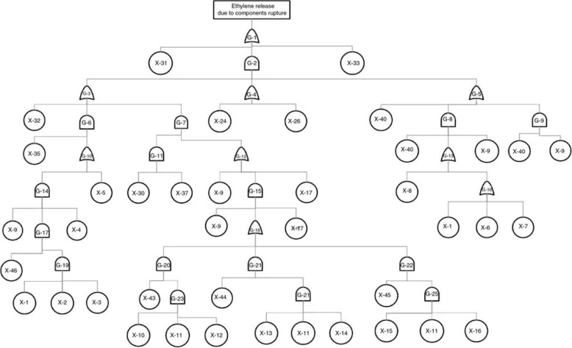
Fault Tree Analysis
A deeper analysis of the refrigeration system would return a Fault Tree that looks more like this...
  …and still more complex systems can be vast…
  …with hundreds of basic events
Further…
  A single basic event might appear multiple times throughout the Fault Tree
  Simply because a single basic event might be the basic cause of multiple failures

Slide 99
Fault Tree Analysis
Event X-40 in 2 pathways ←
→ Event X-11 in 3 pathways ←
Example of a more complex system
  …and still more complex systems can be vast…
  …with hundreds of basic events
Further, a single basic event (basic event d) might appear multiple times throughout the Fault Tree
  Simply because a single basic event might be the basic cause of multiple failures

Slide 100
Fault Tree Analysis
It is COMMON for Basic Events to be implicated in multiple pathways to failure in an Fault Tree
  To develop a sense of the impact of these repeat Basic Events on the total system, we develop Minimal Cut Sets
  Minimal Cut Set
    A minimal cut set is a cut set such that if any basic event is removed from it, the top event will not necessarily occur if all remaining events in the cut set occur

Slide 101
Minimal Cut Set

Slide 102
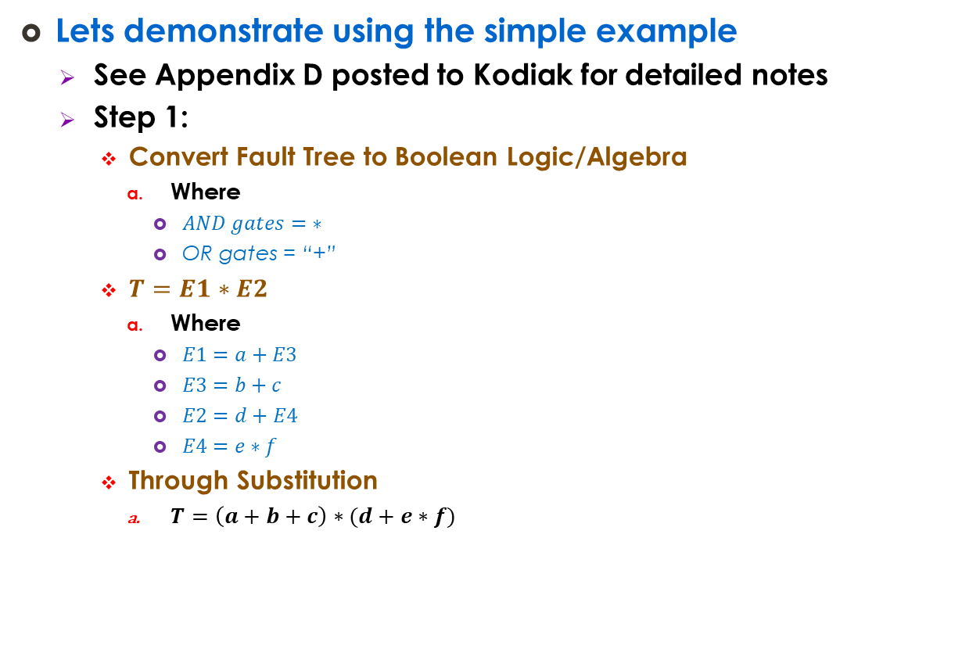
Minimal Cut Sets
Lets demonstrate using the simple example
  See Appendix D posted to Kodiak for detailed notes
  Step 1:
    Convert Fault Tree to Boolean Logic/Algebra
      Where
        $AND gates=\text{∗}$
        OR gates = “+”
    $T=E1∗E2$
      Where
        $E1=a+E3$
        $E3=b+c$
        $E2=d+E4$
        $E4=e∗f$
    Through Substitution
      $T=\left(a+b+c\right)∗(d+e∗f)$

Slide 103

Minimal Cut Sets
Lets demonstrate using the simple example
  $T=\left(a+b+c\right)∗\left(d+e∗f\right)$
  Step 2:
    Review Boolean Logical Rules for minimization of Expression

Slide 104
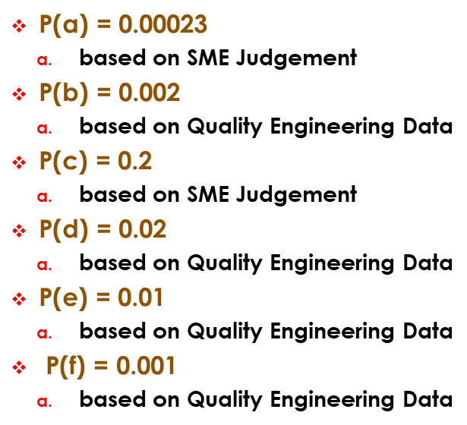
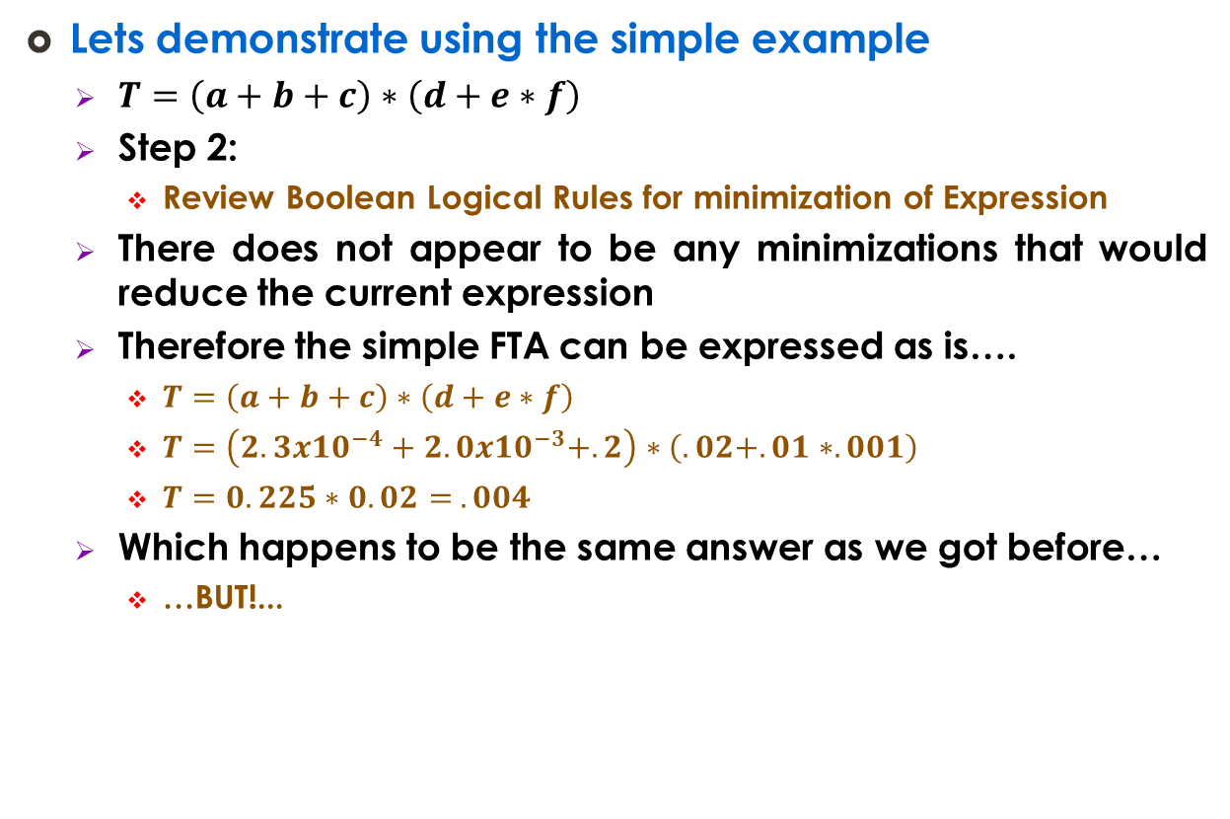
Minimal Cut Sets
Lets demonstrate using the simple example
  $T=\left(a+b+c\right)∗\left(d+e∗f\right)$
  Step 2:
    Review Boolean Logical Rules for minimization of Expression
  There does not appear to be any minimizations that would reduce the current expression
  Therefore the simple FTA can be expressed as is….
    $T=\left(a+b+c\right)∗\left(d+e∗f\right)$
    $T=\left(2.3x10^{−4}+2.0x10^{−3}+.2\right)∗\left(.02+.01∗.001\right)$
    $T=0.225∗0.02= .004$
  Which happens to be the same answer as we got before…
    …BUT!...

Slide 105
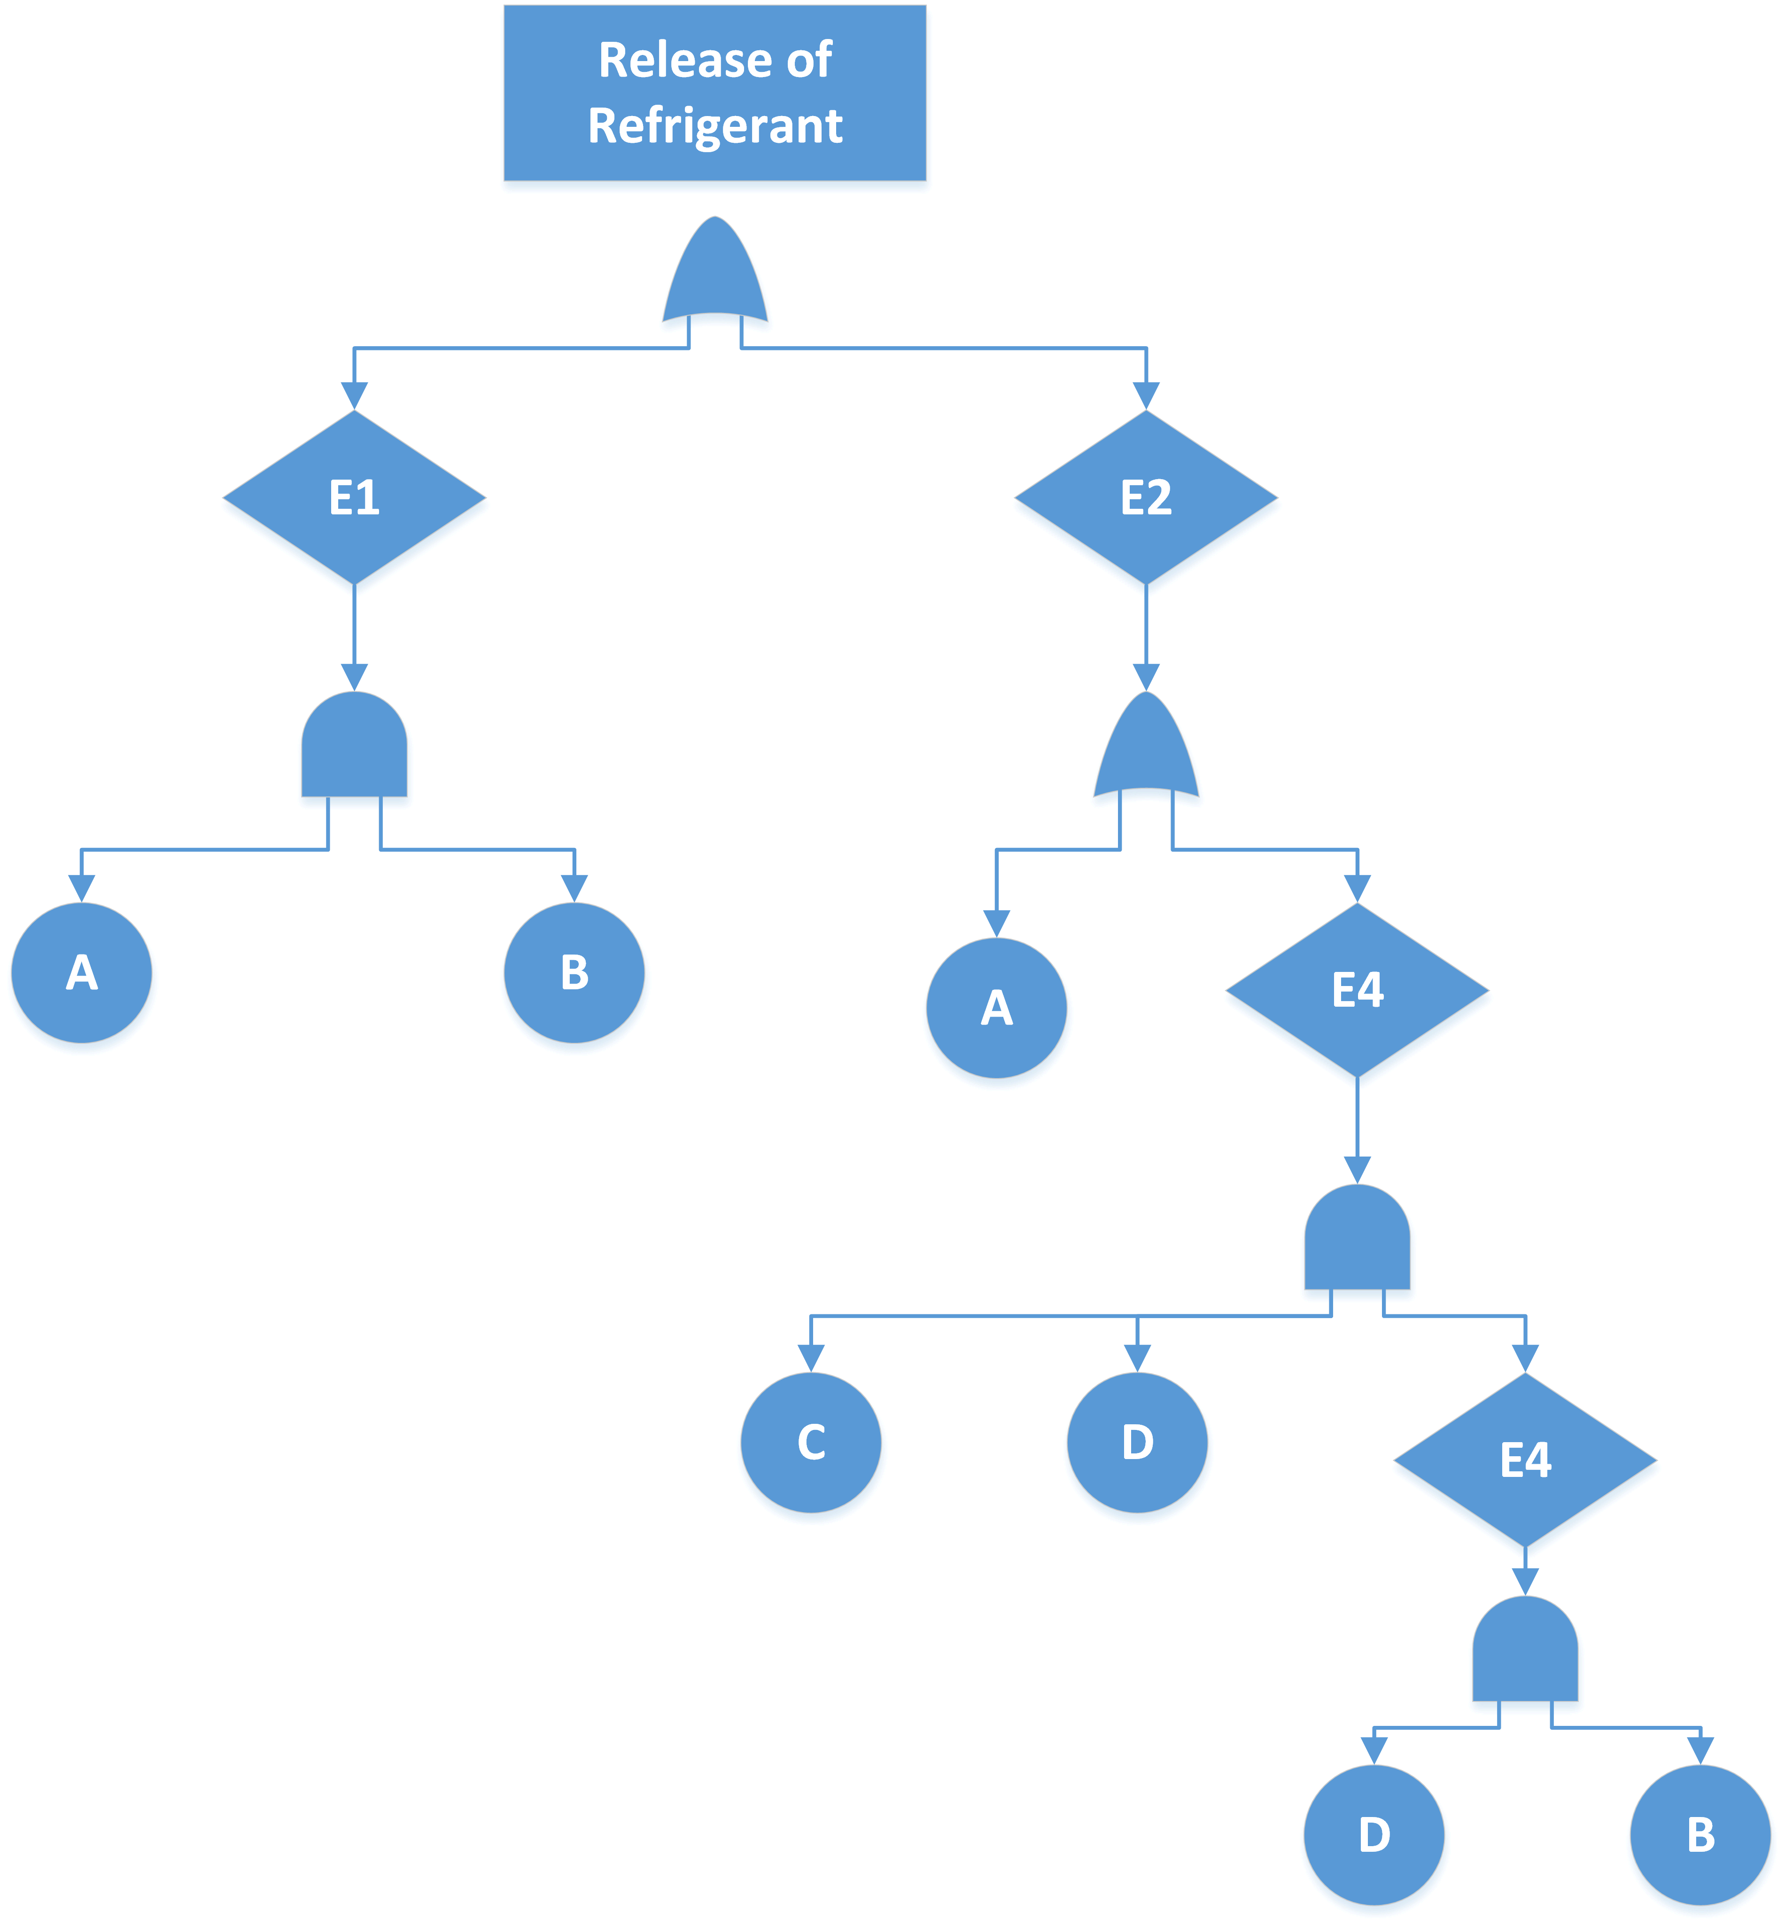
Minimal Cut Sets
Lets demonstrate using the simple example
  Watch what happens when we make some minor adjustments to the Fault Tree
  New Old

Slide 106


Minimal Cut Sets
Lets demonstrate using the simple example
  Watch what happens when we make some minor adjustments to the Fault Tree
    $T=E1+E2$
      $E1=a∗b$
      $E2=a+E3$
      $E3=c∗d∗E4$
      $E4=d∗b$

Slide 107
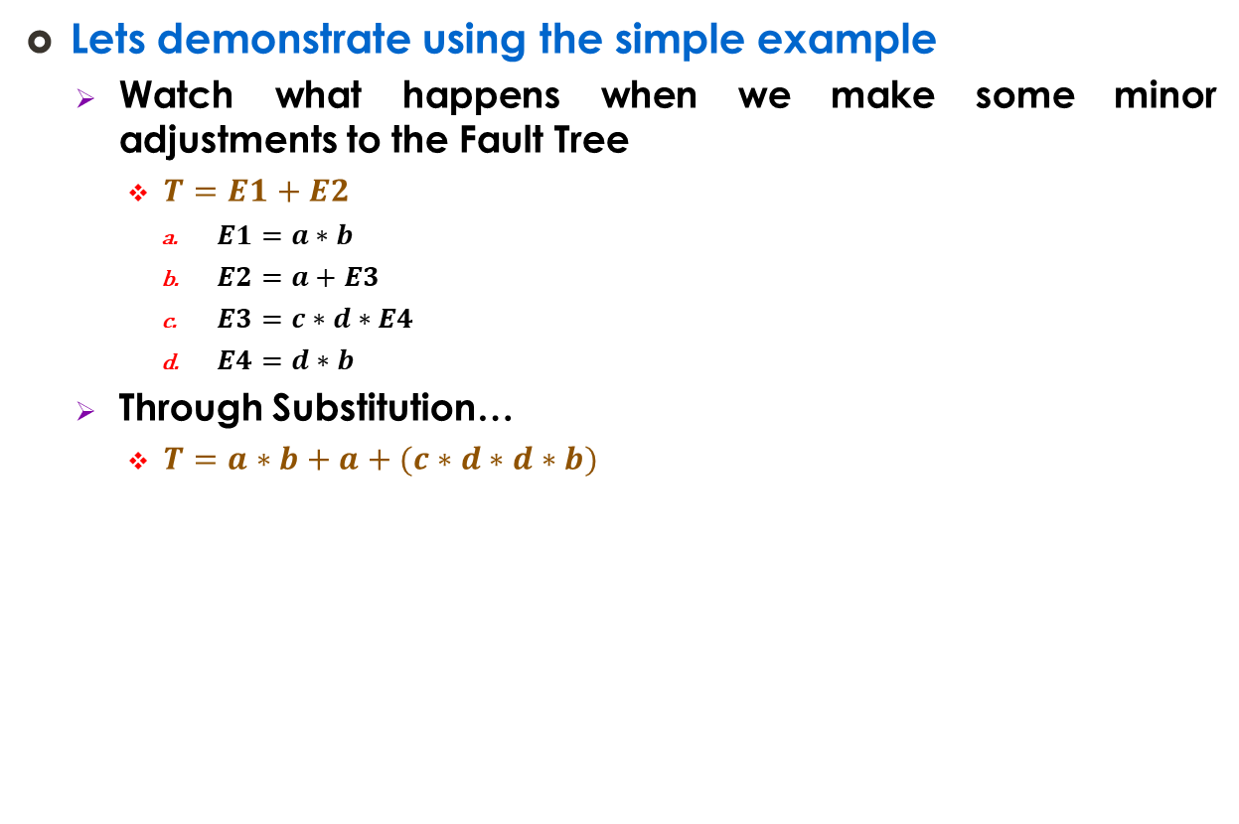
Minimal Cut Sets
Lets demonstrate using the simple example
  Watch what happens when we make some minor adjustments to the Fault Tree
    $T=E1+E2$
      $E1=a∗b$
      $E2=a+E3$
      $E3=c∗d∗E4$
      $E4=d∗b$
  Through Substitution…
    $T=a∗b+a+(c∗d∗d∗b)$

Slide 108

Minimal Cut Sets
Lets demonstrate using the simple example
  Watch what happens when we make some minor adjustments to the Fault Tree
    $T=a∗b+a+\left(c∗d∗d∗b\right)$
  Through Boolean Logic
    $T=a+b∗c∗d$

Slide 109
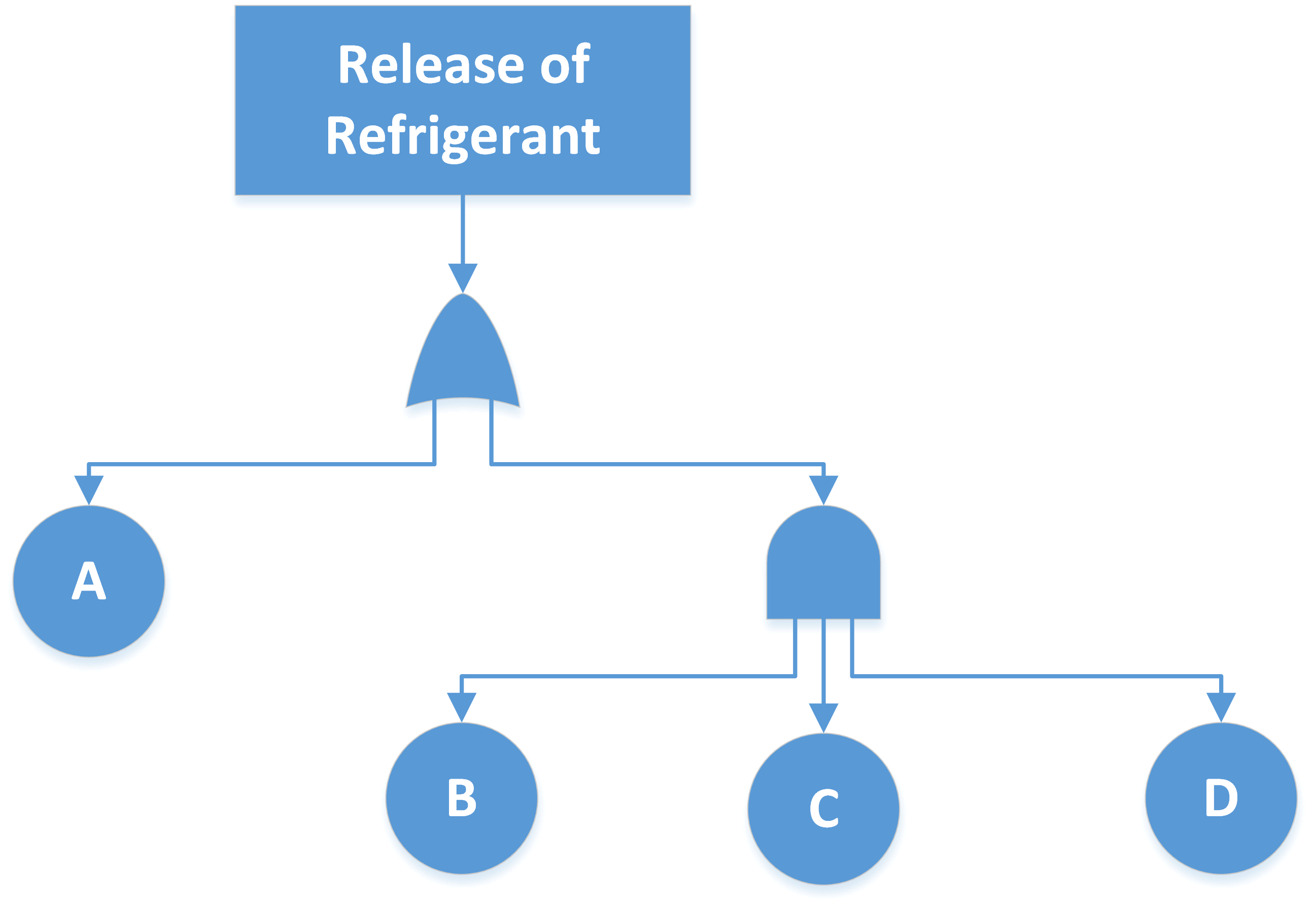

Minimal Cut Sets
Lets demonstrate using the simple example
  Watch what happens when we make some minor adjustments to the Fault Tree
    $T=a+b∗c∗d$
  Reconfigure Fault Tree as Minimal Cut Sets

Slide 110
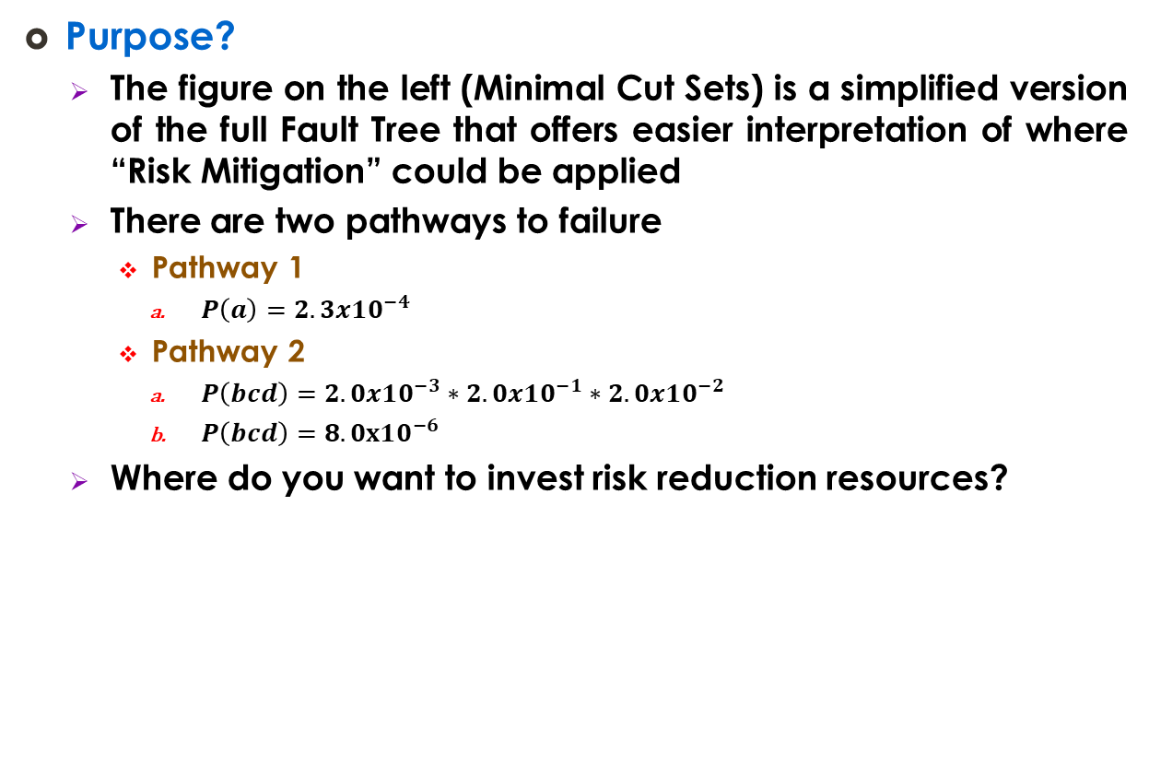
Minimal Cut Sets
Purpose?
  The figure on the left (Minimal Cut Sets) is a simplified version of the full Fault Tree that offers easier interpretation of where “Risk Mitigation” could be applied
  There are two pathways to failure
    Pathway 1
      $P\left(a\right)=2.3x10^{−4}$
    Pathway 2
      $P\left(bcd\right)=2.0x10^{−3}∗2.0x10^{−1}∗2.0x10^{−2}$
      $P\left(bcd\right)=8.0x10^{−6}$
  Where do you want to invest risk reduction resources?

Slide 111
Back to the Bow Tie Analysis / Diagram

Slide 112
BTA – ETA - FTA
So, here we have the Bow Tie Diagram from ISO 31010

Slide 113
BTA – ETA - FTA
What is the left side?

Slide 114
BTA – ETA - FTA
What is the right side?

Slide 115
BTA – ETA - FTA
A BTA is a simplified FTA-ETA combined analysis which can be used as a
  Conceptual framework to model causes and consequences of system failure
  Quantitative tool to determine probability of failure and numeric consequence of this failure
  Just about any level of analysis between the purely quantitative and purely quantitative

